Slide 1
Pitch, Timbre, and Source Separation
David Griesinger
David Griesinger Acoustics
dgriesinger@verizon.net
www.davidgriesinger.com

Slide 2
Source Localization Requires Separation from other signals and noise
This talk will present and demonstrate a model of hearing that largely explains how sound separation works, and when it will cease to work in poor acoustics.
It all depends on PITCH, and the phases of upper harmonics…
How does it work? – some clues:
1. The acuity of pitch perception: better than 0.1%, or 3 cents
2. The perception of pitch, which is circular in octaves
3. The frequency content of speech information – largely above 1000Hz
4. The properties of the outer and middle ear

Slide 3
“Near”, “Far”, and Harmonic Coherence
Humans can immediately hear if a sound is “near” or “far” with a single ear.
But how do we perceive it, and how can it be measured?
The author believes that engagement, near/far, pitch perception, timbre perception, direction detection, and stream formation all derive from the same property of sound:
the phase coherence of harmonics in the vocal formant range, ~630Hz to 4000Hz.
Example: The syllables one to ten with four different degrees of phase coherence. The sound power and spectrum of each group is identical
Click for sound

Slide 4
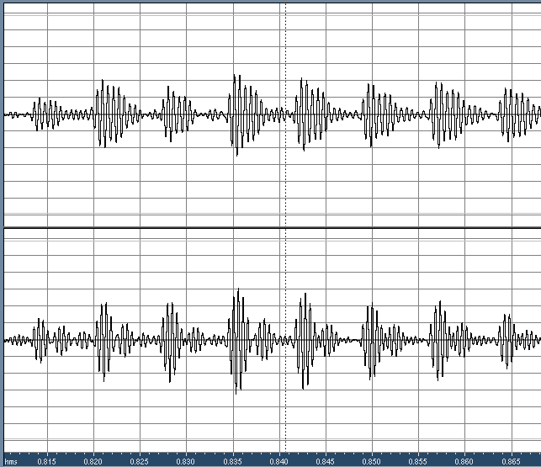
Basilar motion at 1600 and 2000Hz
Top trace: The motion of the basilar membrane at 1600Hz from the word “two”
Bottom trace: The motion at 2000Hz.
The modulation is different because there are more harmonics in this band.
Click for sound
When we listen to these signals the fundamental is easily heard

Slide 5
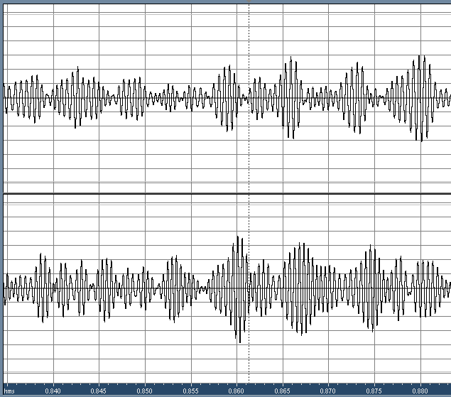
Effect of reverberation on the basilar motion at 1600 and 2000Hz
Here are the same signals with reverberation.
The modulations are no longer regular or time-synchronous.
The sound is garbled.
The sound example is first without reverberation, then with
Click for sound

Slide 6
Separation of Simultaneous Sounds
Source separation, perceived distance, and clarity of localization ALL depend on same physics:
The encoding of information in the upper harmonics of tones with a definite pitch.
Why is PITCH so important?
Broks and Noteboom (1983) found that two simultaneous monotone speech signals can be separately understood if there is a 3% difference in pitch.

Slide 7
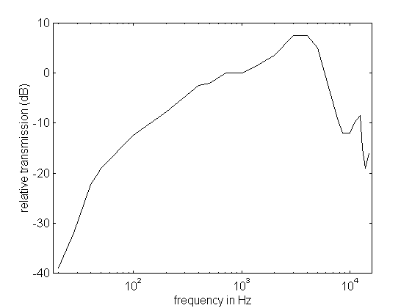
The importance of harmonics
The sensitivity of human hearing is weighted to the frequencies of vocal formants.
Transfer function from sound outside the head through the outer and middle ear.
Evolution is not wasteful.
This curve is not an accident!

Slide 8
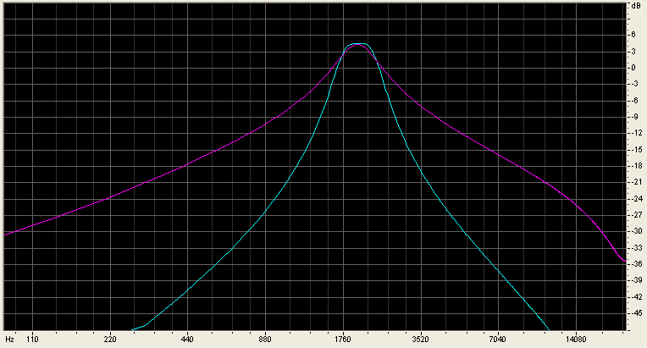
Frequency Selectivity of the Basilar Membrane
The basilar membrane is a ~ 1/3 octave mechanical filter of ~2nd order.
The filter has long skirts!
Blue: 2000Hz 2nd order 1/3 octave filter
Red: 1st order

Slide 9
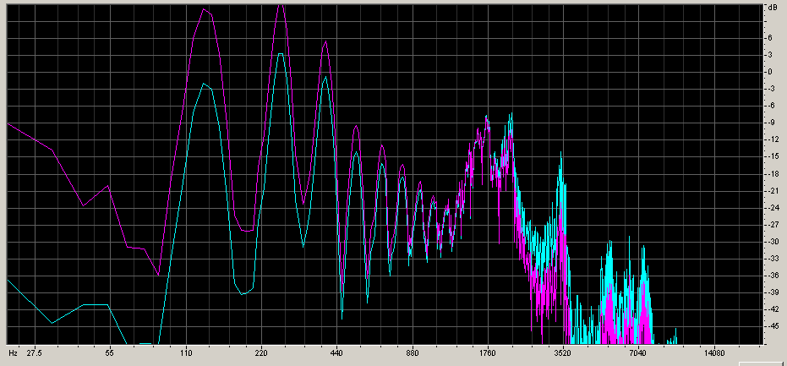
Spectrum Equalization
Red – the spectrum of the vowel in “two” at the outer ear. Blue – the spectrum of the same vowel after equalization with the outer and middle ear.
The effect of the outer and middle ear is to reduce the masking of formant bands by the frequencies below 800Hz.

Slide 10
Vocal Formants
The formants that determine various vowels can be seen as peaks in a frequency spectrum.
The two orange bars show the bandwidth of a critical band. Note that many harmonics of the fundamental lie within the critical band.

Slide 11
What if two vowels overlap?
Blue – spectrum of “five” after eq. Red – spectrum of “two”.
The critical bands are too broad to separate the two sets of harmonics,
Yellow: combined third-octave spectrum. No recognizable vowel But the PITCH is different!

Slide 12
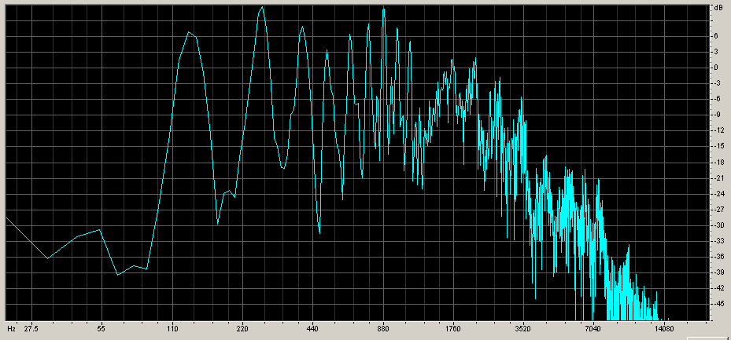
The ear can separate the two vowels even if the eye cannot.
The spectrum of “two” and “five” combined. We would expect to hear neither vowel – but in good acoustics we can easily hear both separately.
(Click here for web sound)

Slide 13
Can my model separate two and five?
Not without an additional cue.
The pitches are mostly separate, but they cross in the middle.
If I add a +- 5 degree difference in azimuth, separation by pitch becomes possible:
Original
One to Ten
Ten to Nine
Click for sound
Click for sound
Click for sound

Slide 14
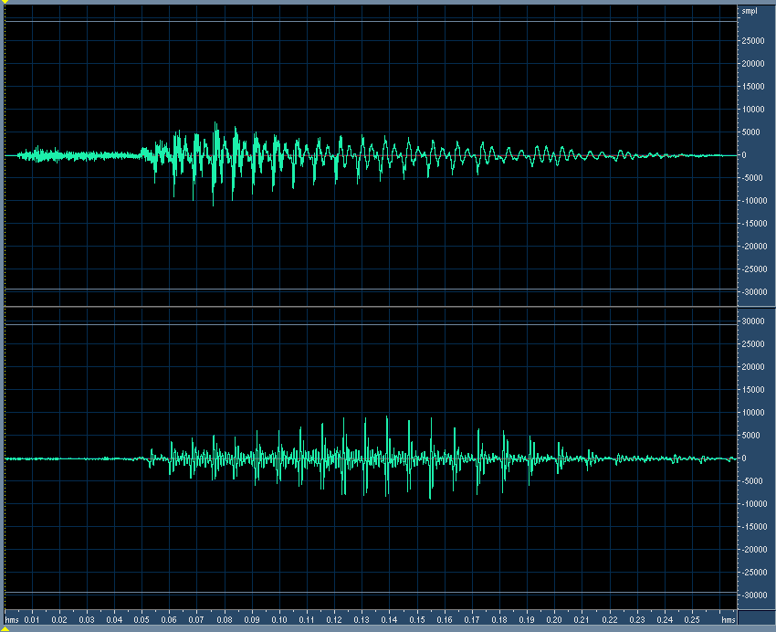
Why are these sounds separable?
Top: “two” Bottom: “five’
All the harmonics align once in each period, creating a huge peak in the sound pressure.
These peaks give the sound its clarity, and allow us to separate the two sounds.

Slide 15
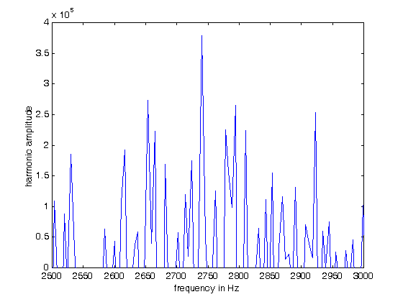
How can separation occur? Harmonic amplitudes form a comb!
Amplitude of the harmonics of “two” from 2500Hz to 3000Hz.
We need a filter that has a series of sharp pass-bands separated by a constant frequency, like the teeth of a comb.
Such filters exist – they are called “comb filters”

Slide 16
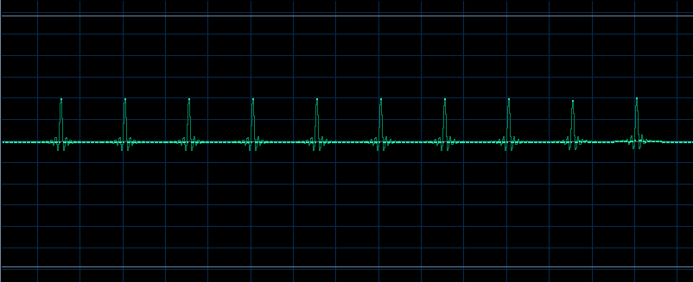
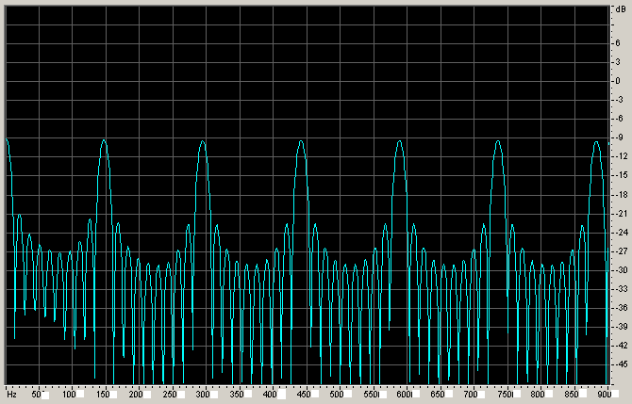
Comb filters come in many flavors
IIR versions (loops with feedback) ring too long to be useful.
FIR versions consist of a number of taps separated by a constant delay
Impulse response with 10 taps at ~150Hz
Frequency spectrum of the comb.
When tuned precisely to the desired fundamental frequency a ten tap comb can separate overlapping harmonics.

Slide 17
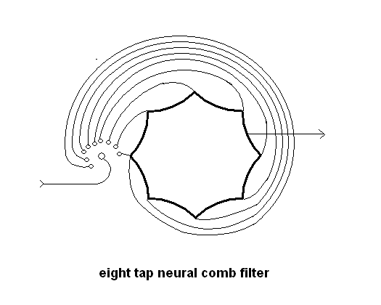
Biological combs
Delay through nerve fibers can create a comb filter with a single neuron.
Mechanical vibrations in the basilar membrane are converted into nerve firings at a rate proportional to the mechanical displacement.
Incoming pulses connect to fibers each longer than the next by a constant length.
The central neuron fires when all the pulses arrive within a short period of time.

Slide 18
Where are they?
We all know the structure of the ear, right?

Slide 19
The basilar membrane and the cochlear duct

Slide 20
And this connects to – The spiral ganglion? What’s that?

Slide 21
Whatever it is, it has a lot of neurons (many thousands)

Slide 22
And each neuron has a lot of fibers
Could these be comb filters?
Have we overlooked something very important in the cochlear ligament?

Slide 23
Comb filters must be precisely tuned
To capture all the harmonics up to a frequency of 3000Hz from a 100Hz fundamental, the frequency of the comb must match the frequency of the fundamental within the quarter-width of the filter.
We see from previous slide that the half-width of a ten tap comb filter is ~1/6th the fundamental frequency.
This implies we need a frequency accuracy of:
Accuracy in percent = 100*(100Hz/12)/3000Hz = 0.28%
If we want to separate harmonics to 6000Hz, the accuracy of pitch needs to be 0.14%.
It is no accident that a musician can tune their instrument to an accuracy of 3 cents, or 0.1%.
We need hundreds of combs for each overlapping critical band. And we appear to have them!

Slide 24
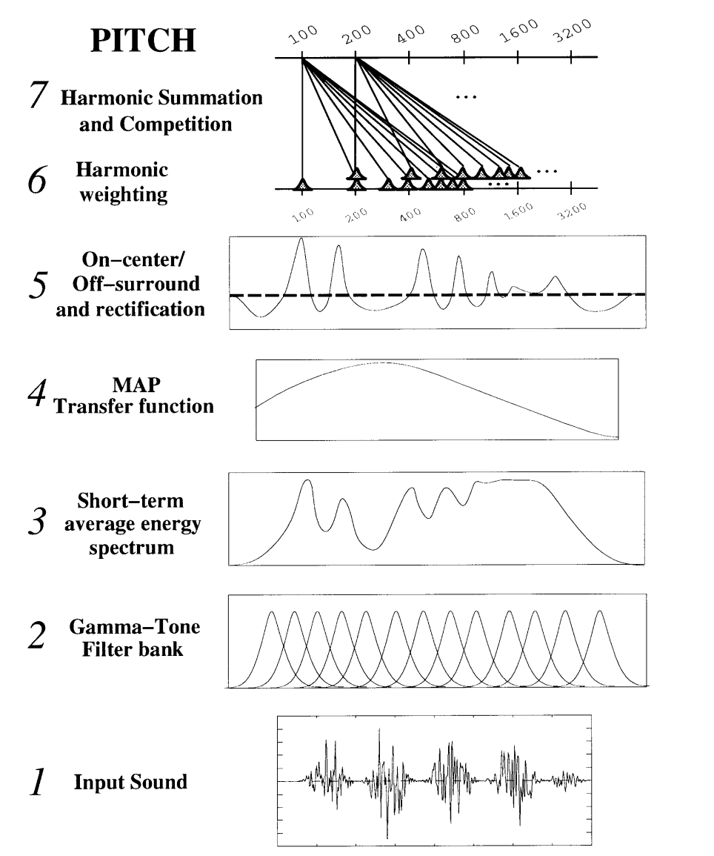
Current hearing models
Current models – this is from Stephen Grossberg (1997) Start with a filter bank – here 60 logarithmically spaced 4th order gamma tone filters.
The amplitude of each filter is obtained with a long time constant.
The resulting spectrum is analyzed with a “harmonic sieve” which sums each frequency and its harmonics.

Slide 25
Problems with the model
The basilar membrane is 2nd order, not fourth. The filters are ~1/3 octave in width.
Even a fourth order filter is not as frequency selective as human hearing – which is capable of 0.1% resolution.
If harmonics of several sources occupy a single filter band they cannot be separated.

Slide 26
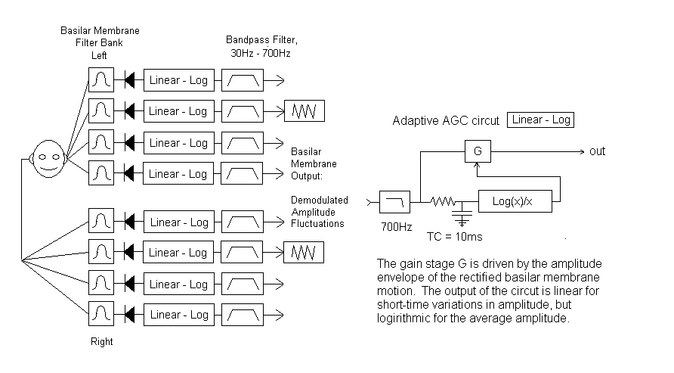
An amplitude-modulation based basilar membrane model (~Identical to Torsten Dau)

Slide 27
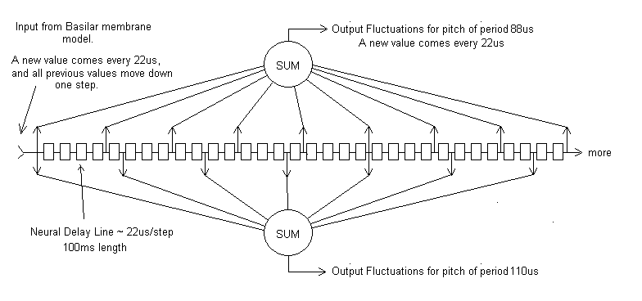
A Comb-Filter Pitch Detection Model
In this version a neural daisy-chain delays the output of the basilar membrane model by 22us for each step. Dendrites from summing neurons tap into the line at regular intervals, with one summing neuron for each fundamental frequency of interest.
Two of these sums are shown – one for a period of 88us, and one for a period of 110us. Each sum constitutes an independent stream of nerve fluctuations, each identified by the fundamental pitch of the source.

Slide 28
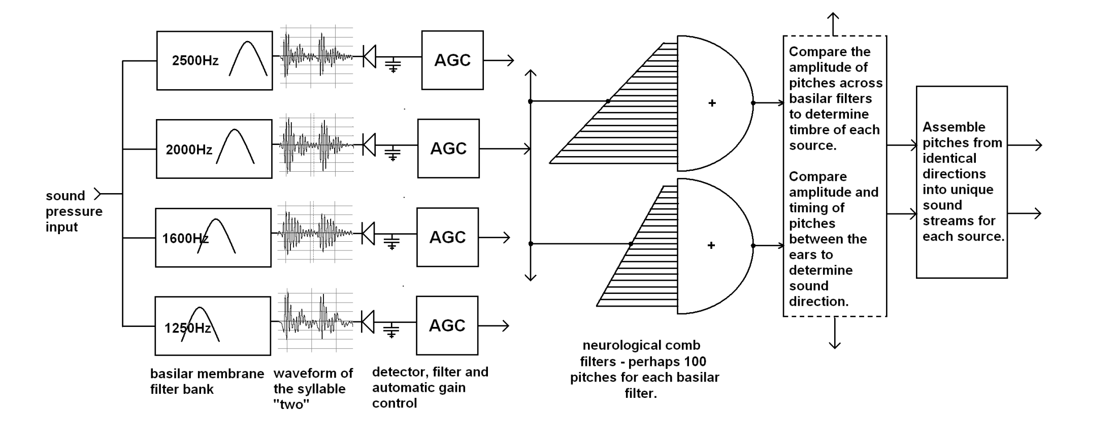
Our Model
.
The waveforms shown to the right of the critical band filters are typical of speech. Notice how the harmonics interfere with each other to make a spiky, highly modulated signal.

Slide 29
Recent work on the model
In the months of evolution since I first proposed this model I have learned to appreciate the importance of several details:
The supreme importance of finding the precise pitch of each fundamental harmonic in a sound scene.
To do this I had to quadruple the number of neurological combs in each octave.
The inclusion of an outer and middle ear equalization.
Using a second-order butterworth filter for the basilar membrane. (Courtesy of David Mountain at Boston University)
Lower orders allow strong low frequency fundamentals to obscure the vocal formants.
Higher order critical band filters cause excessive phase shift and intermodulation distortion.
Maintaining the 1/3 octave width of each critical band – (keeping the overlap at least 50%)
Narrower critical bands contain too few harmonics to yield sharp pitch acuity.
The net result is always to move the model closer to well-known properties of our ear/brain system. (I should have known…)

Slide 30
Separation of monotone speech
Broks and Noteboom (1983) found it possible to separate monotone speech with a pitch separation of ¼ semitone.
The following demonstration separates a monotone sentence at C from a sentence at C#, a one semitone difference.
Monotone C Monotone C# C and C# mixed C Separated C# separated
Click for sound Click for sound Click for sound Click for sound Click for sound

Slide 31
Separation in poor acoustics
We can add some reflections to the mixed C and C# sentences, and then attempt to separate them.
Here is the same mix convolved with a small room and then separated with the model ear:
Acoustics have altered the vital phase relationships between the harmonics, and the pitch can no longer be precisely found.
It is also obvious that the voice(s) sound distant and have lost a great deal of clarity.
(Click for room mix)
(Click for room mix)

Slide 32
Clarity, Distance, and Audience Attention
We detect “near” versus “far” instantly on perceiving a sound
“Near” sounds demand attention and sometimes immediate attention.
“Far” sounds can usually be ignored
Cinema and Drama directors demand that dialog be perceived as “Near”
Drama theaters are small and acoustically dry
Movie theaters are dry and use highly directional loudspeakers with linear phase response at vocal formant frequencies.
High sonic clarity and low sonic distance requires that harmonics in the vocal formant range are reproduced with their original phase relationships.
Unmodified by loudspeaker characteristics or reflections.
The near/far perception is not commonly recognized when sound is reproduced, either in live performance or in recordings.

Slide 33
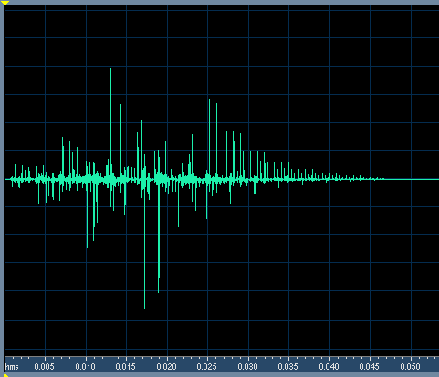
Example of Clarity for Speech
This impulse response has a C50 of infinity
STI is 0.96, RASTI is 0.93, and it is flat in frequency.
In spite of high C50 and excellent STI, when this impulse is convolved with speech there is a severe loss in clarity. The sound is muddy and distant.
The sound is unclear because this IR randomizes the phase of harmonics above 1000Hz!!!
(Click for sound )

Slide 34
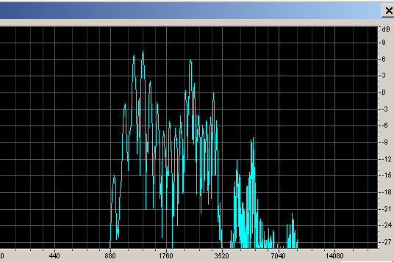
Demonstration
The information carried in the phases of upper harmonics can be easily demonstrated:
Click for sound
Click for sound
Click for sound
Dry monotone Speech with pitch C
Speech after removing frequencies below 1000Hz, and compression for constant level.
C and C# together
Spectrum of the compressed speech
It is not difficult to separate the two voices – but it may take a bit of practice!

Slide 35
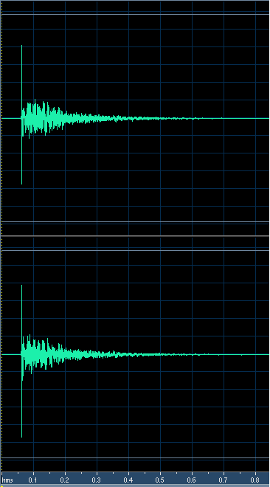
What happens in a room?
Measured binaural impulse response of a small concert hall, measured in row 5 with an omnidirectional source on stage. The direct level has been boosted 6dB to emulate the directivity of a human speaker.
RT ~ 1s
Looks pretty good, doesn’t it, with plenty of direct sound.
But the value of LOC is -1dB, which foretells problems…

Slide 36
Sound in the hall is difficult to understand and remember when there is just one speaker. Impossible to understand when two speakers talk at the same time.
Click for sound
Click for sound
Click for sound
C in the room
C# in the room
C and C# in the room together
All these effects depend on the coherence of upper harmonics. When sound is reproduced over multiple loudspeakers this quality usually suffers. This difficulty applies both to Ambisonics and WFS, especially because spatial aliasing is significant at formant frequencies

Slide 37
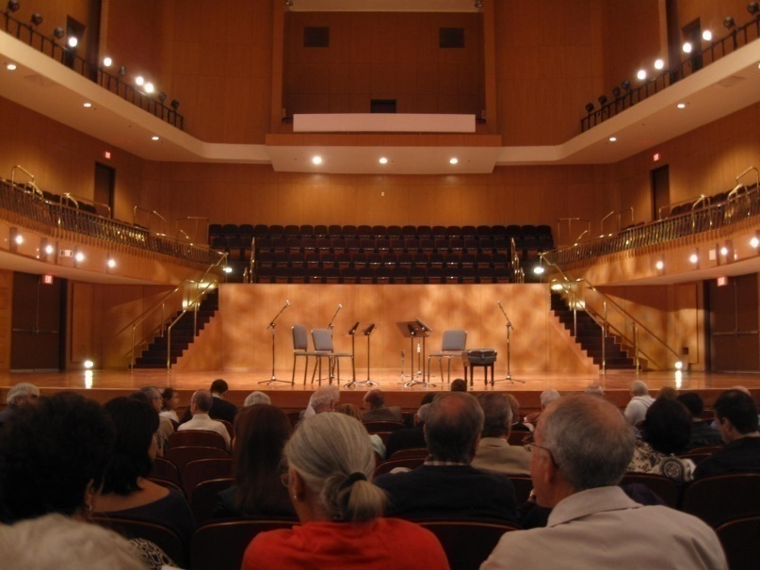
Sound separation: Localizing a String Quartet
From the author’s seat in row F behind the lady in red the string quartet was +-10 degrees in width.
But in the presence of substantial reverberation it was possible to distinctly localize all four players with eyes closed, even when they played together.
This implies a localization acuity of better than three degrees.
Click for sound
With just slightly more reverberation it was not possible to localize the musicians at all. Click for sound

Slide 38
Conclusions for source separation
Separating sources by pitch into independent neural streams is a fundamental process of human hearing, and takes place before timbre and azimuth are decoded in the brain-stem.
Separation requires acute sensitivity to pitch, which explains our ability to hear music.
Separation and clarity are maximized when phases of upper harmonics are un-modified by reflections and noise.
Our ability to precisely localize multiple sources, to detect the timbre, and to detect the meaning of each source depends on the same physical process, which relies on the phase coherence of multiple harmonics.
Once the physics of the separation process is known, it is possible to construct measures that predict when the ability to separate sounds is lost, and clarity, localization, and timbre of multiple sources suffers.

Slide 39
Localizing separated sounds in natural hearing
It is well known that we localize sounds through:
the Interaural Level Difference (ILD)
and the Interaural Time Difference (ITD)
Experiments with sine tones show that ITD is not useful above 2kHz due to frequency limits on nerve firings.
And that ILD loses accuracy below 1kHz as head shadowing decreases.
But high harmonics in the 1kHz to 4kHz range of low frequency fundamentals contain nearly all the information of speech
And also provide timbre cues that identify musical instruments.
When these harmonics are present we find that we can localize tones accurately with ILD
To understand our ability to localize speech and music we need to use signals that include harmonics
When harmonics are present our ability to localize can be extremely acute, +-2 degrees or better

Slide 40
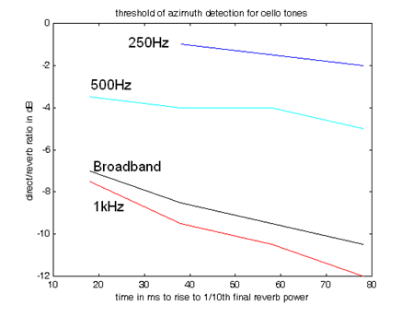
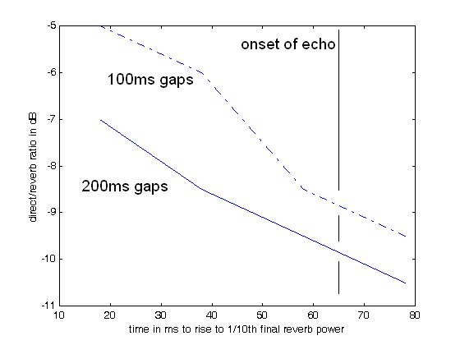
Threshold for azimuth detection as a function of frequency and initial delay
As the time gap between the direct sound and the reverberation increases, the threshold for azimuth detection goes down. (the d/r scale on this old slide is arbitrary)
As the time gap between notes increases (allowing reverberation to decay) the threshold goes down.
To duplicate the actual perception in small halls I need a 50ms gap between notes.

Slide 41
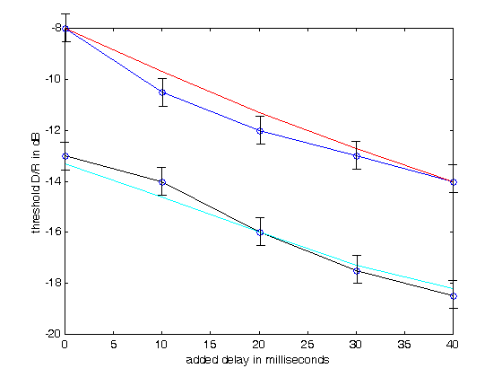
A localization measure was developed to fit experimental threshold data for the localization of broadband speech at low values of D/R
RT = 1s
RT = 2s
Blue – experimental thresholds for alternating speech with a 1 second reverb time. Red – the threshold predicted by the localization equation. Black – experimental thresholds for RT = 2seconds. Cyan – thresholds predicted by the localization equation.

Slide 42
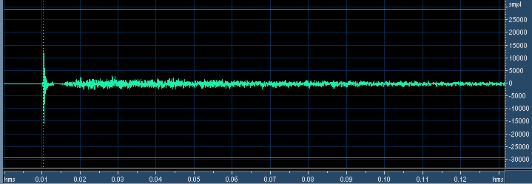
A measured impulse response
A measured IR with RT = 1s
An equivalent IR formed from decaying binaural noise.

Slide 43
The ear perceives notes – not the impulse response itself.
Here is a graph of the ipselateral binaural impulse response from spatially diffuse exponentially decaying white noise with an onset time of 5ms and an RT of 1 second. This is NOT a note, and NOT what the ear hears!
To visualize what the ear hears, we must convolve this with a sound.
Let’s use a 200ms constant level as an example.
The nerve firings from the direct component of this note have a constant rate for the duration of the sound.
The nerve firings from the reverberant component steadily build up until the note ceases and then slowly stop as the sound decays.
D/R = -10dB
RT = 2s:
C80 = 3.5dB C50 = 2.2dB IACC80 = .24
RT = 1s:
C80 = 6.4dB C50 = 4.1dB IACC80 = .20

Slide 44
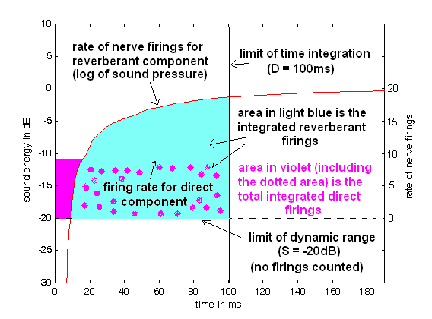
This is how the brain perceives a continuous sound that has just started.
I have plotted the build-up of a 1s RT reverberation with a direct to reverberant ratio of -10dB.
The line at -20dB marks the limit of the dynamic range of the nerves, below which they do not fire.
The blue line shows the rate of nerve firing rate for a constant direct sound 10dB less than the total reverberation energy. The red line shows the rate of nerve firings for the reverberation, which builds up for the duration of the note. The black line shows a time window (100ms) over which to integrate the two rates. In this example the area in light blue is larger than the area in pink, so the direct sound is inaudible.

Slide 45
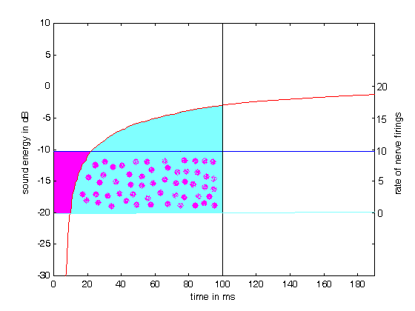
Direct and build-up RT = 2s
At two Seconds RT the reverberation builds more slowly.
The blue area decreases, and the direct sound is more audible.
In a large hall the time delay between the direct sound and the reverberation also increases, further reducing the area in light blue.

Slide 46
Equation for Localizability – 700 to 4000Hz
We can use this simple model to derive an equation that gives us a decibel value for the ease of perceiving the direction of direct sound. The input p(t) is the sound pressure of the source-side channel of a binaural impulse response.
We propose the threshold for localization is 0dB, and clear localization and engagement occur at a localizability value of +3dB.
Where D is the window width (~ 0.1s), and S is a scale factor:
Localizability (LOC) in dB =
The scale factor S and the window width D interact to set the slope of the threshold as a function of added time delay. The values I have chosen (100ms and -20dB) fit my personal data. The extra factor of +1.5dB is added to match my personal thresholds.
Further description of this equation is beyond the scope of this talk. An explanation and Matlab code are on the author’s web-page..
S is the zero nerve firing line. It is 20dB below the maximum loudness. POS in the equation below means ignore the negative values for the sum of S and the cumulative log pressure.

Slide 47
Matlab code for LOC
% enter with xin = filename
% file is assumed to be a binaural impulse response with the source on the left side
[Y,sr,bits] = wavread(xin);
ln = length(Y);
ir_left = Y(1:ln,1);
ir_right = Y(1:ln,2);
upper_scale = 20; % 20dB range for firings
box_length = round(100*sr/1000); % 100ms window
early_time = round(7*sr/1000); %7ms direct sound
D = box_length; %the window width
wb = [2*800/sr 2*4000/sr]; % filter the input
[b a] = butter(3,wb);
ir_left = filter(b,a,ir_left); ir_right = filter(b,a,ir_right);
datamax = max(ir_left);
for index1 = 1:0.1*sr
if abs(ir_left(index1))+abs(ir_right(index1)) > datamax/100
break
end
end
ir_left(1:index1-10) = [];
ir_right(1:index1-10) = [];
S = upper_scale-10*log10(sum(ir_left.^2));
early = 10*log10(sum(ir_left(1:early_time).^2));
ln = length(ir_left);
log_rvb = 10*log10(cumsum(ir_left(early_time:ln).^2));
for ix = 1:ln-early_time % look at positive values of S+log_rvb
if S+log_rvb(ix) < 0
log_rvb(ix) = -S;
end
end
LOC = -1.5 +(early+S) - (1/D)*sum(S+log_rvb(1:D-early_time))
% the limits look different from the equation – but this is actually OK.
%************************* graph box ********************
ir_left_rvb = ir_left;
ir_left_rvb(1:early_time) = datamax/100000; %zeros(size(1:early_time);
ir_right_rvb = ir_right;
ir_right_rvb(1:early_time) = datamax/100000;
left_power = sqrt(sum(ir_left_rvb.^2));
right_power = sqrt(sum(ir_right_rvb.^2));
n = round(sr*122/1000);
n2 = round(sr*200/1000);
n3 = box_length;
build_up_left = sqrt(cumsum((ir_left_rvb/left_power).^2));
direct_level_left = sqrt(sum((ir_left(1:early_time)/left_power).^2));
ln = length(build_up_left);
assymptote_left = 20*log10(build_up_left(ln));
direct_reverb_left = 20*log10(direct_level_left)- assymptote_left
log_build_up_left = 20*log10(build_up_left)- assymptote_left;
direct_level_left_plot(1:n) = direct_reverb_left;
direct_level_left_plot(n+1:n2) = -80;
window_plot(1:n3) = 0;
window_plot(n3+1:n2) = -80;
zero_line_plot(1:n2) = -upper_scale;
plot(1000*(1:n2)/sr,direct_level_left_plot(1:n2)), axis([0 120 -22 5])
hold on
plot(1000*(1:n2)/sr,log_build_up_left(1:n2),'r')
plot(1000*(1:n2)/sr,window_plot(1:n2),'k')
plot(1000*(1:n2)/sr,zero_line_plot(1:n2),'g')
hold off
xlabel('left_channel time in ms')
ylabel('rate of nerve firings - sound energy in dB')

Slide 48
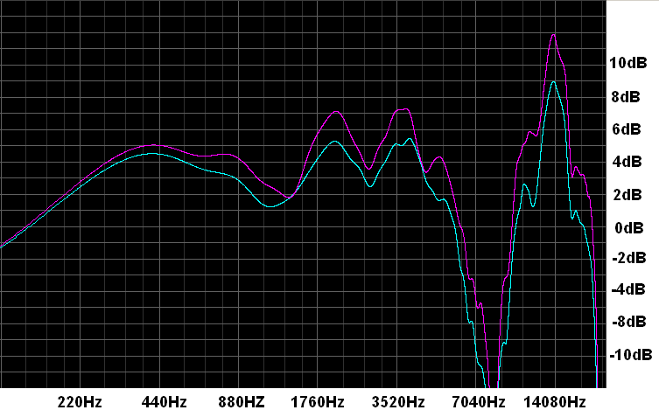
ILD differences in human hearing
Note that the 2 to 3dB of level difference between the two ears is nearly constant in the vocal formant range
MIT Kemar HRTF for 0 degrees elevation and 5 degrees azimuth. Blue is the contralateral (far) ear, and red is the ipselateral ear (near)
Head shadowing is >2dB above 800Hz. If we assume a 1dB threshold for level differences we should be able to localize a frontal source with an uncertainty of only 2 degrees. And we can…

Slide 49
Individual Instruments vs Sections
Ability to localize individual instruments with an uncertainty of 3 degrees or better is possible in good acoustics.
The ability disappears abruptly when there are too many early reflections, and multiple instruments fall together in a fuzzy ball.
With eyes open the visual localization dominates, and we are typically not aware that auditory localization is lost.
When multiple instruments are playing the same notes (a section) the uncertainty increases dramatically.
The section tends to be both visually and sonically wide.
But in a performance of a Haydn Symphony by the Boston Symphony Orchestra under Ton Koopman, the string sections played without vibrato.
The visual image was wide – but the auditory image was of a single instrument, and was sharply localized at the center of the section.

Slide 50
Summary of Natural Hearing
When early reflections are not too strong we are able to localize multiple sound sources with high precision – approximately two degrees.
If multiple people are talking simultaneously we are able to choose to listen to any of them.
If multiple instruments are playing we are able to follow the lines of several at the same time.
These abilities disappear abruptly when the early reflections exceed a certain level with respect to the direct sound.
The information responsible for these abilities lies primarily in harmonics above 1000Hz from lower frequency tones.
Localization for natural hearing is independent of frequency!!!
Acuity, the sharpness of localization, can vary, but the perceived position does not vary.
In the author’s experience a binaural recording from a great concert seat can have sharper localization over the entire width of the orchestra than the best recording reproduced over stereo loudspeakers.
But in a poor seat localization is considerably worse.

Slide 51
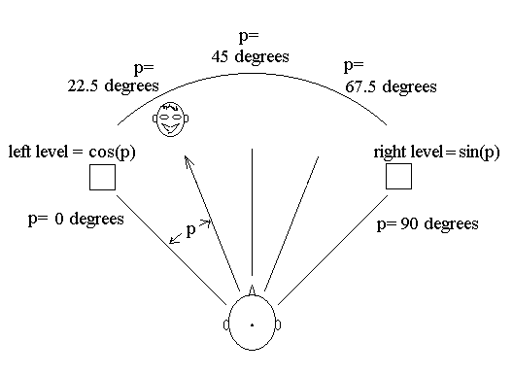
Stereo Reproduction
Stereo recordings manipulate the position of image sources between two loudspeakers by varying time or level.
With the common sine/cosine pan law a level difference of 7.7dB to the left should produce a source image half-way between the center and the left loudspeaker, or 15 degrees to the left.
If we listen with headphones, the image is at least 30 degrees to the left. And the position is independent of frequency.

Slide 52
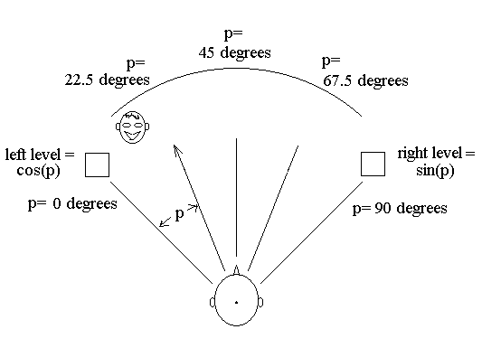
With broadband signals the perceived position is closer to the left loudspeaker

Slide 53
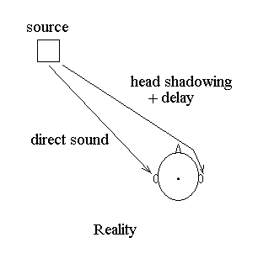
Sound diffracts around the head and interferes with sound from the opposite speaker
Sound from the left speaker diffracts around the head and appears at the right ear.
The diffracted signal interferes with the signal from the right loudspeaker – and at s~1600Hz the sound pressure at the right ear can be nearly zero.

Slide 54
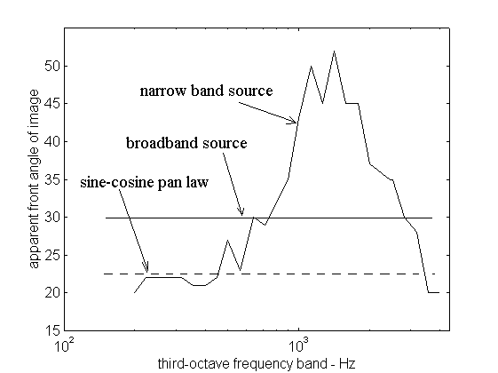
Sound panned to the middle between left and center is perceived beyond the loudspeaker axis at high frequencies.
Note that frequencies we principally use for sound localization in a complex field the perceived position of the source is very different from the sine/cosine pan-law.
The diagram shows the perceived position of a sound source panned half-way between center and left with the speakers at +-45 degrees.

Slide 55
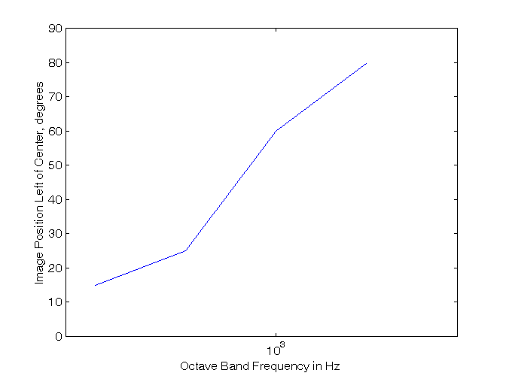
Delay Panning
Techniques such as ORTF combine amplitude and delay panning
But delay panning is even more frequency dependent.
And if a listener is not in the sweet spot Delay panning does not work.
This graph shows the approximate position of third octave noise bands from 250Hz to 2000Hz, given a 200 microsecond delay.
This delay corresponds to a 15 degree source angle to two microphones separated by 25cm.
The panning angle is about 15 degrees at 250Hz – but it is nearly 90 degrees at 2000Hz.

Slide 56
Stereo localization is an illusion based on fuzzy data
The only stable locations are left, center, and right
And center is stable only in the sweet spot.
Confronted with an image between center and left, or center and right, the brain must guess the location based on an average of conflicting cues.
The result can be beyond the speaker axis.
Our perception of sharp images between center and left or right is an illusion generated by our brain’s desire for certainty, and it’s willingness to guess.

Slide 57
Headphone reproduction of panned images
Headphones reliably spread a panned image +-90 degrees
The frontal accuracy is about +-2.5 degrees
And the perceived position is independent of frequency – if the headphones perfectly match the listener’s ears
It is useful to adjust a 1/3rd octave equalizer with 1/3rd octave noise bands to obtain a stable central image.
Thus it is possible to hear precisely localized images from pan-pots when listening through headphones
But not with speakers.
I must emphasize that headphone reproduction requires accurate equalization of the headphones – ideally individually different for the left and right ear!

Slide 58
Coincident Microphones
Coincident microphones produce a signal similar to a pan-pot.
But the range of the pan is limited.
The most selective pattern is figure of eights at 90 degrees (Blumlein)
A source 45 degrees to the left will be reproduced only from the left loudspeaker.
A 3.3 degree angle from the front produces a 1dB level difference in the outputs.
Not as good as natural hearing, but not too bad when listening through headphones.
To produce a “full left” or “full right” signal the peak sensitivity of one microphone must lie on the null of the other microphone.
Cardioid microphones can only do this if they are back-to-back (180 degrees apart)
To pick up a decorrelated reverberant field the microphones must be at least supercardioid. Cardioid microphones pick up a largely monaural reverberant field at low frequencies in the standard ORTF configuration.
If properly equalized hypercardioid or supercardioid microphones sound much better.

Slide 59
Compare Soundfield and Binaural
When you use headphones to compare a binaural recording to a Soundfield recording with any pattern:
The soundfield has a narrower front image – (it is not as sharp)
more reflected energy – (there is no head shadowing)
And less envelopment – (the direct sound is less distinct)
Comparing a binaural recording on headphones to a Soundfield recording on speakers is not a reasonable thing to do!

Slide 60
First Order Ambisonics and WFS
Ambisonics has a problem with head shadowing.
The lateral velocity vector is created by subtracting the left loudspeaker sound from the right loudspeaker sound.
But if the head is in the way the signals do not subtract – and the lateral sound is perceived stronger than it should be – and often as excess pressure.
Even in high order Ambisonics the frequency dependent panning problems still exist between loudspeakers.
This results in a lower Direct to Reverberant ratio at frequencies above ~500Hz.
Gerzon knew all about the problem, switching to crossed hypercardioid patterns above 500Hz.
The resulting directional beams are about 100 degrees wide! And the front image has all the problems of stereo.
If more speakers are used accuracy of localization is not increased, as the first order patterns are not selective enough to limit reproduction to only two speakers at the same time

Slide 61
5.1 Front image with a hard center
A precise center location is perceived anywhere in the listening space, and not just at the sweet spot (sweet line).
Accuracy of localization in the front is greatly improved
As long as only two speakers are active a time.
This requires panning from center to left or center to right, and not simultaneously producing a phantom image from the left or right speakers.
An image panned to the middle from center to left is perceived at 30 degrees at 3kHz.
This is a factor of two improvement over two channel stereo.
But the localization accuracy of three front speakers is still far inferior to natural hearing.
A five channel, five speaker front array is considerably better – again as long as only two channels are active for a given sound source.

Slide 62
5.1 side and rear
Perceiving a discrete image at the side between the front and rear speaker is difficult or impossible.
Sharp localization is only possible if a single speaker is activated, either a front or a rear.
Amplitude panning between the two rear speakers is possible, with all the disadvantages of two-channel stereo.

Slide 63
Vertical Localization
Vertical localization is achieved entirely through timbre cues above 1000Hz.
Sounds in the horizontal plane lack frequencies in the range of 6000-10000Hz.
Augmenting these frequencies with loudspeakers above and forward of the listener leads to a pleasing sense of natural reverberation.
Two loudspeakers above the listener reproducing decorrelated reverberation sound much better than one.
The best location is to the left and right 60 to 80 degrees above the listener.
The signals reproduced can be derived from the reverberant component of a stereo or 5.1 recording.

Slide 64
Conclusions for sound reproduction
Localization in natural hearing takes place mostly at frequencies above 1000Hz, and has a precision of ~ 2 degrees in the horizontal plane.
With care this precision can be reproduced over headphones from a binaural or amplitude panned recording.
Commonly used pressure-gradient microphone techniques are not capable of capturing sound direction with this precision.
The vey best they an do is about four degrees, and techniques that use cardioid microphones give at best about 8 degrees.
Two channel loudspeaker reproduction suffers from frequency dependence for frequencies above 1000Hz, spreading apparent localization of a panned image over ~30 degrees.
The brain must make a best guess for the perceived position of a source – and the frequency spread is sometimes audible.
Multichannel reproduction in 5.1 improves the accuracy about a factor of two.
The more channels used the more natural the frontal image becomes, as long as only two adjacent loudspeakers are active for any one source.
First order Ambisonics with four speakers has all the problems of stereo and then some. With multiple speakers localization accuracy is slightly improved.

