Slide 1
Presence as a measure of acoustic quality and its application in sound recording, reinforcement, and the design of acoustic spaces.
David Griesinger
David Griesinger Acoustics
www.davidgriesinger.com
dgriesinger@verizon.net

Slide 2
A Few Conclusions about hearing
1. The most common cause of hearing loss is damage to the spiral ganglia by sustained loud sound.
Popular music at high levels is particularly damaging – if your ears do not recover within an hour you have sustained permanent damage.
2. Spiral ganglia are critical to our abilities to localize and separate sounds from each other and from noise.
They are the mechanism for the cocktail party effect.
3. Attention and recall of sonic information is enhanced by the sense of presence that the spiral ganglia detect.

Slide 3
Presence, Intelligibility and Recall
4. Excessive early reflections reduce or eliminate this sense of presence, reducing localization, comprehension, attention, and recall.
5. Attention, comprehension and recall are enhanced when visual and sonic images coincide.
6. Intelligibility does not predict recall – A major factor is sonic presence – which promotes attention.

Slide 4
Sound Reinforcement
7. Most sound reinforcement systems reduce sonic presence – increasing intelligibility but reducing recall.
Monaural music reinforcement stifles the details of performance.
8. Excess loudness reduces presence
Because the acuity of hearing shuts down!

Slide 5
A few conclusions about halls
9. Envelopment requires both direct sound and adequate late reverberant sound pressure. When noise is low, playing or speaking softly reduces the sense of the hall and can increase presence and recall.
10. The perception of the hall – ENVELOPMENT – requires that the direct sound is perceived as separate from the reverberation.
No direct sound – no envelopment!

Slide 6
The boundary where presence vanishes
11. In most halls there is a distinct boundary between where the direct sound is detected, and where localization is no longer possible. – true envelopment disappears at that point.
12. In most cases direct sound localization and envelopment can be greatly improved by absorbing or re-directing the earliest reflections, especially from the stage back-wall or the ceiling.
There is no decrease in loudness or intimacy.

Slide 7
Classrooms
13. In most classrooms noise is excessive and must be better controlled.
14. When noise is controlled a major factor is the loss of presence in the rear seats.
15. When presence is lacking it is more difficult to comprehend and remember information, and attention suffers.
16. Classrooms require a higher standard of acoustics than is currently realized.

Slide 8
What is “Presence”
Recording engineers know it when they hear it!
Sound has a “up front” quality – a biting sound that grabs attention.
But what is the physics of this perception?
Why do we know it immediately when we hear it?
There are two major cues…

Slide 9
A major cue is treble content
A page from Jens Blauert’s first paper to the German Tonmeisters in 1970.
Here he describes the “presence bands” at 3000Hz and 300Hz.
Enhancing the 3000Hz band enhances “presence”
WHY?

Slide 10
Treble content enhances pitch perception and information retrieval
The 300Hz band contains the second and third harmonics of typical male speech – and of many musical instruments.
Enhancing this band can make pitch perception easier – but only when a voice or instrument is prominent in a mix.
The 3000Hz band contains most of the information in speech – and nearly all the timbre information in music.
Enhancing this band reduces masking of this vital information by other frequencies.

Slide 11
Frequencies above 6000Hz play a role
The Harvard University Flentrop organ is articulate, bright and clear.
E. Power Biggs’ recordings changed the course of organ playing and building in the United States.
The sound on these recordings is clear, penetrating, and intensely articulate.
There are few if any early reflections, and just the right amount of late reverberation.
The 1959 Flentrop tracker action organ at the Harvard Busch-Reisinger Museum

Slide 12
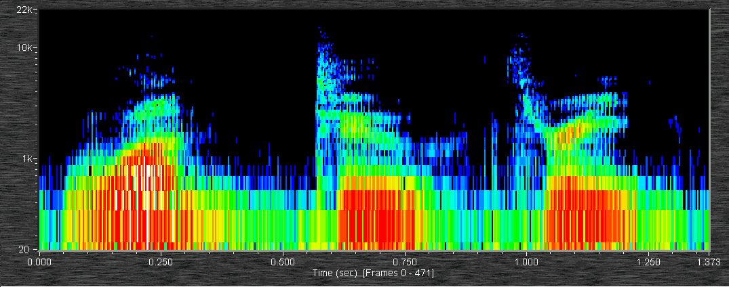
But the MAJOR source of the presence perception lies in the time domain – In the time structure of sound, and the structure of the inner ear.
Nearly all the study of human hearing ignores time structure!
It has concentrated on frequency domain spectrograms!

Slide 13
Current understanding of speech and music is based on spectrograms
Nearly all studies of hall, opera, and classroom acoustics are spectrogram based.
Voiced speech and whispered speech are treated identically.
The ear operates differently.
Why do we (and nearly all other creatures) communicate through the high harmonics of richly harmonic tones?
Voiced sounds have an intensely interesting time-domain structure!
Whispered sounds do not!

Slide 14
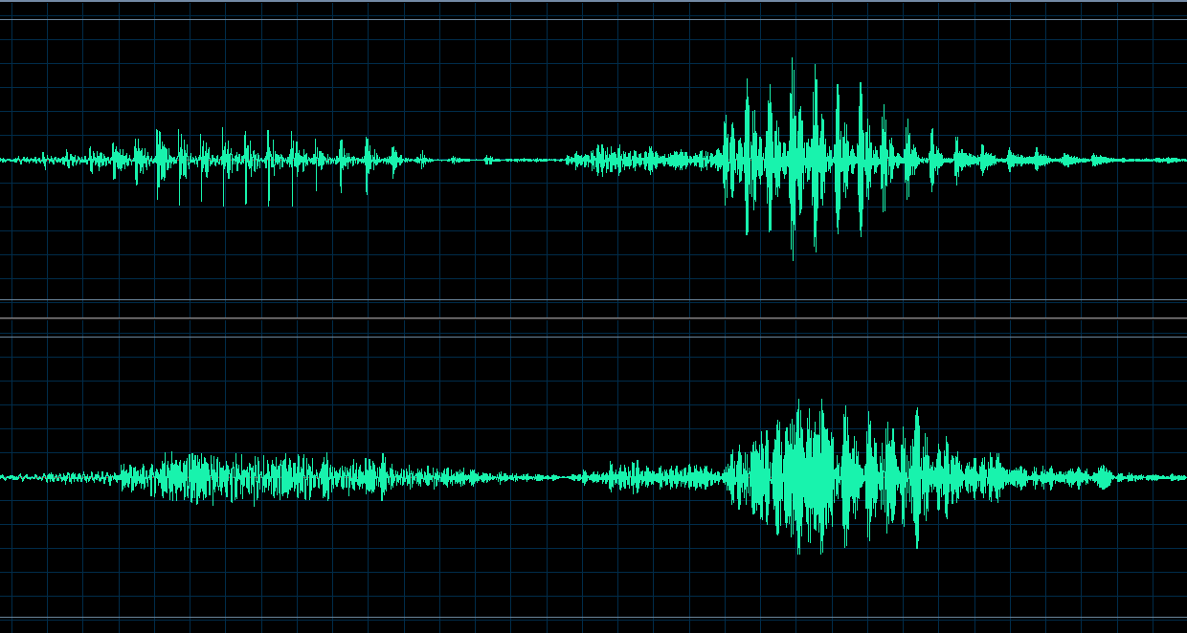
The pressure-time waveform of speech and music contains sharp SPIKES!
Broadband pressure waveforms of “One”
and “Two”.
These sound present and close!
Spikes cut through noise and reverberation, but they are destroyed by excess early reflections.
These spikes are invisible to current hearing models, and to all the ISO3382 measures of acoustic quality.
The same waveforms with excessive early reflections sound distant.

Slide 15
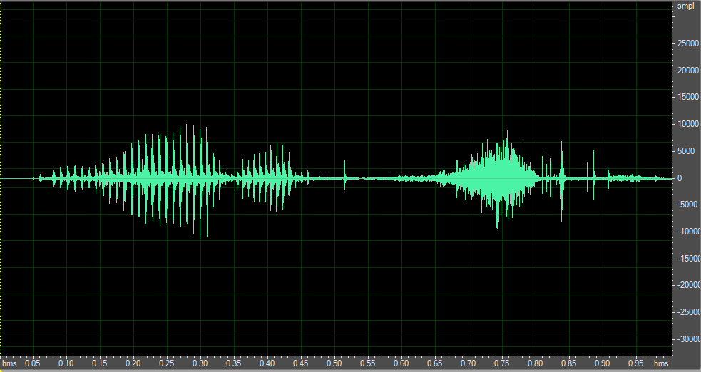
An example of spikes vs whispers
The syllable “one” voiced and then whispered, high-pass filtered at 1000Hz, with equal RMS level.

Slide 16
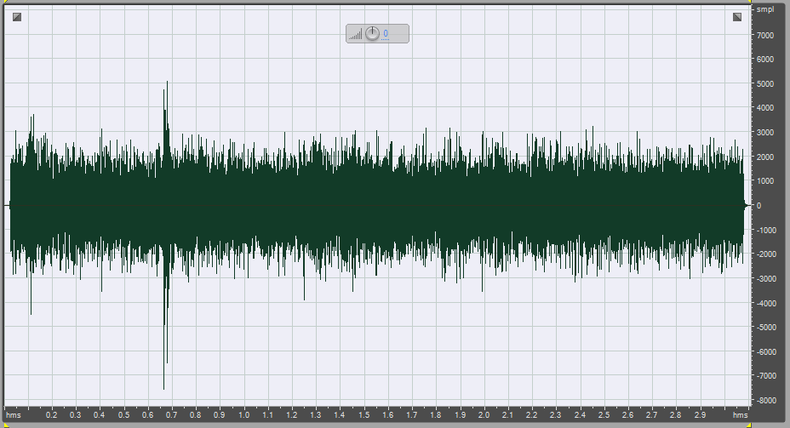
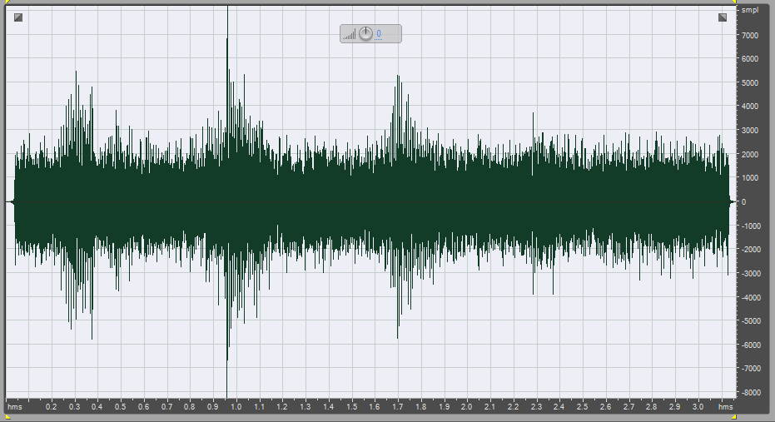
Voice and whisper in noise
If we add noise the difference in intelligibility with the spikes is dramatic.
The time-domain waveform of “one two three four” above 1000Hz with noise, first whispered, then voiced with the same signal power

Slide 17
Can we measure presence by the comparing the peak level to the RMS level?
If we take the ratio of the peak amplitude and the RMS amplitude of these two signals, does it measure the degree of presence?
Alas – NO!
The measure works for noise, but not for reflections!
Reflections generate random peaks – enough to make the measure useless.
We must use something that is sensitive to the regular period of the spikes generated by speech.
We need an autocorrelator!

Slide 18
Reflections produce spikes too – but the periods are random
Broadband pressure waveforms of “One”
and “Two”.
When there are reflections peaks are still generated – but at random intervals.
We must test for the regularity of the peaks
The same waveforms with excessive early reflections.

Slide 19
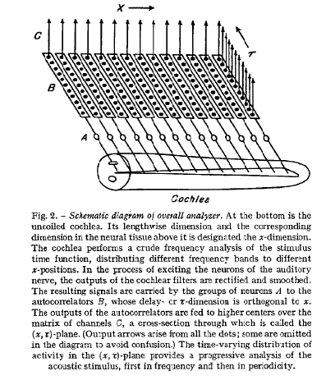
A mechanism for perceiving period was proposed by J. C. R. Licklider 1951
Licklider proposed that our acuity of pitch (period) perception could only be explained by an autocorrelator located as close as possible to the hair cells.
This circuit exist – and it is directly below the hair cells.
Before signals are sent to the auditory nerve they have already been separated from each other by pitch.
But true autocorrelators are too complex. Comb filters are better.

Slide 20
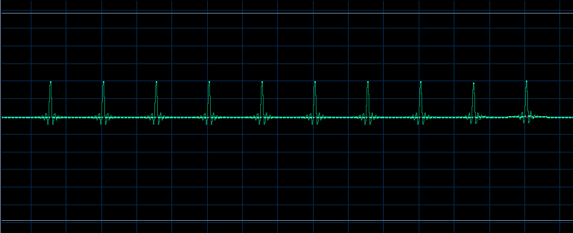
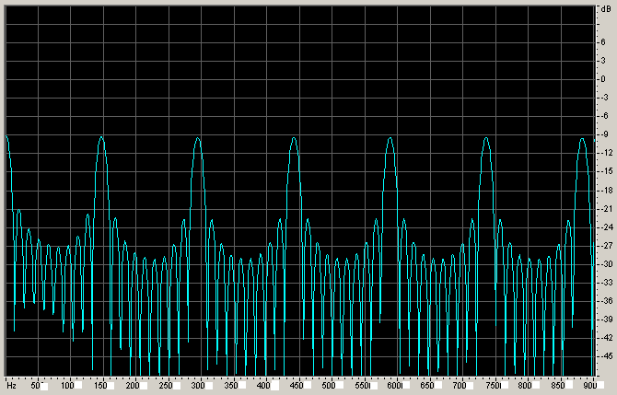
Comb filters come in many flavors
IIR versions (loops with feedback) ring too long to be useful. FIR versions, a number of taps separated by a constant delay, do not ring.
Time structure of a comb with 10 constant amplitude taps
Frequency spectrum of the comb at left. The period – the fundamental frequency – is ~150Hz.
If the spikes in the waveform of complex tones align with the peaks in the comb, that signal can be separated from all others!
Such a comb behaves just like most musical instruments: It responds equally to octaves, fifths, and fourths of the fundamental.

Slide 21
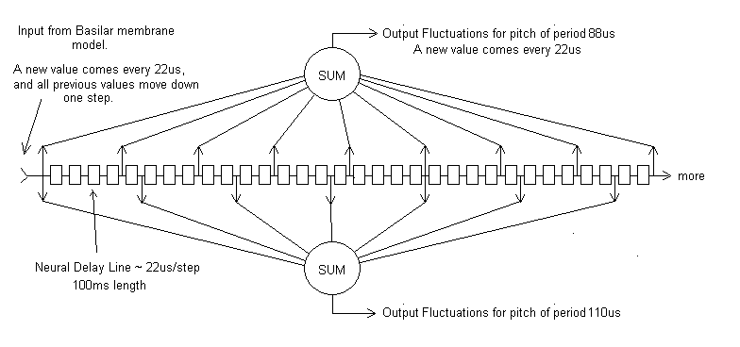
A comb filter separates signals by their pitch, circular in octaves
In this slide a neural delay line delays the output of the basilar membrane model by 22us for each step. Dendrites from summing neurons tap into the line at regular intervals, with one summing neuron for each fundamental frequency of interest.
Two of these sums are shown – one for a period of 88us, and one for a period of 110us. Each sum constitutes an independent stream of nerve fluctuations, each identified by the fundamental pitch of the source – or octave multiples.

Slide 22
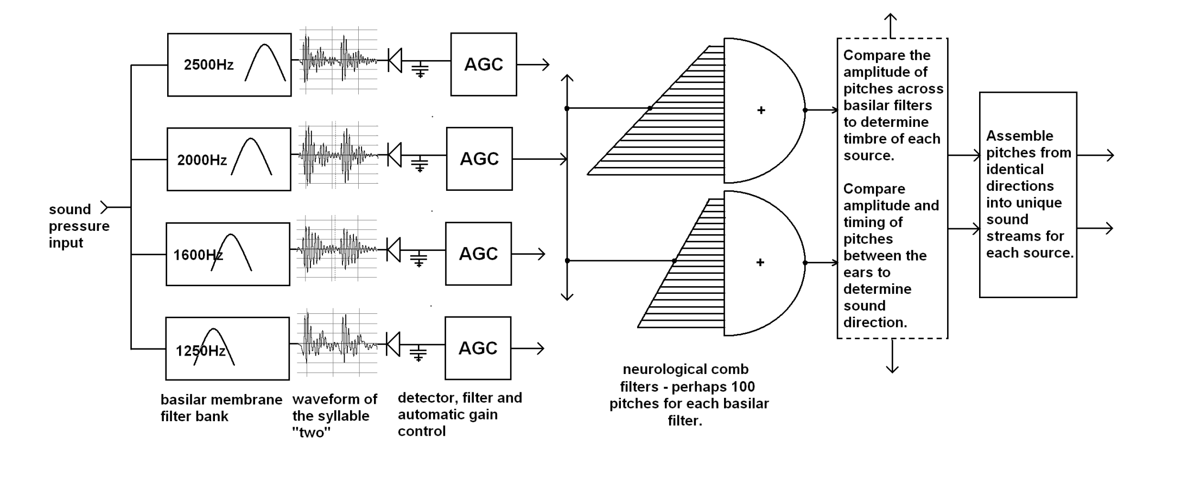
We add an ensemble of combs to a standard hearing model
.
Inner hair cells
Outer hair cells
The waveforms shown to the right of the critical band filters are typical of speech. Notice how the harmonics interfere with each other to make a spiky, highly modulated signal.
There is not time in this talk to discuss this model in detail. Further descriptions can be found on my web page, along with a description of a measure for phase coherence clarity - LOC

Slide 23
We perceive “Presence” when the spikes are audible
Demo of speech with and without reflections.
“one”,”two” with and without reflections
When spikes are present our model can separate speech from noise or reverb.
If we can determine period!
News Hour + Noise News Hour+Reverberation
(Sanders Theater at Harvard)

Slide 24
Clarity, Distance, and Audience Attention
We detect “near” versus “far” instantly on perceiving a sound
“Near” sounds demand attention and sometimes immediate attention.
“Far” sounds can usually be ignored
Cinema and Drama directors demand that dialog be perceived as “Near”
Drama theaters are small and acoustically dry
Movie theaters are dry and use highly directional loudspeakers with linear phase response at vocal formant frequencies.
High sonic clarity and low sonic distance requires that harmonics in the vocal formant range are reproduced with their original phase relationships.
Unmodified by loudspeaker characteristics or reflections.
The near/far perception is not commonly recognized when sound is reproduced, either in live performance or in recordings.

Slide 25
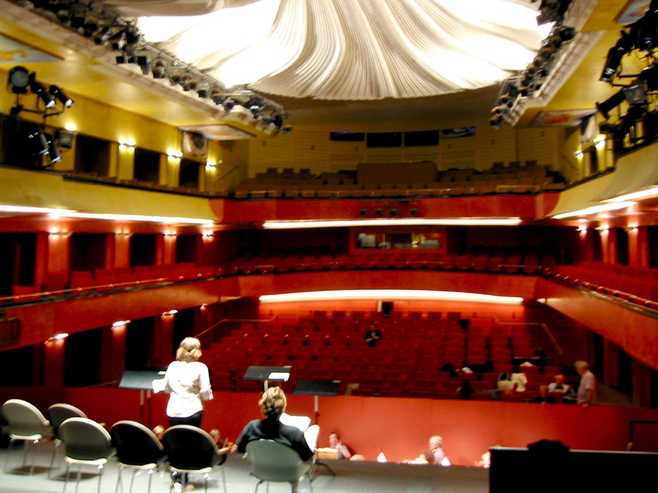
How do we know that sonic closeness focuses attention? Ask drama directors!
We were asked to improve loudness and intelligibility of the actors in this venue.
64 Genelec 1029s surrounded the audience, driven by two line array microphones and a LARES early delay system. A gate was used to syllable.
Five drama directors listened to a live performance of Chekhov with the system on/off every 10 minutes.
The result was unanimous – “it works, we don’t like it!” “The system increases the distance between the actors and the audience. We would rather the audience did not hear the words than that this connection is compromised. If they can’t quite hear the words they will pay ever closer attention. This is what we want.”

Slide 26
Early reflections can sound good!
A certain amount of early reflections are beneficial!
They add a perception of space around dry recorded sound,
And they can blend close-miked instruments into an ensemble.
Lexicon products have been doing this for years.
But too many reflections coming too soon destroy presence!
How do you know how much is too much?
How can we measure presence?

Slide 27
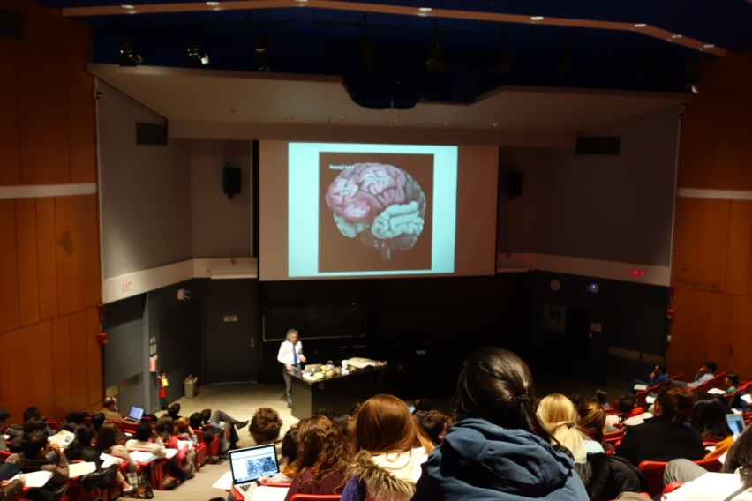
Binaural recordings in Harvard Science Center C showed extreme variation in acoustic conditions.
When the loudspeaker is used the quality of sound – but not intelligibility – varies greatly from front to back.
Sound from front row with no microphone.
Sound from rear of hall with no microphone.
The sound was clear but not loud.
With the microphone in the rear the sound was muddy and too loud. Students were looking at their cell phones and talking.

Slide 28
Let’s try comparing the peak level to the RMS level at the output of the comb filters.
When we add comb filters to the model the peak level to RMS level comparison works both with noise and reflections.
Because the comb filters emphasize regular peaks and ignore random ones, a measure of presence becomes possible directly from sound itself.
In theory we could make an smart-phone app that could measure presence from live speech.
At present the calculations are too complex for real-time.

Slide 29
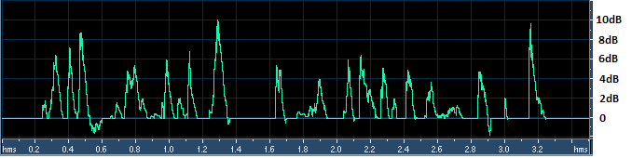
Results: Peak to RMS ratios with live speech
Clarity with no microphone in the front of the hall.
In the rear of the hall with no microphone.
In the front of the hall with the microphone.
In the rear with the microphone.
Amplification often reduces clarity.

Slide 30
How can we measure presence from an impulse response?
We can convolve speech with the IR and use the hearing model above.
But there is a simpler way that works pretty well – the measure LOC.
LOC is based on nerve-firings. It assumes a sound of constant level starts at time zero
And it counts the nerve firings that result from the direct sound without the reflections,
And counts the nerve firings from the reflections without the direct sound.
The ratio, in dB, between the two counts is the measure LOC.
A value of zero is a threshold for presence detection. A value of +3dB or more predicts good presence.

Slide 31
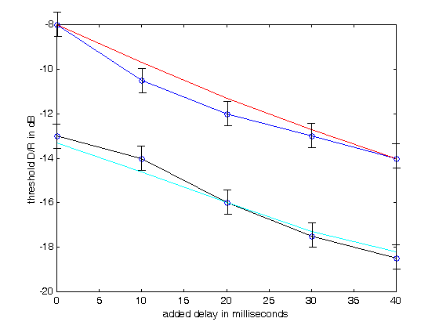
Our first measure, LOC, uses the ability to sharply localize sound as a proxy for near/far.
We determined the threshold of localization of voiced speech in reverberation as a function of D/R and pre-delay. RT values of 1 second and two seconds were tested.
For a 2s RT the threshold of localization can be as low as -17dB!
We developed the function LOC to predict this data. The red and cyan lines show the accuracy of the fit.
The LOC measure has been tested in real rooms and halls with useful results.

Slide 32
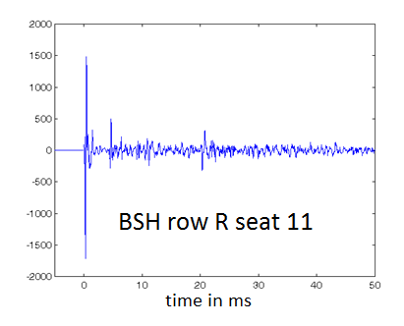
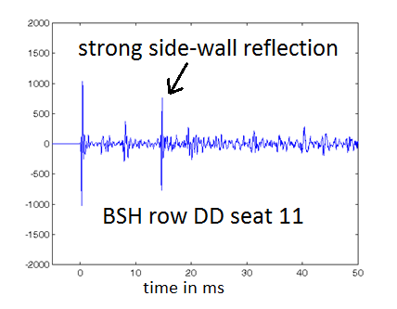
Example: Two seats in Boston Symphony Hall
C80 = 0.85dB IACC80 = .68 LOC = 9.1dB
C80=-0.21 IACC80 = 0.2 LOC = -1.2dB
C80 predicts no difference. IACC predicts row DD sounds better. LOC finds row R 10dB better!

Slide 33
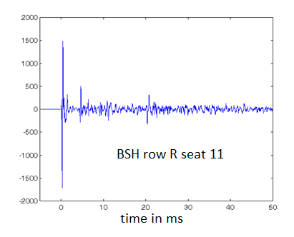
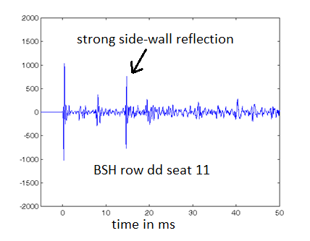
Example: Two seats in Boston Symphony Hall
C80 = 0.85dB IACC80 = .68 LOC = 9.1dB
C80=-0.21 IACC80 = 0.2 LOC = -1.2
C80 and IACC80 predict either no difference, or row DD should sound better. It does not. LOC gets it right!

Slide 34
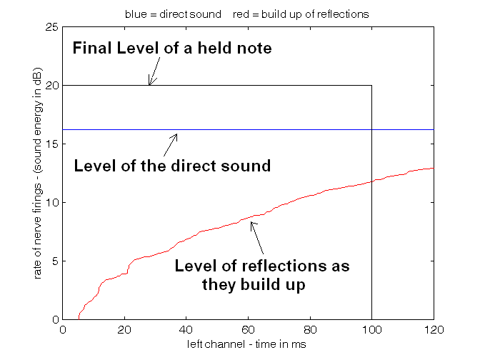
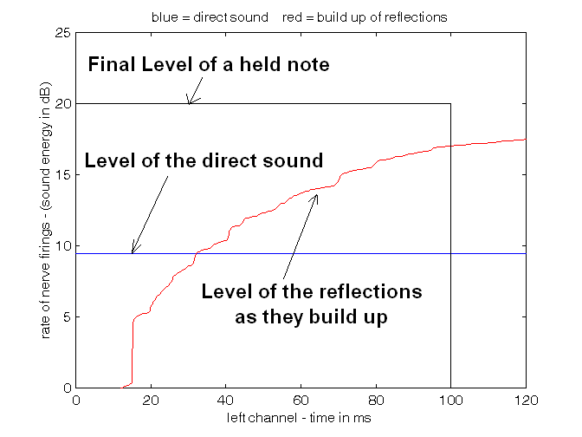
Here is how LOC sees the IRs:
row R seat 11. LOC = 9.1dB
row DD, seat 11. LOC = -1.1dB
LOC is the ratio in dB of the area under the blue line inside the black box, divided by the area under the red line inside the box. LOC > 3db indicates good clarity.

Slide 35
What does this mean in practice?
In smaller venues – classrooms, chamber music halls, small operas etc. many reflections are likely to arrive within 80ms of the direct sound.
Finding the correct balance between direct and early in all the seats requires particular attention.
Almost invariably some absorption in the stage area is essential.
When the direct sound is clearly audible in most all seats the reverberation in the hall becomes more audible.
Even if the reverberation time is low by contemporary standards.
In small venues even short reverberation times can be enveloping
But only if the direct sound has presence!

Slide 36
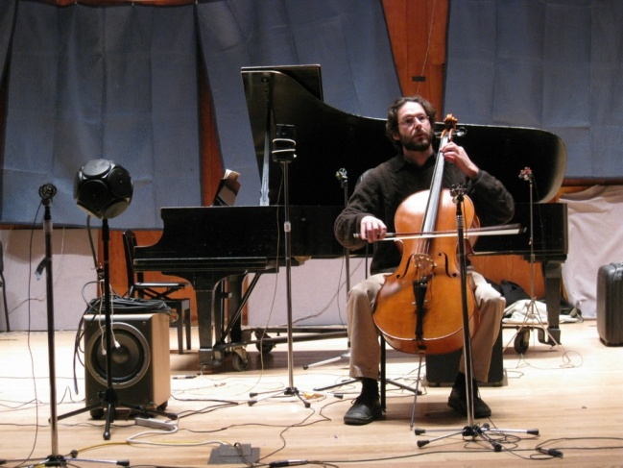
The Physics of Presence matters because it shows you how to make better sound
Experiments at the Longy School of Music, an ~300 seat hall in Cambridge
The original stage was highly reflective. The sound on stage and in the audience was not clear.
So we experimented for a week.

Slide 37
Results of the experiments:
The predictions from our model were verified!
We found that clarity is lost when too many early reflections in the first 100ms of the onsets of notes randomize the phases of harmonics above 1000Hz.
The earlier reflections arrive the more they randomize phase.
Clarity is preserved when just a few reflections arrive in the first 100ms.
When there are too many, Clarity abruptly disappears.

Slide 38
At Longy the conventional fixes did not work!
Current wisdom predicted that putting a small shell around the musicians would improve clarity.
But when we tried this suggestion, clarity was reduced.
Early reflections were already too strong.

Slide 39
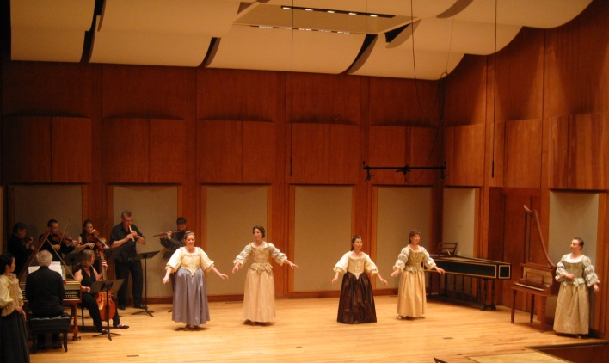
The final design was dictated by these experiments
The earliest and strongest reflections are from the back wall and side walls of the stage.
Reducing their strength through absorption on stage improved the sound throughout the hall.

Slide 40
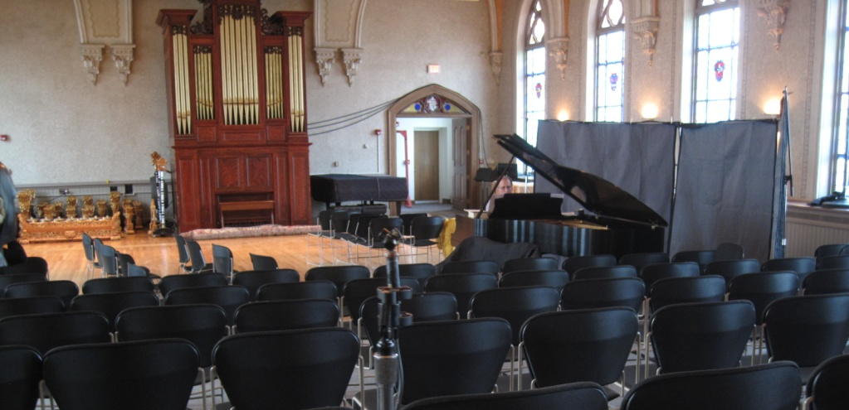
Experiments at Holy Cross in Worcester
A 200 seat long shoebox hall with >2s RT and twice the volume of Longy. Clarity was non-existent. We experimented with putting musicians along the side wall with absorption behind. Clarity improved.

Slide 41
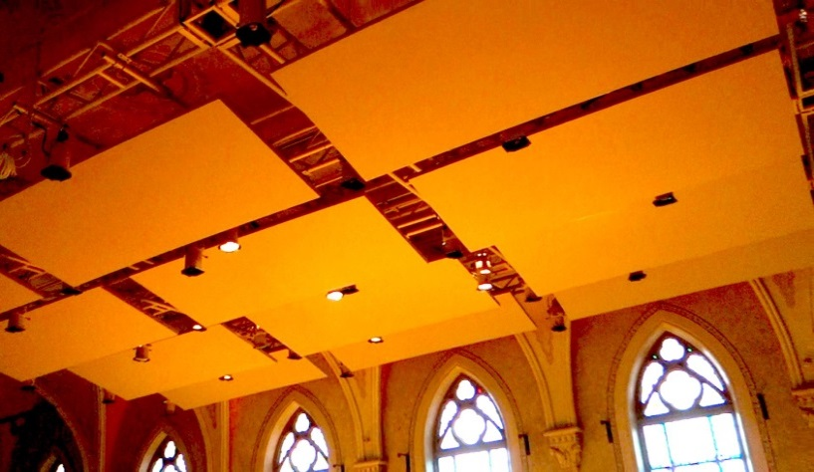
The final design
The audience surrounds the musicians. Overhead clouds of 2” fiberglass are open on both sides.
The clouds attenuate ceiling reflections and reduce the overall reverberant level.
Curtains behind the musicians await installation.
Musicians, teachers, and audiences love the new hall.

Slide 42
In large venues first order reflections also must be controlled.
In general – the first choice of action is to minimize prompt medial reflections – for example from the ceiling or stage back wall.
Next choice of action is to block or absorb side-wall reflections in the rear of the hall – but not in the front.

Slide 43
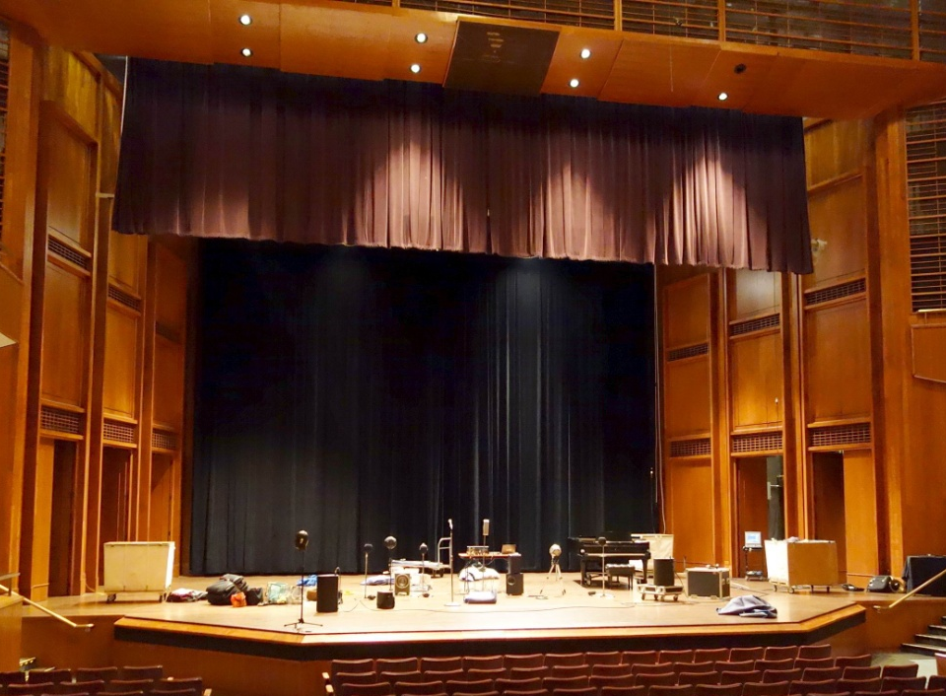
Experiments at Bucknell University
~1200 seats, and RT > 2s. The stage was highly reflective.
We set up an Tapio Lokki’s soprano and string quartet. 2/3rds of the way back the instruments were impossible to localize and separate. Speech intelligibility was poor and amplified performances were muddy.
Adding an absorbing curtain on the stage rear wall and an absorbing valence in front of the proscenium dramatically improved clarity and increased the perception of reverberance.

Slide 44
These sonic differences are not subtle!
Clarity and Presence originate in the physics of the sound wave –
their presence or absence can be heard by anyone, even from a monaural loudspeaker.
Orchestra Row V bare stage
Orchestra Row V with curtains
Balcony row A bare stage
Balcony row A with curtains

Slide 45
Speech Reinforcement in Bucknell
We tested a simple PA: just a microphone and a near-by horn-loaded monitor speaker.
The speech was crisp and clear throughout the hall.
The standard PA with two proscenium speakers created an impossible muddle in most seats.

Slide 46
Jordan Hall at New England Conservatory A renowned 1000 seat recital hall
The historical 45’x17’ proscenium valence was removed in 1994 as part of a renovation.
The change in sound was decried by many local musicians and conductors. (As the removal of the same curtain from Carnegie Hall was also decried.)
We decided to see what would happen if we put it back.

Slide 47
A 42’ by 12’ absorbing valence was hung above the stage
We also covered most of the floor and parquet with blankets to emulate an audience, and set up our electronic orchestra on stage.
Without the valence localization and clarity were lost at about row I in the orchestra.
With the valence the sound was clear all the way to the back of the hall. (Most, but not all, of the balcony seats were also improved.)

Slide 48
Intelligibility and presence in small classrooms
We made an image-source model of a classroom.
We added the directivity of the source using data from Peter Mapp.
From the impulse responses STI and LOC can be calculated,
and the result can be auralized.

Slide 49
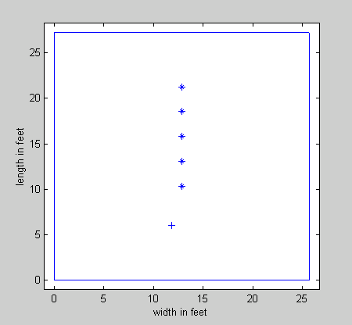
A 27’x25’x10’ room with surface absorption of 0.15 and RT 0.34s
A room was modeled with a single sound source and five receiver positions.
The intelligibility measured by STI is very good in all positions.
LOC greater than +3dB predicts good presence and localization. LOC less than zero is poor.
Receiver pos.
STI LOC
.75 -2.3dB
.73 -3.4dB
.74 -2.7dB
.74 0.3dB
.75 4.0dB
21.3’
18.5’
15.8’
13.8’
10.4’
9.5’
Teacher
6’
A small room with low RT has excellent STI – but presence and localization are only possible near the source.

Slide 50
What can be done?
In concert halls absorbing the back wall reflection or the ceiling reflection can make an enormous difference.
These reflections are the strongest and come the soonest.
But in this room LOC went up only 1dB.
The best solution is to increase the average absorption to 0.3
Impractical perhaps – but effective.

Slide 51
A 27’x25’x10’ room with surface absorption of 0.3 and RT 0.26s
Receiver pos.
The intelligibility measured by STI is constant and very good.
LOC is excellent to fair in all positions.
STI LOC
.84 2.4dB
.85 1.4dB
.85 2.4dB
.85 5.1dB
.85 8.5dB
21.3’
18.5’
15.8’
13.8’
10.4’
9.5’
Teacher
6’
A small room needs a lot of absorption if presence is to be high over all seats.

Slide 52
A Few Conclusions about hearing
1. The most common cause of hearing loss is damage to the spiral ganglia by sustained loud sound.
Popular music at high levels is particularly damaging – if your ears do not recover within an hour you have sustained permanent damage.
2. Spiral ganglia are critical to our abilities to localize and separate sounds from each other and from noise.
They are the mechanism for the cocktail party effect.
3. Attention and recall of sonic information is enhanced by the sense of presence that the spiral ganglia detect.

Slide 53
Presence, Intelligibility and Recall
4. Excessive early reflections reduce or eliminate this sense of presence, reducing localization, comprehension, attention, and recall.
5. Attention, comprehension and recall are enhanced when visual and sonic images coincide.
6. Intelligibility does not predict recall – A major factor is sonic presence – which promotes attention.

Slide 54
Sound Reinforcement
7. Most sound reinforcement systems reduce sonic presence – increasing intelligibility but reducing recall.
Monaural music reinforcement stifles the details of performance.
8. Excess loudness reduces presence
Because the acuity of hearing shuts down!

Slide 55
A few conclusions about halls
9. Envelopment requires both direct sound and adequate late reverberant sound pressure. When noise is low, playing or speaking softly reduces the sense of the hall but can increase presence and recall.
10. The perception of the hall – ENVELOPMENT – requires that the direct sound is perceived as separate from the reverberation.
No direct sound – no envelopment!

Slide 56
The boundary where presence vanishes
11. In most halls there is a distinct boundary between where the direct sound is detected, and where localization is no longer possible. – true envelopment disappears at that point.
12. In most cases direct sound localization and envelopment can be greatly improved by absorbing or re-directing the earliest reflections, especially from the stage back-wall or the ceiling.
There is no decrease in loudness or intimacy.

Slide 57
Classrooms
13. In most classrooms noise is excessive and must be better controlled.
14. When noise is controlled a major factor is the loss of presence in the rear seats.
15. When presence is lacking it is more difficult to comprehend and remember information, and attention suffers.
16. Classrooms require a higher standard of acoustics than is currently realized.

