Slide 1
Measuring sonic presence and the ability to sharply localize sound using existing lateral fraction data
David Griesinger
David Griesinger Acoustics
www.davidgriesinger.com

Slide 2
Sound quality depends on the listener’s expectation
A: Soothing sound: Emotionally neutral or beneficial, but not challenging.
Background music: Bland and Innocuous
Symphonic mush: Loud, sometimes stirring, but well blended.
B: Exciting sounds
Military Bands
Rock Concerts
C: Sounds that communicate information that can be parsed, understood, and remembered later.
Classrooms:
Theaters
Operas
Concert Venues
This talk is concerned with sounds in category C

Slide 3
The ear and brain evolved to detect, parse and remember information.
The system works incredibly well
To measure sound as the ear can hears it requires a level of sophistication that current measures do not approach.
The ear is more sensitive than most microphones
The ear can detect signals in noise and information better than any current machine
The ear can detect horizontal localization five times more accurately than any first-order microphone.
Only third order microphones do as well – and they have a much higher noise floor.

Slide 4
All Science requires models that are as simple as possible, but not too simple!
Current measures, such as ISO3382, are based on models that are far too primitive. The results obtained are incorrect and misleading.
In addition – Even the very best halls have less than 50% of the seats with really good sound. (Boston, Vienna, etc.)
But current practice lumps all the seats together to create average values for measured parameters.
And these values are recommended as guides for good sound.
Very little effort goes into determining which seats are excellent, average, or poor acoustically.
Designing for measurements averaged over all seats guarantees an unsatisfactory result
Useful measures must accurately predict the perceived sound in each seat!!
And we must use such measures to design halls for a maximum number of great seats

Slide 5
More problems with current measures
1. Current measures use omnidirectional or first-order directional microphones
Which are far less capable of capturing information than human hearing
2. They use omnidirectional sources
Almost no source of human interest is omnidirectional
3. They analyze and display impulse responses
Impulse responses are the sounds of pistol shots, and have no direct relationship to music or speech.
Impulse responses have a white spectrum. Half of the energy displayed is above 10kHz
4. They analyze the IRs with drastically oversimplified methods
The ear and brain system is much more subtle and interesting than sonograms and simple energy integrals.
5. Most laboratory playback systems cannot recreate a great hall.
(With the exception of Tapio Lokki’s.)
WFS, first and second order Ambisonics all fail.

Slide 6
Problems with first order microphones such as Omnis, Eights, Cardioids, and Soundfields
Human hearing has an angular acuity of 2 degrees, which corresponds to an ILD JND of 1dB, and an ITD JND of 2 microseconds.
A dummy head captures ITDs and ILDs with this precision..
The best you can do with a first order microphone array is an 8 degree angular offset for a one dB JND, and it creates no ITDs.
If the S/N is high enough the direct sound from an impulse response of a single sound source can be detected with 2 degree accuracy,
but the directions of reflections that follow cannot be accurately resolved because they cannot be separated from each other.
Recording multiple musical sources in a particular seat with the precision of human hearing requires a binaural microphone or at least a third-order pressure-gradient microphone.
These microphones are not commonly used or analyzed with current measurement methods.

Slide 7
Omnidirectional sources
1. Almost no sound source of interest for human communication is omnidirectional.
2. The directivity of sources has evolved purposely to maximize the strength of the direct sound and minimize the sound power in early reflections
3. Measuring with omnidirectional sources gives radically different results for the ability to localize, parse, and remember sounds.
4. Current use of omnidirectional sources has encouraged a mind-set that has led to travesties such as the halls in Helsinki, Copenhagen, and the Gardener Museum in Boston.
And more are on the way.

Slide 8
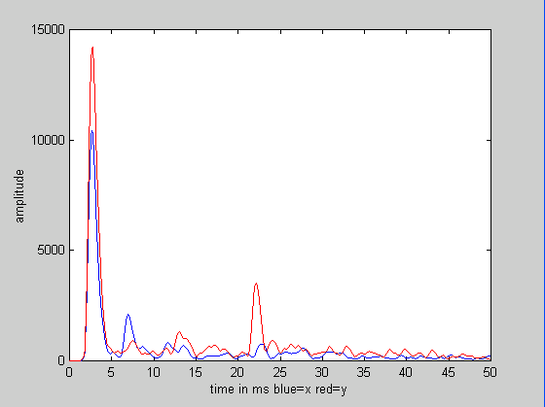
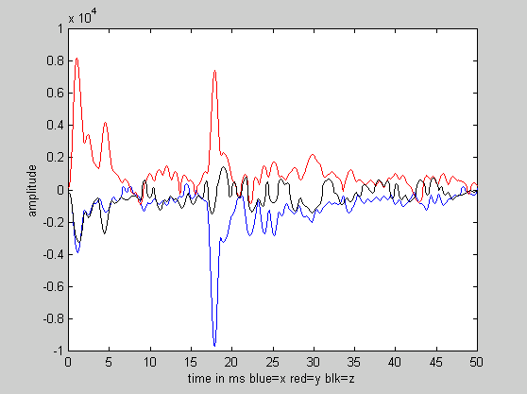
Example of misleading results from omnidirectional measurements.
Two impulse responses from Boston Symphony Hall (BSH) from the right of the conductor to seat R-11 at 2kHz.
Binaural IR from a Genelec 1029 speaker Soundfield IR from a tiny balloon
Blue: left ear Red: right ear Red: front/back Blue: left/right Black: up/down
Note the enormous reflection in the balloon data from the right side wall. This is not present in the data from the loudspeaker. This reflection should both muddy the sound and cause an image shift – but no instrument on stage excites this reflection. This seat has good sound.

Slide 9
Valid acoustic measurements must take this complexity into account
We need to test whether or not a reflection is actually excited by the expected sound sources.
If it is, is the reflection audible? If so, is it harmful, beneficial, or irrelevant?
Any useful measure must accurately account for such reflections.
You need to model both the directivity of each instrument and the directional acuity of the receiver.
And then you must analyze the data with the same hardware and the same methods that the ear uses.
Almost all current measures are based on a sonogram model, and use pistol shots as a “typical” sound excitation.
Sonograms cannot separate signals from reverberation and noise with human acuity.
They do not have the pitch acuity of the ear.
They plot and integrate sound energy from a pistol shot as a function of time.
But the ear’s response to sound is logarithmic, and the ear integrates the log of sound pressure over a time window of ~ 100ms
The ear hears notes and syllables – not pistol shots.
We must manipulate impulse responses mathematically to represent notes and syllables before we attempt to measure them.

Slide 10
Problems with current measures
C80 and C50 have little or no ability to predict the ability to localize sources or to separate individual sources from one another
And current recommended values – around 0dB - almost guarantee a muddy, blended sound
RT is sometimes useful as a guide – but it predicts nothing about the strength of the reverberation relative to the direct sound.
All too often a small hall is designed to have a 2s RT. The resulting high reverberant level makes the sound muddy and loud in almost every seat.
IACC is somewhat sensitive to amount of lateral energy, but it treats all the medial reflections as direct sound.
And the current “optimal” values are way too low.
Once again, designing to that standard results in muddy sound.
G and G late in combination with RT might be more helpful than most

Slide 11
G. W. Sabine
Sabine used a note from an organ pipe as a source, not a pistol.
He understood that sound power builds up in a room as a note or syllable is held.
And that the reverberation from such a held note or a syllable can mask the onset of a succeeding note or syllable.
He proposed reducing RT in a room to the point where most succeeding syllable onsets are not masked.
This criterion depends both on the reverberation time and the strength of the reverberation relative to the direct sound.
Sabine’s insight is as essential today as it ever was!
When sound onsets are masked acoustic communication is severely compromised.
Most current concert hall and opera measures do not take the build-up of sound in a hall into account!
They only test pistol shots.

Slide 12
What can be done?
We need to accurately predict four essential sound perceptions in each seat.
1. Does the build-up of reverberation mask the onsets of succeeding sounds?
2. Can each instrument be accurately localized with eyes closed?
3. The ability to hear the sound of the hall as separate from the sound of each instrument.
4. The loudness of the total sound from a given instrument or section, and the loudness of the late reverberation.
The second and third perceptions are closely related.
Hearing the sound of the hall as separate from the sound of each instrument requires that the brain can separate the direct sound from the reflections that follow it.
When this separation is possible the sound is localizable, and is perceived as sonically close to the listener.
But hearing the hall requires that the late reverberant energy is be strong enough that it is not masked by the direct sound and early reflections.
When note onsets are masked only loudness is relevant to perception.

Slide 13
LOC
We have an inner ear model that includes the proposed functionality of the spiral ganglia below the hair cells.
It includes the CNS control of the basilar membrane, which causes the logarithmic response of nerve firings to sound pressure.
And it includes the function of the spiral ganglia of integrating nerve firings over an 80 to 100ms window.
Based on the model we developed a binaural impulse response measure for the ability to localize sound in a reverberant field: LOC.
LOC integrates the nerve firings from the direct sound separately from the build-up of reflections in a 100ms window. The ratios of thee two integrals in dB determines the ease of localization.
LOC is also an over-simplification – but it works better than other measures we have found.
It often predicts the ability to localize, separate, parse, and remember sounds in individual seats.
But LOC requires binaural data!

Slide 14
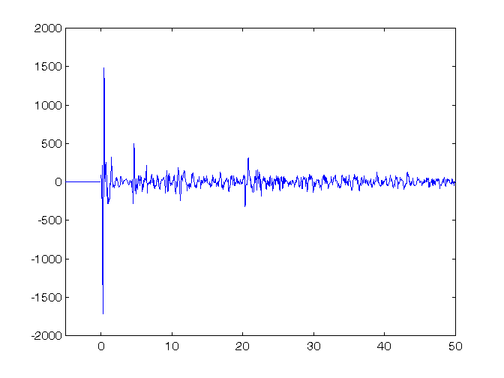
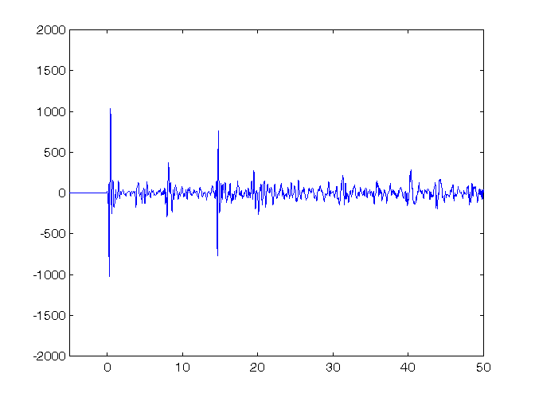
Two impulse responses from Boston Symphony Hall
And current ISO measures that fail to quantify them.
Binaural impulse from BSH row R seat 11 C80 = 0.85dB IACC80 = .68 LOC = 9.1dB
Same, Row DD, seat 11 C80=-0.21 IACC80 = 0.2 LOC = -1.2
Both C80 and IACC80 predict the opposite of what we hear!

Slide 15
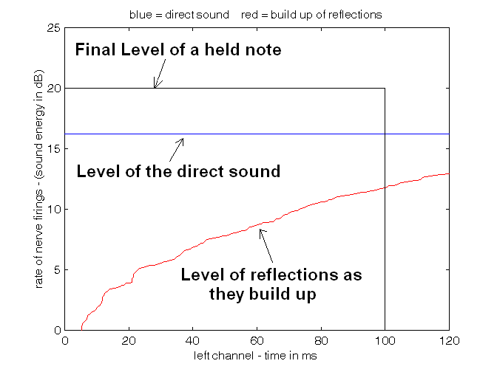
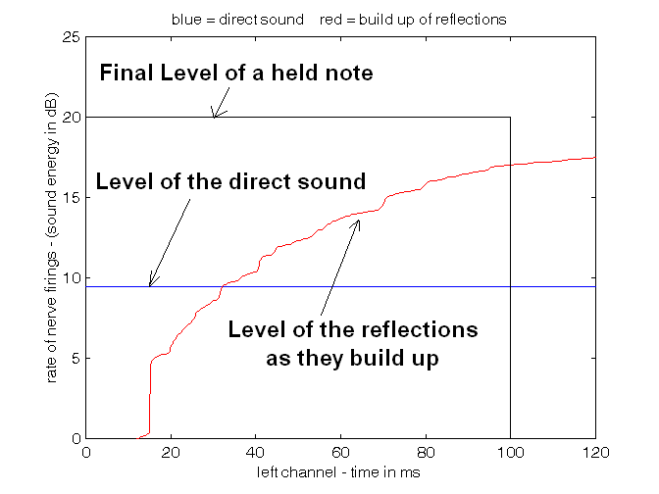
This is how the ear and LOC perceive these seats with music above 1kHz:
Boston Symphony Hall row R seat 11 The left channel of a binaural impulse response. LOC = 9.1dB
Same, row DD, seat 11. The final sound level is almost the same, but in this seat it is mostly reflections. LOC = -1.1dB
Note the window defined by the black box. We propose that if the area under the direct sound is greater than the area under the red line, the sound will be CLEAR. The ratio of these areas is LOC (in dB).

Slide 16
The importance of frequency and upward masking
We have shown that the ability to sharply localize sounds in a reverberant environment is primarily in the frequency range of 1000-5000Hz.
These frequencies also carry almost all the information in human speech.
In acoustics for both speech and music low frequencies are chiefly important because they mask frequencies in the vocal formant range.
Equal loudness curves – which illustrate the sensitivity of human hearing – are not accidental
Current LOC code does not take upward masking into account.

Slide 17
LOC requires binaural impulse response data
What if we only have conventional hall measurement data?
Is it possible to use information from a lateral fraction measurement to calculate LOC?
LF data consists of the sound pressure (w) and the lateral sound velocity (x) at (hopefully) a single point.
from this we can compute the sound intensity in the lateral (x) direction.
Information about the intensity in the up/down (z) direction and the front/back direction (y) is unavailable.
But sound from the medial plane - front, back, below, and above - all affect the ability to localize in approximately the same way.
To some extent the medial energy can be inferred from the total sound pressure.
The angle of each reflection from the medial plane can be computed, and the ILD and ITD of a binaural representation can be computed from HRTF data.
In practice it appears possible to synthesize a useable binaural impulse response from lateral fraction data – if the two microphones were close enough together.

Slide 18
Procedure
In our code the omni (w) and figure-of-eight (x) data are time-aligned by adjusting the peak from the direct sound to the closest sample at 44100Hz.
It is also useful to check the spectra of the two microphones and adjust the data if they are substantially different.
The data is then rotated about the x-w axis to minimize the x component of the direct sound.
this is equivalent to rotating the array to point at the sound source.
The IR data is then filtered into the 1kHz, 2kHz, 4kHz, and 8kHz octave bands using phase-linear filters.
The filtered signals can be re-combined to form the original signal without artifacts.
The product of x and w (which is an approximation to the x direction sound intensity) and the square of w are then convolved by a raised cosine window with a width of two times the sample rate divided by the band frequency. This procedure removes the carrier – or band frequency – leaving a smooth energy function and preserving the sign of x relative to w.
The arcsine of sign-sensitive square root of the convolved x and w is taken to find the instentanious value and sign of the angle between a reflection and the medial plane. From this we can select an appropriate HRTF. We used MIT Kemar data.
Reflections with positive sign are convolved with an ipselateral HRTF and added to the left binaural output. Their convolution with a contralateral HRTF is added to the right binaural output. Reflections with a negative sign are treated oppositely.
The result is a surprisingly accurate binaural HRTF.

Slide 19
Unresolved reflections
First order microphones are typically only capable of resolving 3 to 5 strong reflections in bands below 10kHz.
We can find the angle for these reflections from the medial plane, and correct them for ITD and ILD using HRTF data as shown above.
The result is to reduce the strength of reflections that will be shadowed by the head.
With first-order microphones other reflections appear as random noise.
The un-resolved reflections can come from any direction. We can assume that they are uniformly distributed in space. The head shadowing from randomly incident sound power can be calculated from HRTF data and applied to all unresolved reflections.
Another method for compensating for un-resolved reflections is to continuously calculate the apparent angle from the medial plane, and apply HRTF data to the result. This is roughly equivalent from using an average attenuation, and results in a more natural sounding binaural impulse response.
The procedure is followed for all frequency bands, and the results are summed to create a pseudo binaural IR.

Slide 20
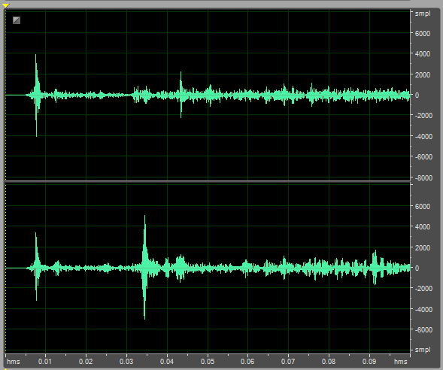
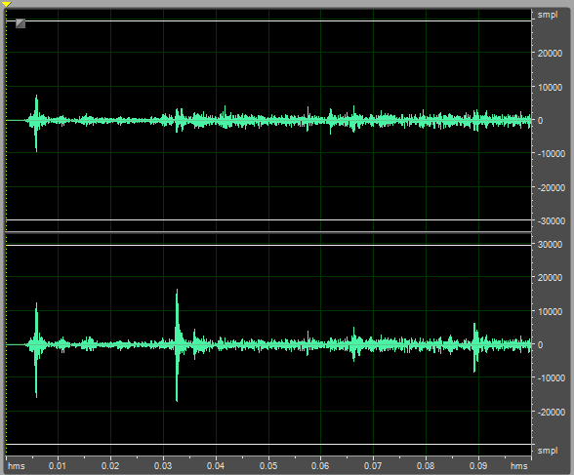
Data from Boston Symphony Hall April 14, 2014
I joined Ning Xiang and his students – along with Leo Bernaek, at BSH. Here is data from Ning’s binaural data (left picture) and binaural data derived from Ning’s omni-eight measurement at row U seat 14
Binaural data from BSH U-14 Binaural data derived from omni-eight
Omnidirectional source near conductor’s right side
Note the strong double side wall reflection – attenuated by head shadowing

Slide 21
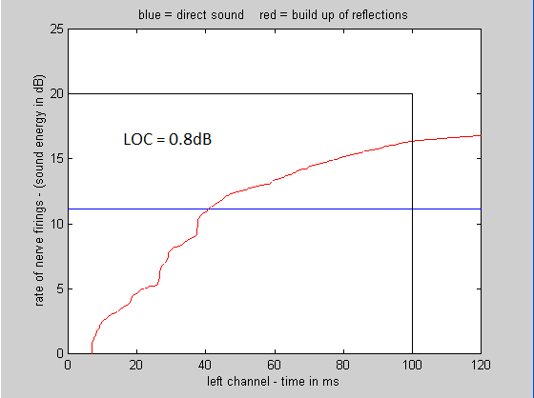
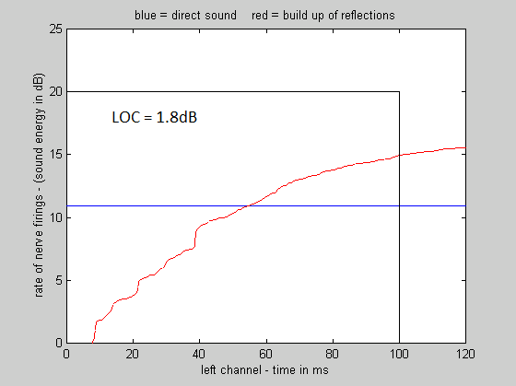
LOC diagrams for the previous slide
Ning’s ipselateral binaural data Ning’s omni-eight data
equalized for flat spectra converted to binaural

Slide 22
Conclusions
Current standard acoustic measures do not predict the ability to localize and separate distinct sound sources in individual seats.
To sharply localize or separate sound sources into separate streams requires that it is possible for the ear and brain to separate the direct sound from reflections and reverberation.
Current measures do not predict this ability.
The perception of envelopment requires both that late reverberation is strong enough that it is not masked by foreground sound
AND that it is possible to detect the direct sound as separate from reflections and reverberation.
LOC provides a possible measure for the ability to localize sound sources and detect the direct sound as separate.
LOC requires binaural data.
It appears possible to convert omni-eight data to pseudo binaural data from which Clarity and localization measures can be obtained.

