Slide 1
Accurate reproduction of non-individual binaural recordings without head tracking through individual headphone equalization
David Griesinger
David Griesinger Acoustics
dgriesinger@verizon.net
www.davidgriesinger.com

Slide 2
Proximity – perhaps the most important predictor of sound quality in halls
Proximity describes the perception that a sound source is sonically close to the listener.
But to consciously perceive it we must close our eyes!
Vision will always override sound to determine distance.
If a source looks close, it sounds close.
To hear proximity you must close your eyes.
To study proximity in a laboratory we must be able to reproduce it!
Almost all current systems cannot.
nearly all previous systems did not!
But binaural techniques can work beautifully!

Slide 3
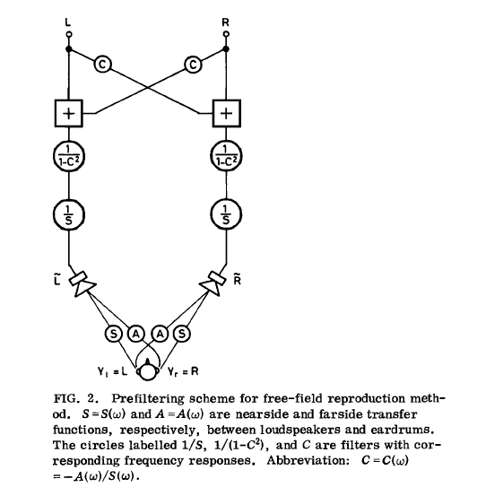
Binaural reproduction of concert halls is not new. Manfred Schroeder attempted it in 1974
Schroeder knew that if the eardrum pressure of a listener can be recorded and reproduced, the sonic impression can be reproduced exactly.
This is not easy, but it can be done.
Schroeder, Gottlob, and Siebrasse: Comparative study of European concert halls. 1974

Slide 4
But Schroeder played the whole orchestra through two loudspeakers!
Proximity was already lost.
To reproduce Proximity you need one loudspeaker per source!
(As found by Edison, DG, Dick Campbell, Kimio Hamasaki, Tapio Lokki and the author)

Slide 5
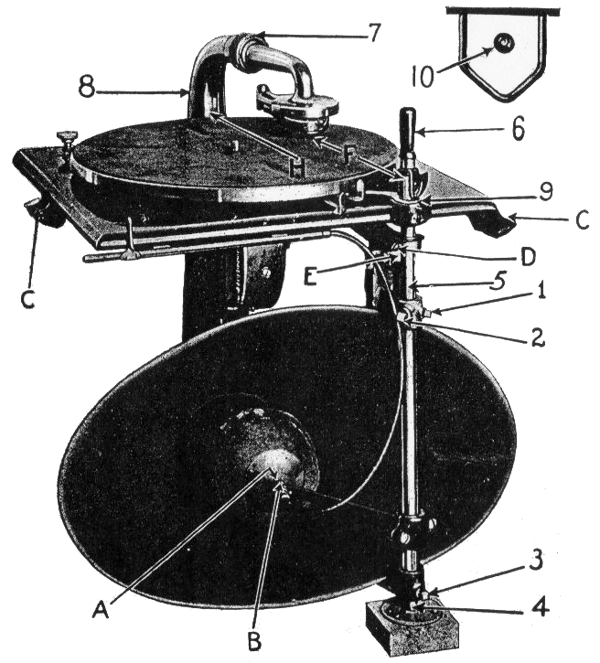
To reproduce “Proximity” the rule is simple: you need one linear phase speaker for each voice.
Edison, through meticulous A/B tests, succeeded with his “diamond disk” phonograph.
I heard one of these phonographs, and found it completely convincing. The soprano was right there in front of me.
Research with electronic orchestras by Hamasaki, Woszczyk, and Campbell found the same thing.

Slide 6
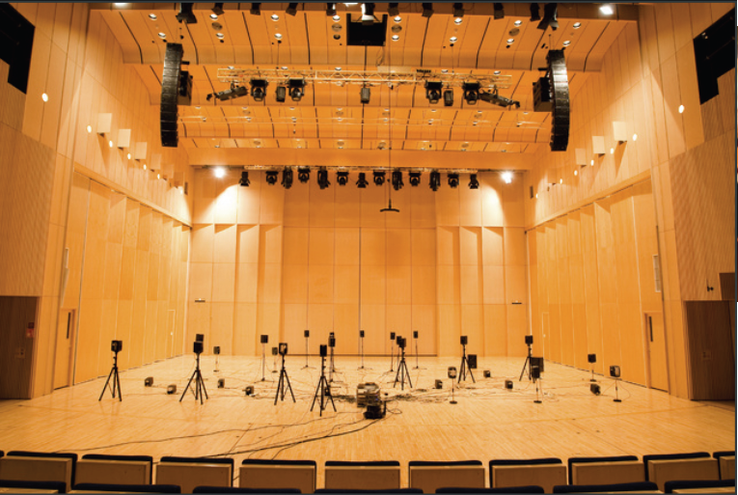
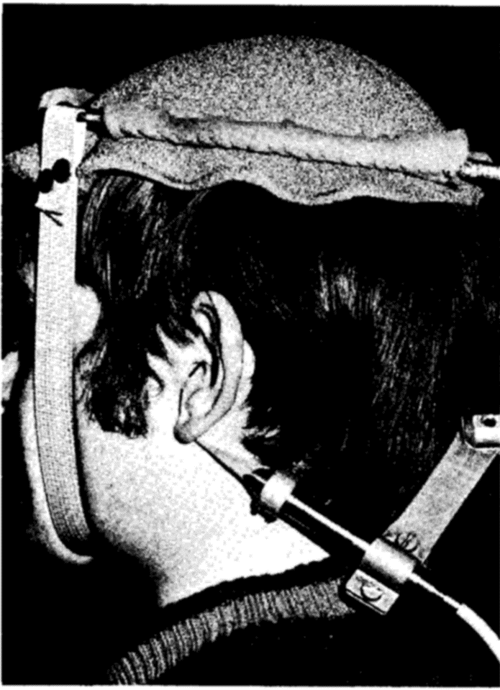
We need to combine Lokki’s electronic orchestra with a practical binaural recording and playback technique.
Lokki’s electronic orchestra set up on a bare stage. (Bare stages can be misleading.)
Recording the eardrum pressure the hard way!

Slide 7
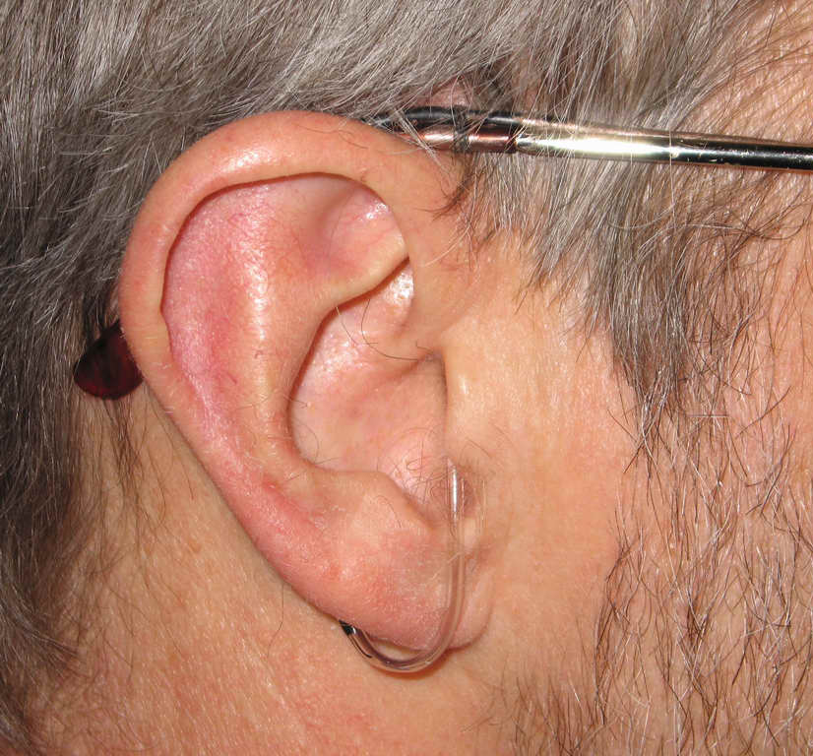
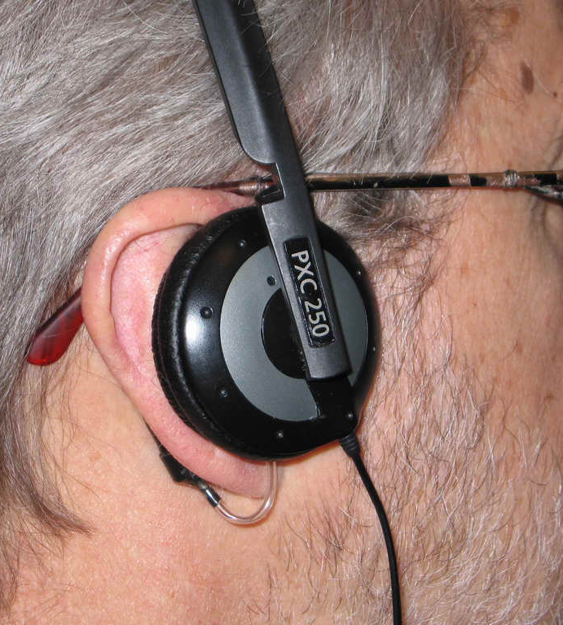
The best way is to record from your eardrums with soft probes, and then equalize the headphones with the same probes!
The author’s probes from Recording at the eardrum with probe on eardrum for 1976 to the current day a soft-tip probe microphone headphone equalization
But there are easier ways to do it!

Slide 8
We can record with a frontal equalized dummy head listen with individually equalize headphones.
Adding a Soundfield microphone tells you where each reflection comes from.

Slide 9
Individual equalization is critical because the ear canal resonances are very different for each person!
We will demonstrate the timbre perceived by ten listeners from a pair of Sennheiser 600 headphones as compared to pink noise from a from a frontal loudspeaker.
One second of pink noise will be followed by 5 seconds of the spectrum perceived for each listener from the headphone.

Slide 10
Sennheiser 600 Timbres
The timbre perceived from a pair of Sennheiser 600 headphones by ten listeners relative to their perception of pink noise from a frontal loudspeaker.
pink noise is played for 2 seconds, followed by the timbre perceived by each listener from the headphone.
David Griesinger
David Griesinger Acoustics
www.davidgriesinger.com

Slide 11
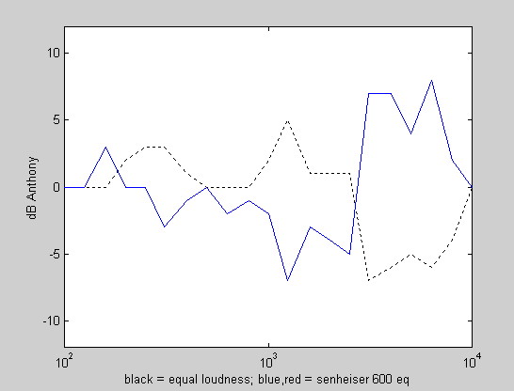
Anthony
Timbre Perceived
Correction Needed
Black is the personal equal loudness to a loudspeaker
Blue is the correction needed for the headphone
The timbre perceived is the inverse of the blue curve.

Slide 12
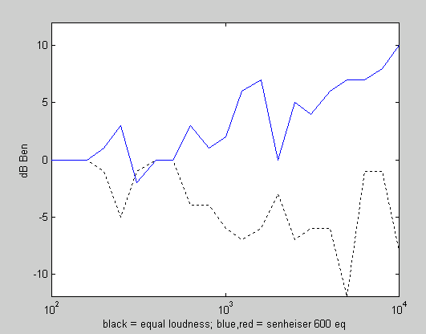
Ben
Timbre Perceived
Correction Needed
Black is the personal equal loudness to a loudspeaker
Blue is the correction needed for the headphone
The timbre perceived is the inverse of the blue curve.

Slide 13
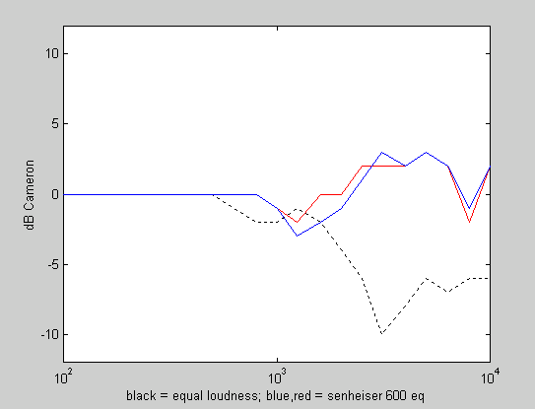
Cameron
Timbre Perceived
Correction Needed
Black is the personal equal loudness to a loudspeaker
Blue is the correction needed for the headphone
The timbre perceived is the inverse of the blue curve.

Slide 14
David
Timbre Perceived
Correction Needed
Black is the personal equal loudness to a loudspeaker
Blue is the correction needed for the headphone
The timbre perceived is the inverse of the blue curve.

Slide 15
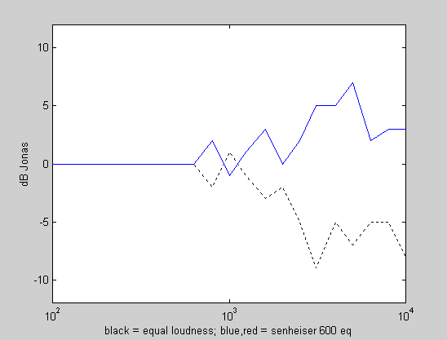
Jonas
Timbre Perceived
Correction Needed
Black is the personal equal loudness to a loudspeaker
Blue is the correction needed for the headphone
The timbre perceived is the inverse of the blue curve.

Slide 16
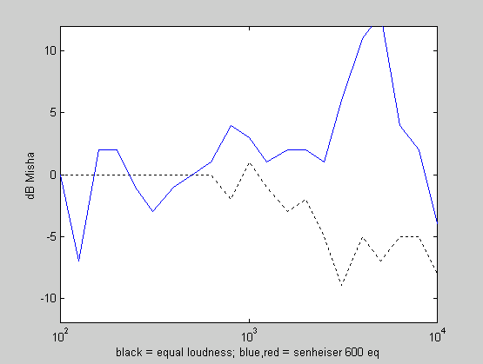
Misha
Timbre Perceived
Correction Needed
Black is the personal equal loudness to a loudspeaker
Blue is the correction needed for the headphone
The timbre perceived is the inverse of the blue curve.

Slide 17
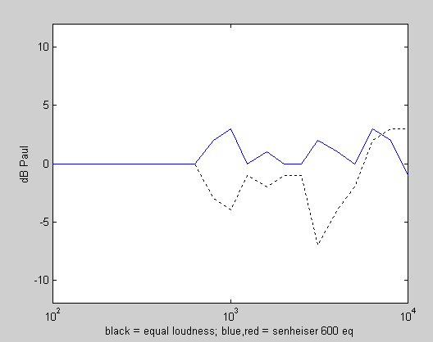
Paul
Timbre Perceived
Correction Needed
Black is the personal equal loudness to a loudspeaker
Blue is the correction needed for the headphone
The timbre perceived is the inverse of the blue curve.

Slide 18
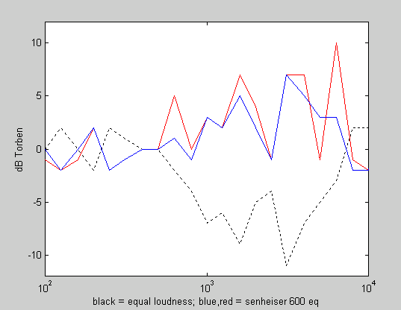
Torben
Timbre Perceived
Correction Needed
Black is the personal equal loudness to a loudspeaker
Blue is the correction needed for the headphone
The timbre perceived is the inverse of the blue curve.

Slide 19
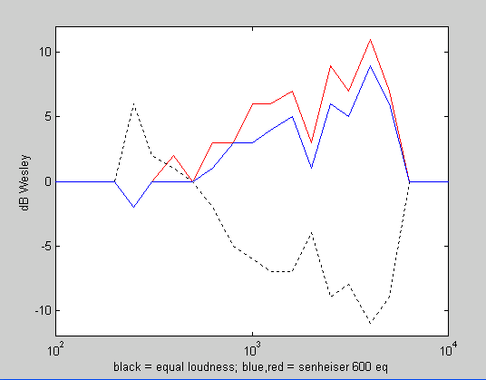
Wesley
Timbre Perceived
Correction Needed
Black is the personal equal loudness to a loudspeaker
Blue is the correction needed for the headphone
The timbre perceived is the inverse of the blue curve.

Slide 20
A comment on the last demonstration
In general, the equalization needed for the headphones in the previous slides is nearly the inverse of the individual’s equal loudness curve.
This means that the headphone is effectively damping their natural ear canal resonances.
The headphone equalization must replace the resonance that was damped if the individual is to perceive natural timbre and frontal localization.

Slide 21
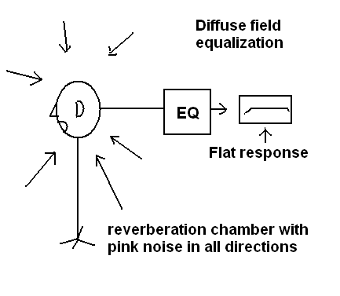
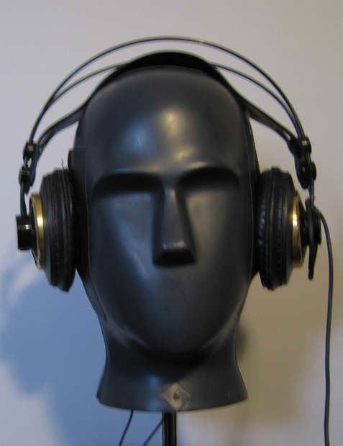
Theile – Spikofski
Spikofski at the IRT Munich promoted the idea of “diffuse field equalization” as the natural standard for both dummy head recording and headphone reproduction. The result was implemented in the Neumann KU-81 dummy microphone.
To equalize headphones, we put them on the equalized dummy, and adjust the headphone equalization until a flat response is achieved.
It does not work!
Check out the KU-81 pinna and couplers.
The ear canal is very different from yours.

Slide 22
But the method did not work for me! ☹
Theile published a comprehensive paper on the subject, which suggested that one could make an individual headphone calibration by putting a small microphone in the ear canal (partially blocking it) and then matching the headphones to a diffuse acoustic field.
But this also did not work. The resulting headphone equalization was far from natural, and unbalanced between the two ears.
Theile’s arguments seemed reasonable:
It should not be necessary to measure the sound pressure at the eardrum if one was only trying to match the sound pressure at the entrance of the ear canal to an external sound field.
Blocked ear canal measurements became an IEC standard for headphone calibration. But they still do not work

Slide 23
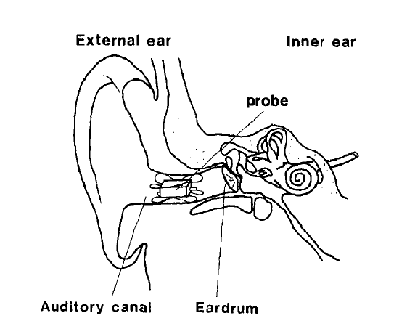
Theile’s method
Note that the ear canal is represented as a tube
It is not! It is a horn.

Slide 24
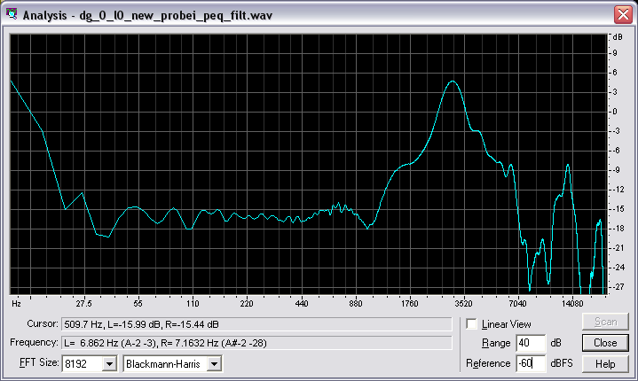
The author’s ear horn
An accurate cast of my ear horn all the way to the eardrum, and the 18dB boost at the eardrum it creates.
Ville Pulkki pointing to the mouth of the authors ear canal

Slide 25
Hammershoi and Moller
Hammershoi and Moller concluded that it was not necessary to measure at the eardrum because the entrance of the ear canal captured all the directional dependence.
But they say “The most immediate observation is that the variation [in sound transmission from the entrance of the ear canal to the eardrum] from subject to subject is rather high…The presence of individual differences has the consequence that for a certain frequency the transmission differs as much as 20dB between subjects.”
The directional dependence as measured at a blocked ear canal can be correct – But the timbre is so incorrect that our ability to perceive the true direction is frustrated.
(And the sound can be awful..)

Slide 26
A Convenient Untruth
The argument that absolute frequency response at the eardrum is unimportant for binaural reproduction is based in part on the perceived consistency of timbre for a sound source that slowly moves around a listener.
But perceiving timbre as independent of direction takes time. If a source moves rapidly around a listener large variations in timbre are audible.
The brain is uses fixed response maps to determine elevation and out-of-head impression.
It compensates for timbre at a later step.
Bottom Line: Accuracy of frequency response AT THE EARDRUM is essential for correct localization with binaural hearing.

Slide 27
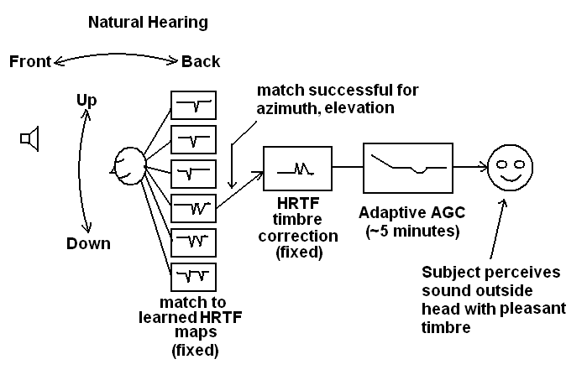
A simple model of human elevation detection
Over a long period of time the brain builds spectral maps of the features in HRTFs that define up/down and back/front information. When a sound is heard these features are compared to the maps, and a localization is found.

Slide 28
A simple model of human hearing-2
When a match has been found, the perceptible features of the particular HRTF are removed, again from a fixed spectral map.
But this spectrum is altered by an adaptive equalizer, which acts to make all frequency bands equally perceived. The time constant of this mechanism for the author is about 5 minutes. It may be shorter for some individuals.
This equalizer can correct for gross errors in timbre if given sufficient time.

Slide 29
An example
The features of this model can be verified through the time constants for the various sections.
The match to a particular direction is very fast.
The correction for the HRTF timbre takes longer – a fraction of a second.
The author once noticed a gliding whistle while walking under an overhead ventilator slot that emitted broadband noise.
Walking rapidly (~3.5mph) under that noise source produced a gliding whistle, somewhat like a Doppler shift.
This is the uncorrected sound of the vertical HRTFs
In spite of the lack of timbre correction the sound was correctly localized – even at much higher speeds.
No timbre shift was perceived when walking slowly under the slot (<2mph).
When there is sufficient time our brains correct the timbre – but this correction takes time.

Slide 30
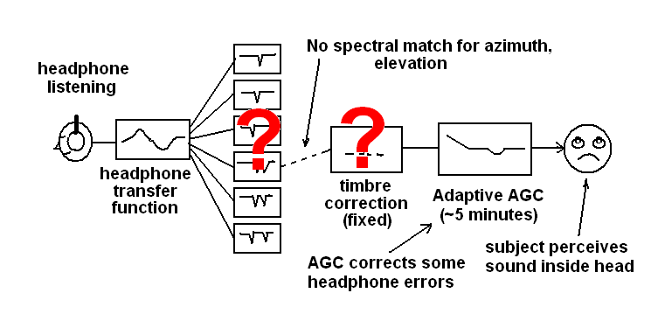
Headphone listening
When we listen to binaural recordings with headphones The brain is confused, and the subject perceives the sound inside the head. The adaptive equalizer is still active – after a time period the sound is perceived as frequency balanced.

Slide 31
Consequences of adaptation for sound engineers.
Tonmeisters talk about “being familiar” with a particular loudspeaker or studio.
They claim they can make an accurately balanced recording with these tools.
A logical conclusion is that the timbre of loudspeakers or playback equipment is irrelevant.
As long as you are “familiar” with it everything is fine.
The conclusion is clearly false.
A recent book by Floyd Toole details the changes in the frequency content of popular records as fashion in monitor loudspeakers changed.
All sound reinforcement engineers are aware of how much intelligibility can increase when a sound system is equalized. This typically involves a treble boost above 1000Hz.
Absolute frequency balance matters.

Slide 32
Headphone calibration through equal loudness contours
There is a non-invasive method of headphone calibration to an individual.
IEC publication 268-7 and German Standard DIN 45-619 recommend loudness comparison using 1/3 octave noise instead of physical measurement for headphones.
These recommendations were superseded by diffuse field measurements as suggested by Theile.
These methods be revived!

Slide 33
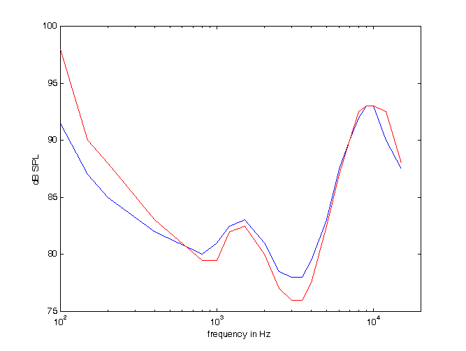
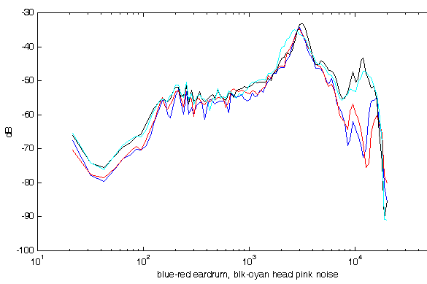
Equal Loudness
Top – ISO equal loudness curves for 80dB and 60dB SPL. These are the average from many individuals, so features in them are broadened.
Bottom – (blue/red) averaged frontal response over a +-5 degree cone in front of the author, measured at the eardrums. The loudspeaker was equalized to 200Hz.
Bottom - black/cyan – the same measurement for the author’s dummy head with no equalization. The difference in eardrum impedance above 8kHz boosts the response of the dummy – but this can be removed by equalization.

Slide 34
Equal Loudness 2
We can measure equal loudness curves because the ear does not adapt when the stimulus is narrow band – either noise or tone.
The differences between the top and bottom curves in the previous slide can be attributed to the properties of the middle ear and the inner ear.
Thus equal loudness curves are a method of measuring the effective frequency response an individual’s hearing system in the absence of short-term adaptation to the environment.
They represent our sensitivity to timbre in a quiet environment, or before adaptation takes place.
Their extreme lack of flatness is proof of the existence, and effectiveness, of adaptation.

Slide 35
Loudness matching experiments
The author wrote a Windows program that presents a subject with alternating bands of 1/3 octave noise, one at 500Hz, and the other at a test frequency
The subject matches the loudness of the two bands by adjusting the test band up and down.
The equal loudness curves from 500Hz to 12kHz for a carefully equalized frontal loudspeaker are obtained for this subject.
The subject then repeats the experiment with a pair of headphones over a frequency range of 30Hz to 12kHz.
In this case the balance between the two ears is also tested and corrected.
The difference of the loudspeaker and headphone measurements becomes the ideal headphone correction for this individual.
This program was used to test the variation in response of a few headphones for a wide range of individuals.

Slide 36
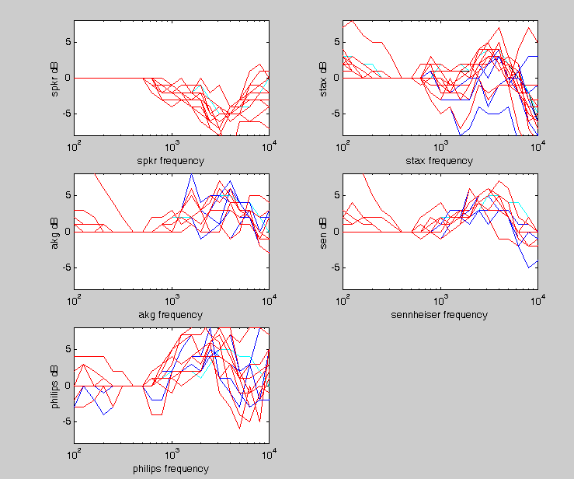
Results for ~10 individuals
About 10 students from Helsinki University participated in the test.
The top left graph shows the equal loudness contours from the loudspeaker for each subject.
The other curves show the difference between this curve and the equal loudness curves for four different headphones.
It was hoped that the Stax 303 phones would show less individual variation. This was not the case.
(blue = left ear, red = right cyan = author’s left ear)
The Philips phones were an insert type. These also showed large variation among individuals.

Slide 37
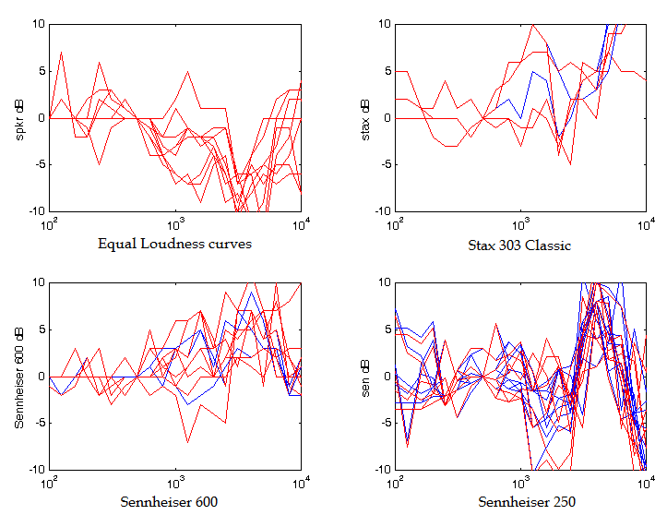
Similar data from RPI

Slide 38
Comments on these results.
The experiment is equivalent to equalizing headphones for a frontal, free-field response measured at the eardrum.
Natural sounds and loudspeaker equalized recordings are intended to be heard in a room where the direct sound is frontal, and dominant.
After individual equalization the author’s binaural recordings were perceived with frontal localization and accurate timbre.
They are beautiful and captivating. It is difficult to turn them off!

Slide 39
Conclusions
Human hearing uses a combination of fixed spectral maps to perceive the localization of a sound, and then corrects the HRTF timbre with a similar map.
The time constant for the directional match is milliseconds, the correction of timbre takes a fraction of a second
Ear canal resonances are both extremely individual and easily altered by headphones.
A universal headphone equalization does not exist
Head motion is NOT needed for frontal localization. Individual headphone equalization is necessary.
All headphones we have tested significantly alter the headphone resonances of our subjects. None meet the requirements of Theile and Moller.
Close fitting on-ear headphones and insert phones are potentially smoother in response, and can be stunning when equalized. Open circumaural phones never reach this quality, equalized or not.
Correctly equalized binaural recordings and individually equalized headphones can be a powerful tool for hall, opera and classroom acoustics.

