Slide 1
Optimizing loudness, clarity, and engagement in large and small spaces
David Griesinger
David Griesinger Acoustics
dgriesinger@verizon.net

Slide 2
Introduction
We will start with a quick review of the physics and physiology behind our perceptions of clarity and envelopment, and how room acoustics affect them.
We will present a series of “rules of thumb” based on this knowledge.
Followed by a series of real-world examples of spaces where these rules can be applied
Along with many sonic demonstrations.

Slide 3
Clarity and Envelopment
Clarity in this talk is a HIGH FREQUENCY phenomenon – 800Hz and above.
These frequencies carry information
Envelopment and reverberation are primarily beautiful at 500Hz and below,
with frequencies below 150Hz particularly important.
Understanding this frequency dependence is vital for understanding human hearing.

Slide 4
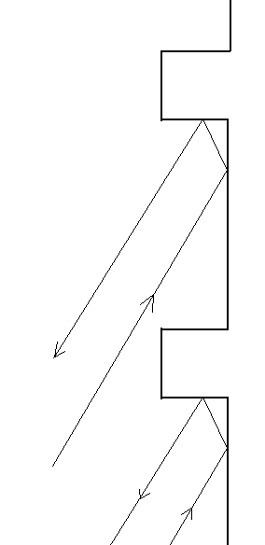
High frequency retro reflectors
Rectangular wall features scatter in three dimensions
High frequencies are reflected back to the stage and to the audience in the front of the hall where they are enjoyed and absorbed.
They are REMOVED from late reverberation – improving clarity for seats in the back of the hall.
Examples: Amsterdam, Boston, Vienna

Slide 5
High frequency overhead filters
A canopy of disks or panels is a high frequency filter.
Low frequencies pass through, exciting the full volume of the hall.
High frequencies are reflected down into the front audience, where they are absorbed.
In Tanglewood they reduce the HF reverberant level in the back of the hall, improving clarity. The sound is amazingly good, in spite of RT > 3s. (Ted Schultz)
In Davies Hall they make the sound in the dress circle and balcony clear and reverberant. But the sound in the stalls can be harsh and elevated.

Slide 6
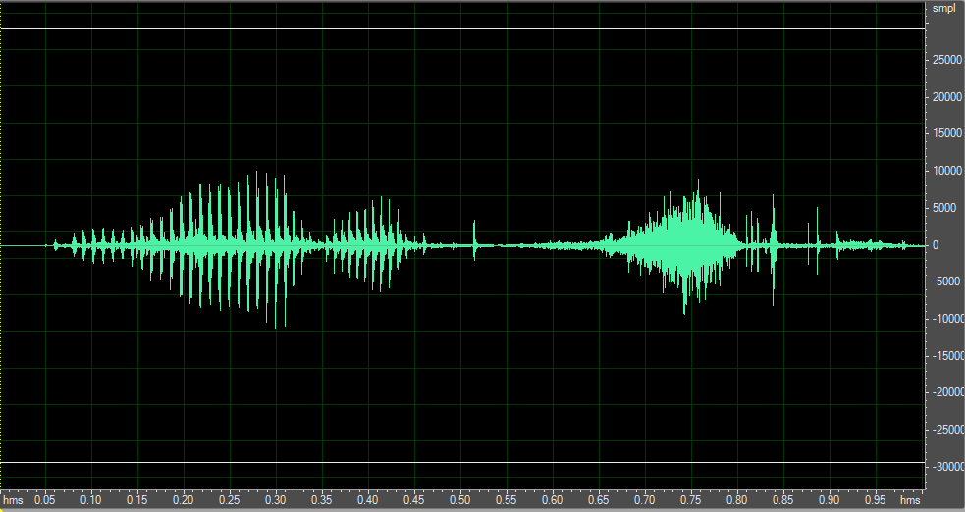
The upper frequencies in voiced speech cut through noise and reverberation
The syllable “one” voiced and then whispered, high-pass filtered at 1000Hz, with equal RMS level.

Slide 7
Voice and whisper in noise
The syllables “one” to “four” voiced and whispered as the previous slide, with pink noise.

Slide 8
Voiced speech in the formant bands has strong periodic peaks in the sound pressure.
The ear has evolved to efficiently detect these peaks.
But they are destroyed by excessive early reflections.

Slide 9
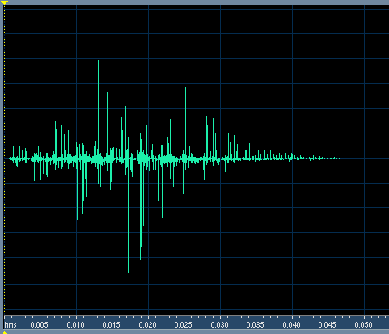
Example of Clarity for Speech
This impulse response has a C50 and C80 of infinity.
STI is 0.96, RASTI is 0.93, and it is flat in frequency.
In spite of high C50 and excellent STI, when this impulse is convolved with speech there is a severe loss in clarity. The sound is muddy and distant.
The sound is unclear because this IR randomizes the phase of harmonics above 1000Hz!!!
(Click for sound )

Slide 10
Once in every fundamental period the PHASE of the harmonics aligns to form a peak pressure.
Four phase-locked harmonics inside a critical band give a 6dB increase in signal to noise over a system that detects only one.
If this critical band is followed by a four tap autocorrelator there is another 6dB gain.
A 12 dB advantage in S/N is an enormous advantage to an organism!

Slide 11
JASA - J. C. R. Licklider 1951
Licklider proposed that our acuity of hearing could be explained by an autocorrelator located as close as possible to the hair cells.
Explaining our sense of pitch, and the rules of harmony.
This circuit exists – and it is directly below the hair cells.
Before signals are sent to the auditory nerve they have already been separated from each other by pitch.

Slide 12
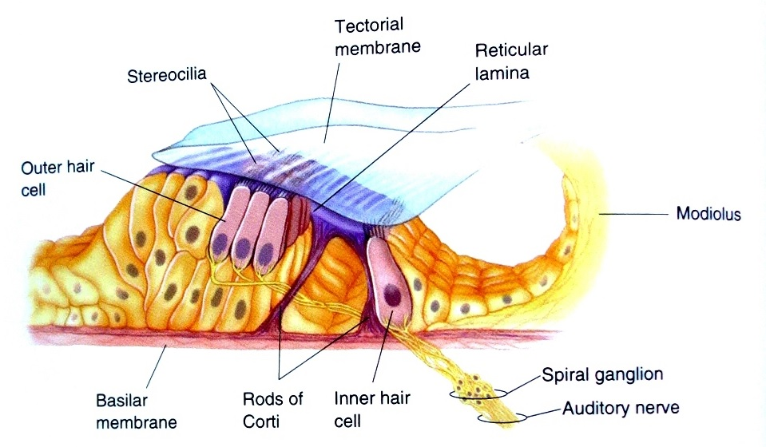
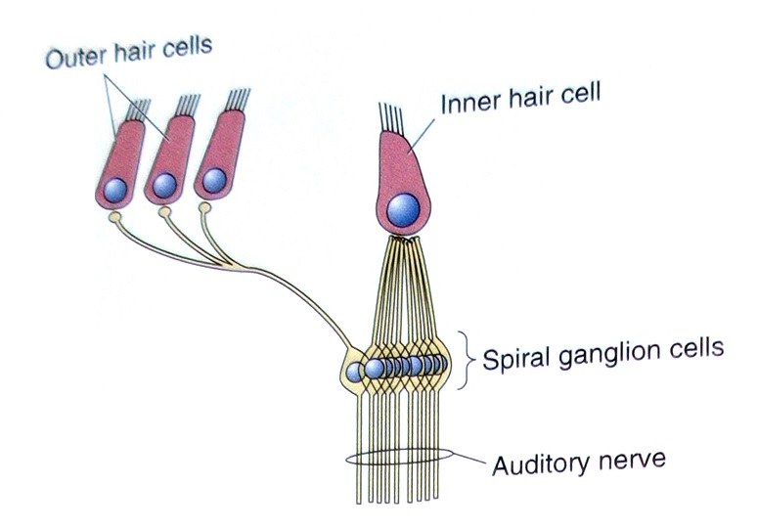
The Organ of Corti
Contains ~3000 inner hair cells, ~15,000 outer hair cells, and ~60,000 spiral ganglia. The inner hair cells detect basilar motion, the outer hair cells control the membrane sensitivity, and the spiral ganglia autocorrelate.
How do they work, and why are they needed?

Slide 13
The autocorrelator in the organ of Corti also enables source separation
Which is essential to surviving parties and enjoying polyphony.
We can separate two simultaneous talkers from each other if their vocal pitches are different by as little as half a semitone!
Without the peaks created by the phases of harmonic tones we cannot separate or localize these signals.
After separation by pitch
C and C# mixed

Slide 14
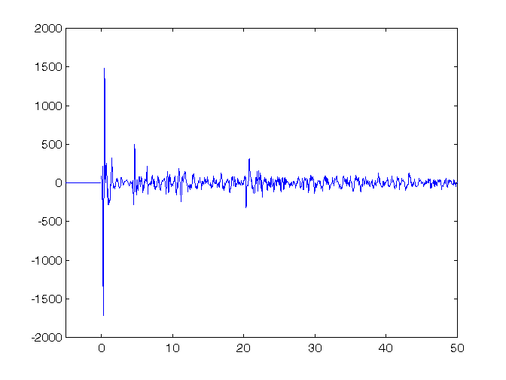
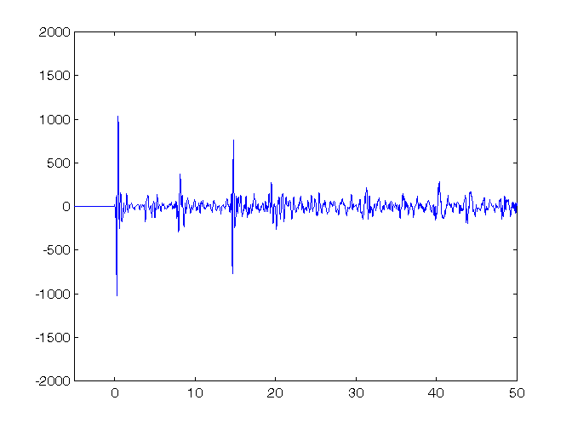
Clarity is the key to this talk
But we don’t know how to define it.
And current ISO measures fail to quantify it.
Binaural impulse from BSH row R seat 11 C80 = 0.85dB IACC80 = .68 LOC = 9.1dB
Same, Row DD, seat 11 C80=-0.21 IACC80 = 0.2 LOC = -1.2
Both C80 and IACC80 predict the opposite of what we hear!

Slide 15
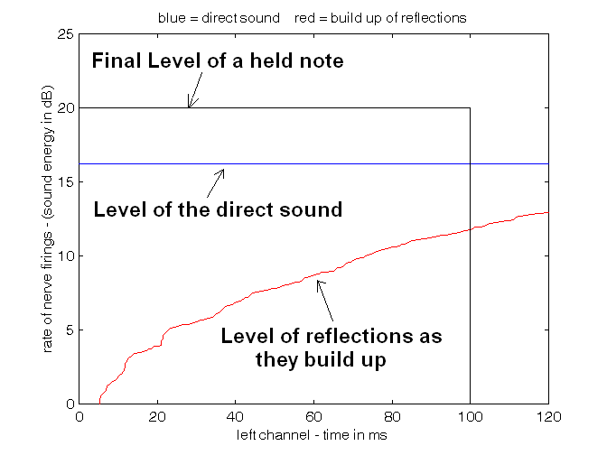
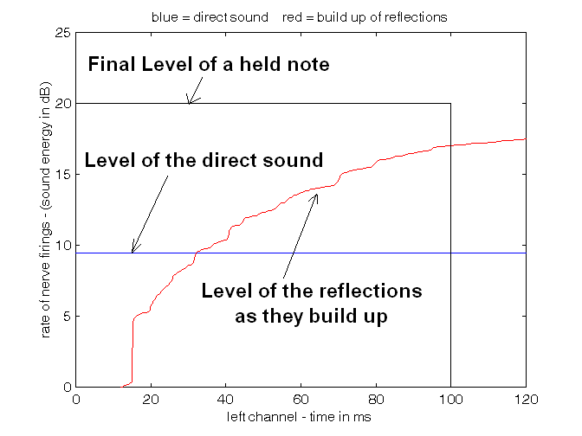
This is how the ear perceives these seats with music:
Boston Symphony Hall row R seat 11 The left channel of a binaural impulse response. LOC = 9.1dB
Same, row DD, seat 11. The final sound level is almost the same, but in this seat it is mostly reflections. LOC = -1.1dB
Note the window defined by the black box. We propose that if the area under the direct sound is greater than the area under the red line, the sound will be CLEAR. The ratio of these areas is LOC (in dB).

Slide 16
What does this mean in practice?
Early reflections are desirable – but we must know when they become excessive!
We want the direct sound to be audible!
The ear logarithmically sums early reflections inside an 80ms window to detect the direct sound.
The earlier a reflection arrives the more it contributes to masking the direct sound.
Too many and the direct sound becomes inaudible.

Slide 17
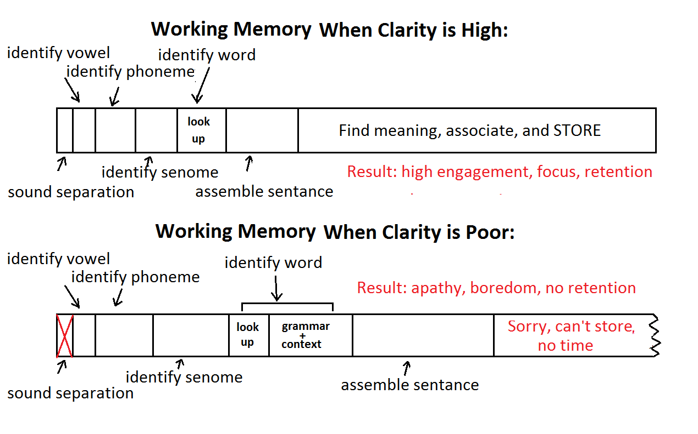
Classrooms to opera: where working memory is limited and clarity is essential.

Slide 18
We also need loudness
First-order reflections almost never contribute to loudness
And when they do, the effect is usually undesirable.
In almost any large hall high order reflections dominate the loudness
But the brief appearance of the direct sound at the onsets of notes determines clarity
Loudness is unchanged if we delete the early reflection at 15ms, and the Clarity improves markedly.
Boston Symphony would be an even better hall if this reflection was eliminated!
Boston row DD, seat 11

Slide 19
Envelopment
Envelopment is a perception.
It depends on how the brain interprets sound streams, not only by the spatial properties of the reverberation!
Envelopment is perceived when the ear and brain can detect TWO separate streams:
A foreground stream of direct sound.
And a background stream of reverberation.
Both streams must be present if sound is perceived as enveloping.
In the rear of most halls there is only one stream, combining foreground and background.
The sound is frontal and muddy.
Envelopment requires High Frequency Clarity, and Low Frequency Glate

Slide 20
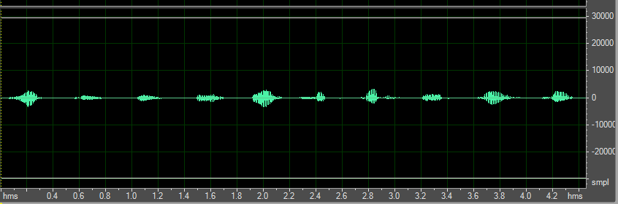
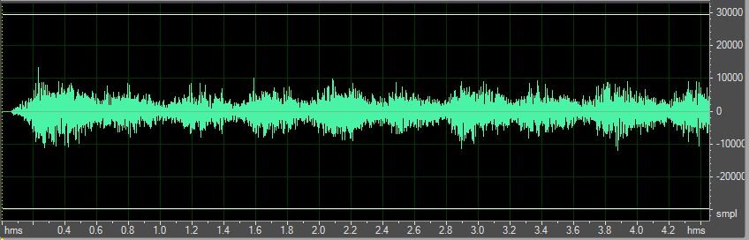
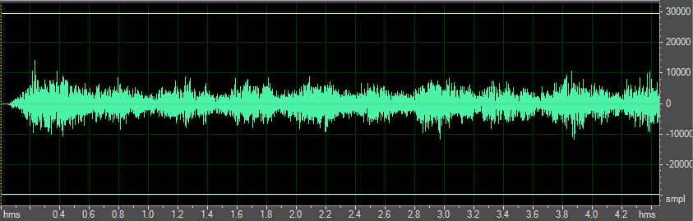
Boston row R seat 11
Direct sound only
Reverb only
Direct and Reverb
mono

Slide 21
Envelopment depends on Glate,
In too many halls nearly all the first-order reflections are directed to the audience, where they are absorbed.
There is too little energy left over for reverberance.
In seats close to the orchestra a few lateral reflections are desirable, but reflections from above are not helpful.
In seats farther away loudness is dominated by multiple reflections. Strong medial reflections only reduce clarity and envelopment.

Slide 22
What causes Clarity and Envelopment to fail?
Clarity and envelopment fail three ways:
1. Too many early reflections randomize phases at the onsets of sounds.
Solution: Use LOC or live speech measures to find where seats fail.
2. Reverberation from a previous sound masks the onset of a succeeding sound.
Solution: Control the RT and reverb level to match the music.
3. Upward masking from excessive low frequencies masks vocal formants..
Solution: Control bass boom!
World Class Acoustics depends on minimizing all these problems!

Slide 23
Rule of thumb #0
Instruments radiate forward, voices radiate forward, and 1000 years of performance practice dictates that audience and performers should face each other.
Live performances live by human contact between performers and audience.
You need to be able to see faces and fingers.
Putting audience behind the performers breaks this essential aspect of the experience.
Do not put audience behind the performers!

Slide 24
Rule of thumb #1
Make the direct sound audible:
Bring the audience close to the performers
Enhance early lateral reflections in the front of the hall while limiting or eliminating the earliest reflections in the rear of the hall.
Rectangular niches and coffers can do this without absorption.
Control masking from excessive RT in smaller venues by reducing the reverberant level, not necessarily the RT.
The traditional absorptive stage house is underutilized in modern designs.
Audible direct sound is particularly important in Classrooms!
An early reflection coming within 5ms of the teacher aids clarity – but anything later than 8ms reduces it.

Slide 25
Rule of thumb #2
Maximize Glate without compromising clarity.
Modern designs use reflective surfaces to direct the first order reflections down into the audience.
This energy is absorbed. It reduces clarity, and does not contribute to late reverberation or envelopment.
So: Maximize the number of surfaces that can direct sound into regions where it bounces around before hitting people.
This will increase Glate while increasing clarity and preserving loudness.
Bare walls above the audience will contribute to late G by giving sound some space to relax before it comes down.
The walls need to have just the right amount of diffusion

Slide 26
Rule of thumb #3
Maximize the clarity and visual coherence of sound reinforcement
Reproducing sound through multiple sources reduces clarity.
Ideally a single loudspeaker should be within five feet of the talker unless the reinforcement is much louder than the natural sound.
But almost always the visual-audio connection is lost.
When reinforcing an ensemble do not combine multiple performers into a single speaker.
The usual practice of mixing to mono and reproducing through multiple speakers is disastrous to clarity.
Use directive loudspeakers with linear phase response from 800Hz to 4kHz wherever possible.

Slide 27
Rule of thumb #4
Control reverberation in the stage house
Multiple reflections inside the stage house reduce clarity.
They eliminate clarity before the sound can escape, and make it hard for musicians to hear each other.
Avery Fisher hall shows what not to do!
First order reflections from the stage should go out into the hall
preferably into areas where they contribute to late reverberation.
Good examples: Stage houses in Boston, Vienna, and Amsterdam

Slide 28
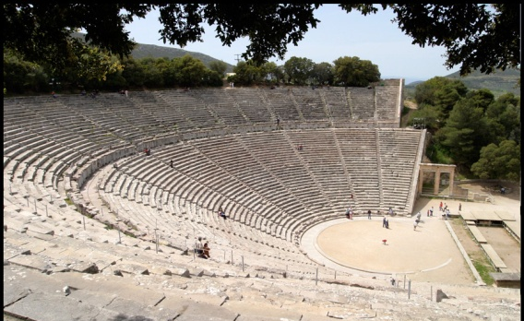
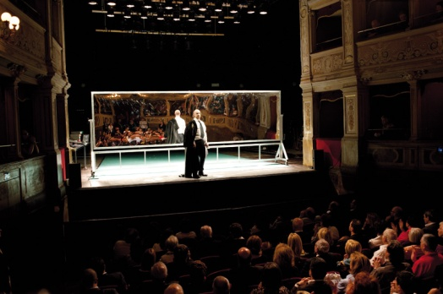
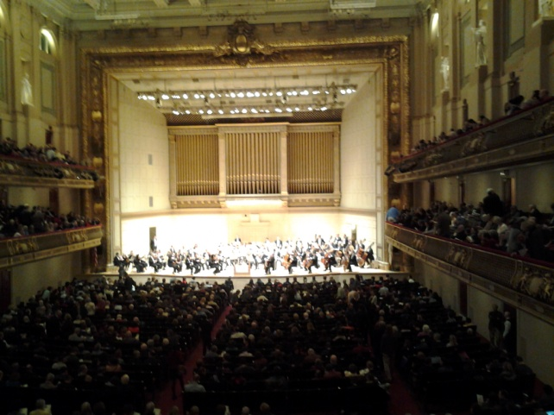
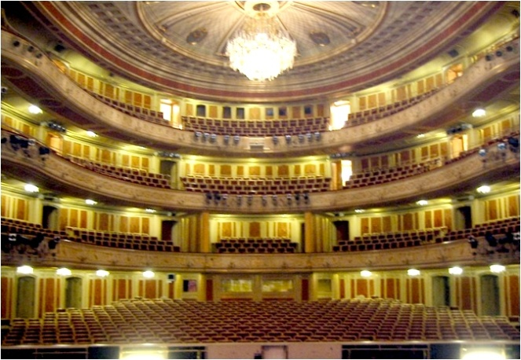
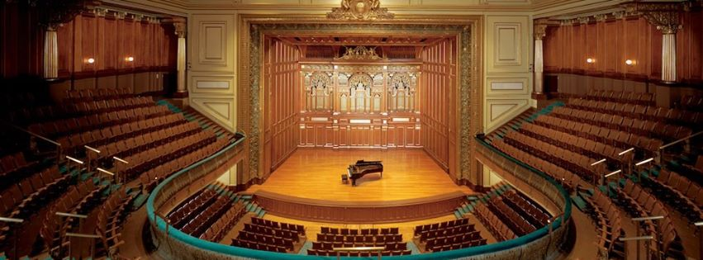
Examples of Excellent Venues
Epidaurus: D/R ~+4dB Spoleto: Teatro Caio Melisso: > 15,000 seats, Clarity A+ Festival dei Due Mondi
Front row first balcony Boston Symphony Hall. ~2700 seats D/R < -10dB, Clarity A+
(N. F. Declercq)
~350 seats, D/R > 0, A+
after and before renovation
Staatsoper Berlin Jordan Hall, New England Conservatory 1500 seats, A+ acoustics 1200 seats A- acoustics

Slide 29
Epidaurus
Analyzed by N. F. Declercq ,15,000 seats D/R +4dB, Clarity excellent.
The low level of reverberation comes from seats and listeners sitting behind you.
The D/R of +4dB is identical to the D/R in almost all commercial recordings.
The performers receive just the right amount of late reverberation back from the audience.

Slide 30
Spoleto: Teatro Caio Melisso
~350 seats. Built in the 17th century, rebuilt in the 19th century.
Audience close to the performers
Stage house relatively absorbent
Late reverberation provided by high ceilings above the audience
Scott Nickrenz, the music director of the Festival dei Due Mondi proclaims this as the ideal venue for chamber music of all forms.

Slide 31
Boston Symphony Hall
Not every seat is superb, as much of the audience is too distant. But every seat in this picture is spectacular.
The high coffered ceiling directs high frequencies to the front of the hall, increasing clarity in the rear.
The stage house is wide, shallow, high, sharply angled outward, and much of the back surface is absorbent.
Articulated parallel surfaces above the balconies maximize Glate.

Slide 32
Staatsoper Berlin
1500 seats, RT ~1s, Clarity excellent.
20 years ago we added a Lares system that raised the RT at low frequencies to 1.7s, while limiting the RT and the reverberant level above 500Hz.
The system preserved the clarity while providing loudness and richness to the orchestra, and has been used (secretly) in every performance since.

Slide 33
Jordan Hall, New England Conservatory
A world renowned 1000 seat chamber music hall.
Theater design brings audience close to the performers.
High ceiling adds late reverberation.
Clarity is excellent in almost all seats if the musicians are on the forestage.
The stage house is problematic, too deep, too reverberant. But this is still one of the finest small halls I know.
The hall sounded better in its original configuration, with a 460 square foot absorptive curtain above the proscenium.

Slide 34
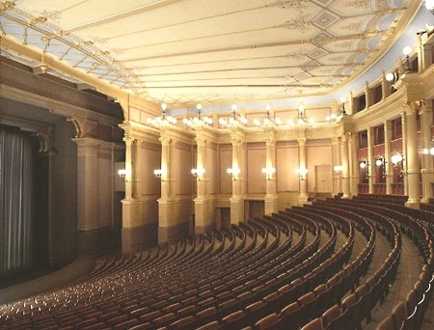
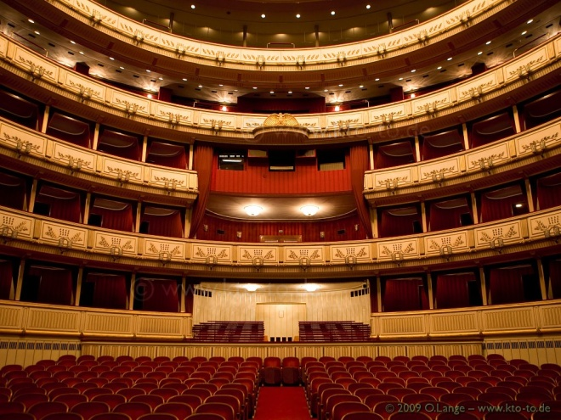
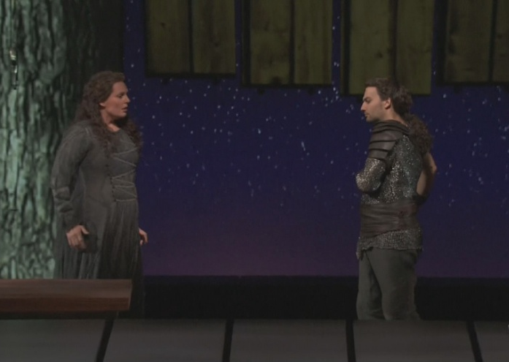
Opera Houses that work
Bayreuth Vienna Your local multiplex
Bring the audience close to the performers
Limit the reverberant level to not obscure the words and the direct sound.
Have a long and distinguished history.
Opera was made for these houses.

Slide 35
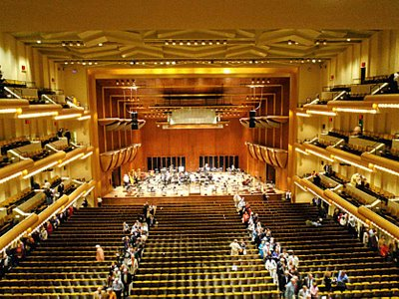
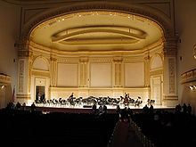
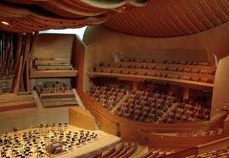
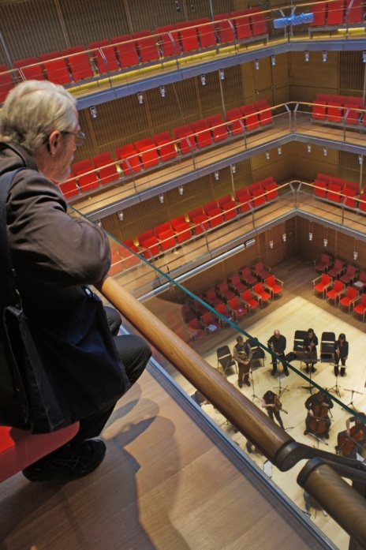
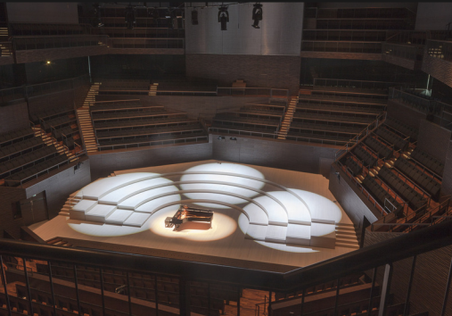
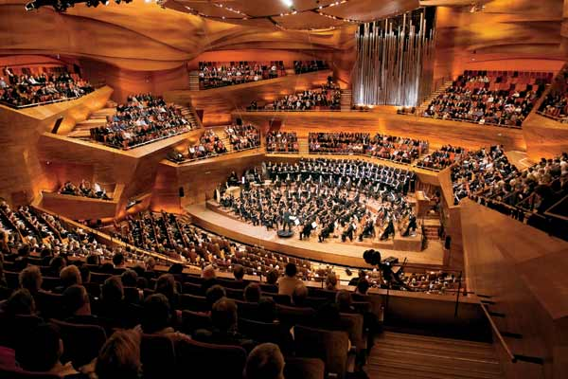
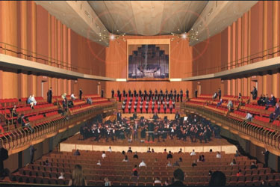
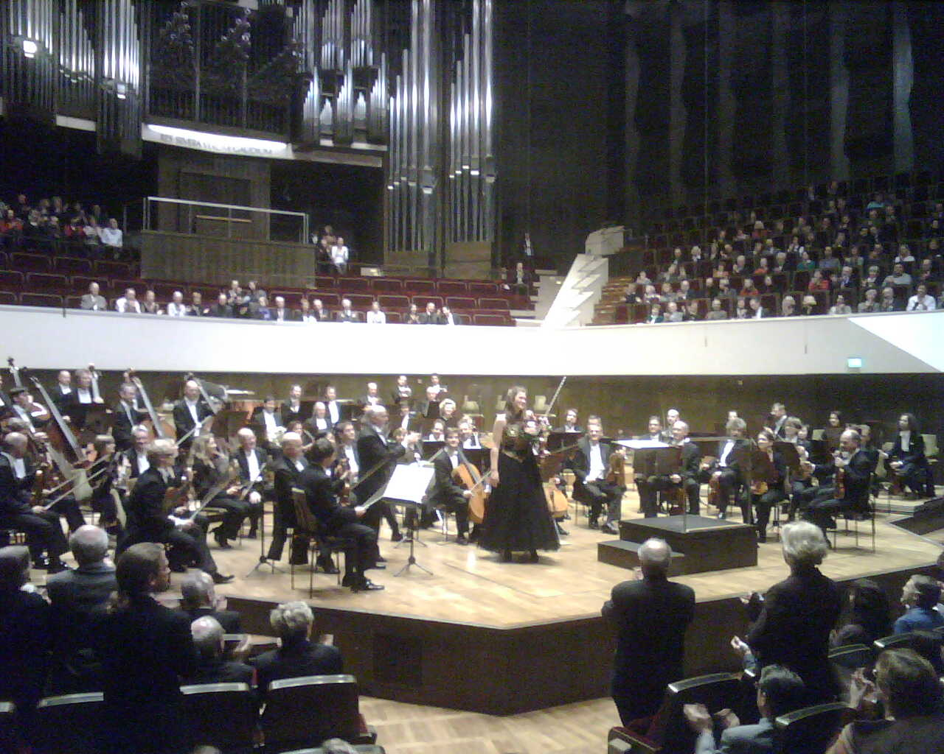
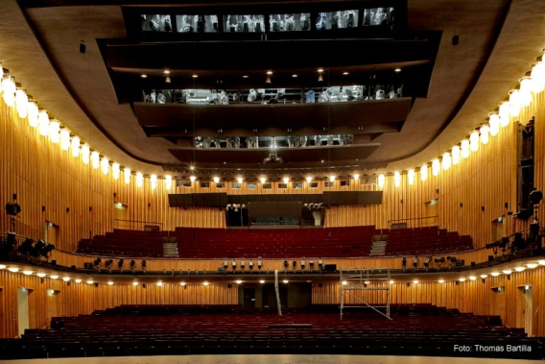
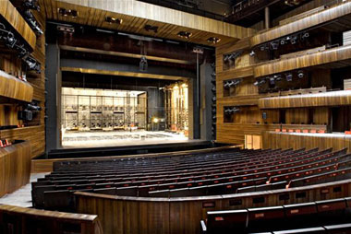
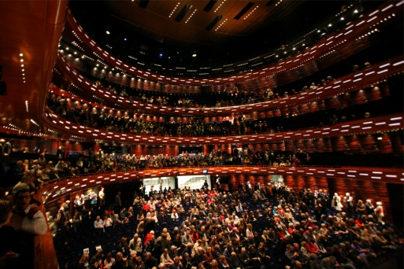
But in spite of 100 years of acoustic science the majority of new halls, opera houses, and lecture rooms are sonically mediocre. With eyes closed the sound is weak, muddy, or both. Too much audience is behind the musicians, and many instruments cannot be heard. In modern opera houses the words are mostly inaudible.

Slide 36
Too much audience behind the performers
All these halls violate Rule of thumb #0
And all have poor loudness and low late G

Slide 37
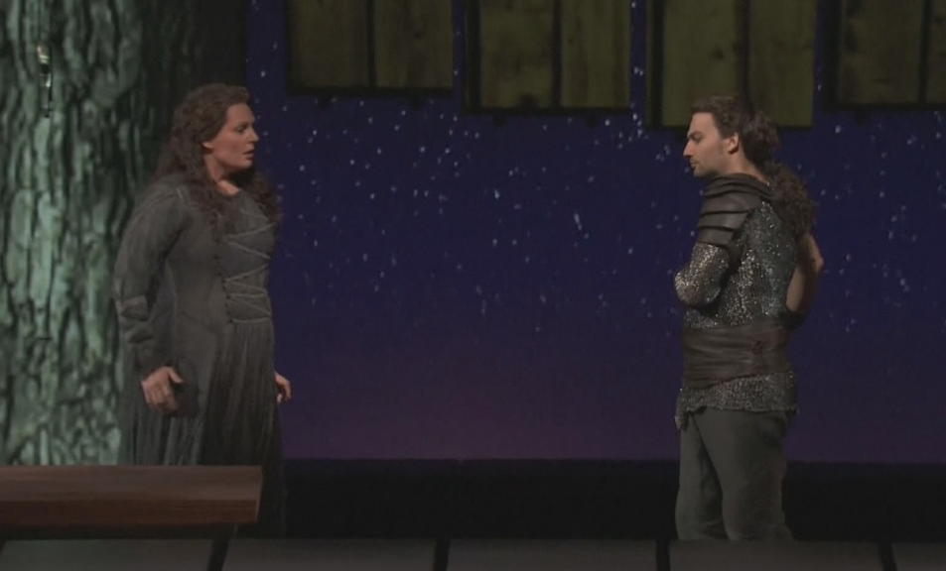
An opera without words is just a silent movie.
Oslo – front second balcony B-
Oslo – standing room A
Schiller Theater – (Staatsoper) Front of balcony B- (C- further back)
Staatsoper Berlin, back of stalls, Sound very good – ( A )
Copenhagen, middle of stalls, C-
Walkure in HD – middle of theater sound A+

Slide 38
Calderwood Hall, Boston
Scott Nickrenz had requested that the new hall resemble the Teatro Caio Melisso. This is what he got.
Half the audience is behind the musicians.
There is a glass window that prevents anyone in the balconies from hearing the direct sound unless they lean uncomfortably over the rail.
At which point vertigo sets in.
Women in the balconies should not wear dresses.

Slide 39
Carnegie Hall
Suffered greatly when the proscenium curtain and the stage fabric was removed.
The sound is now over-bright, muddy in many places
And often with disturbing echoes.
The old curtain and stage fabric eliminated the echoes, increased the D/R, and made the sound warmer and richer.
Sigh…

Slide 40
Avery Fisher
The stage house is too large, too deep, and too reverberant. Instruments not on the forestage are muddy before anyone hears them.
The ceiling is flat and not coffered.
The balcony fronts increase the early reflections in the rear of the hall, just where the reflections should be reduced.
Clarity is poor or non-existent for seats more than 1/3 of the way back.
It is apparently going to be rebuilt, but with current practice it is unlikely to sound better.

Slide 41
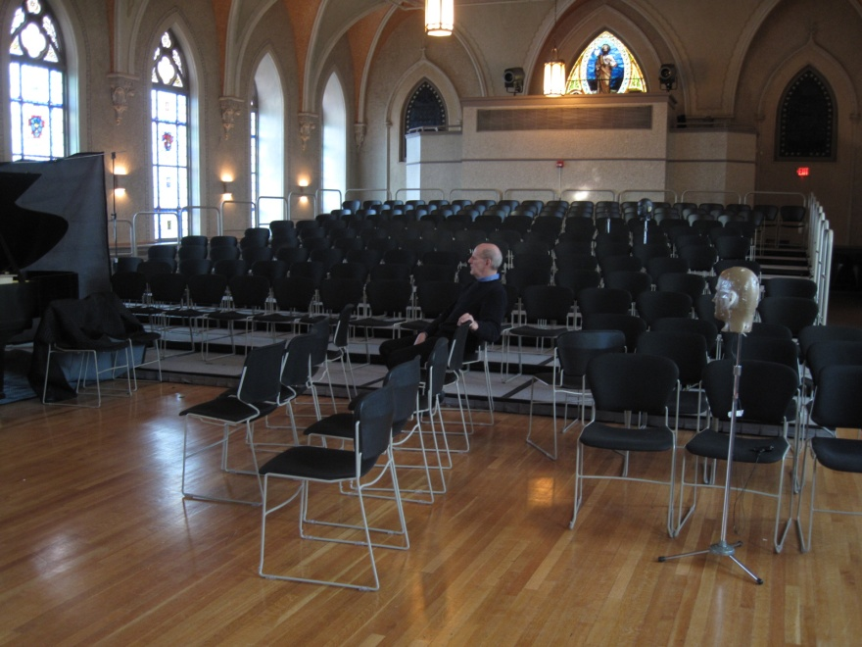
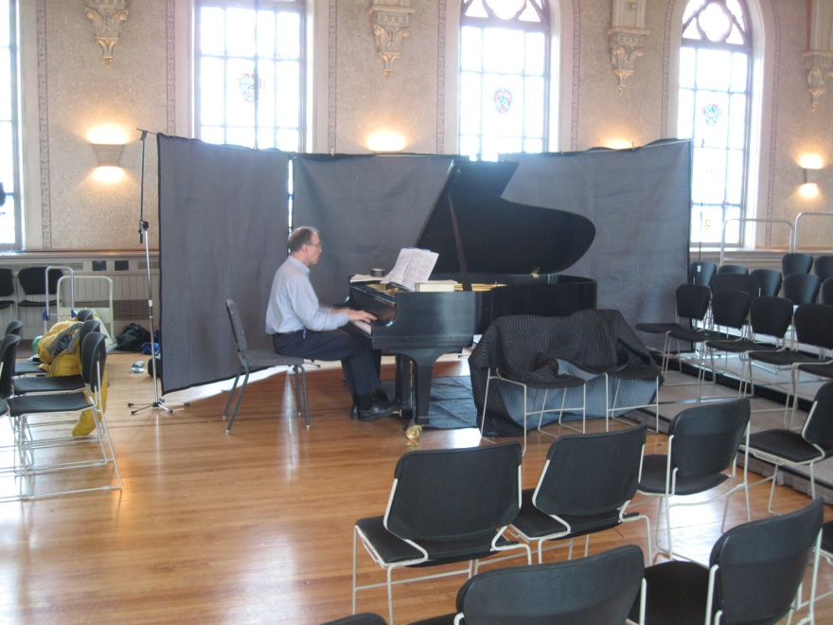
What can we do?
Bring the audience closer to the musicians
In a long high ceilinged shoebox with an RT of over 2 seconds, we recommended putting the musicians in the center of the long wall, and adding absorption behind them. There was a dramatic improvement.

Slide 42
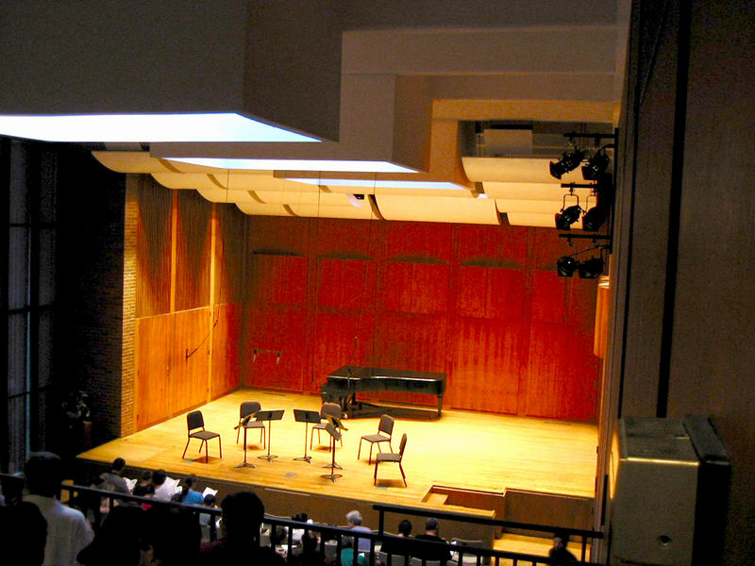
Add absorption to existing stage houses
Absorptive panels around the back of this stage transformed this hall from muddy to a delightful place for chamber performance.

Slide 43
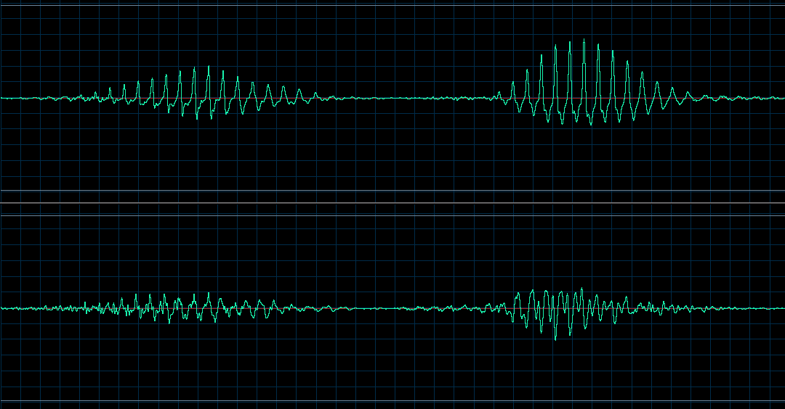
Try out my measure that quantifies Clarity from live speech using a model of hearing
Signal at the output of a 4 tap correlator.
Same but with randomized phase.
The difference in peak amplitude of these two signals can be used as a real-time measure of clarity.

Slide 44
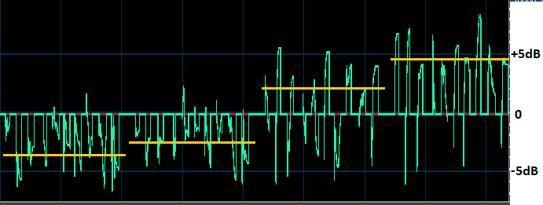
Example: The numbers 1 to 10 repeated four times with increasing clarity.
All the sequences have C50 = infinity and STI > 96.
Click for sound

Slide 45
Measured Clarity in a Classroom
Harvard Science Center C: ~200 sharply raked seats. Large muticellular horn speaker.
Students in the rear were chatting to each other and playing with their smart phones. Why?

Slide 46
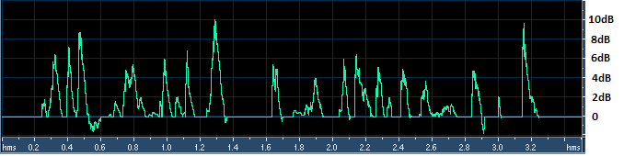
Results: Clarity ratios with live speech
Clarity with no microphone in the front of the hall.
In the rear of the hall with no microphone.
In the front of the hall with the microphone.
In the rear with the microphone. Amplification reduces clarity.

Slide 47
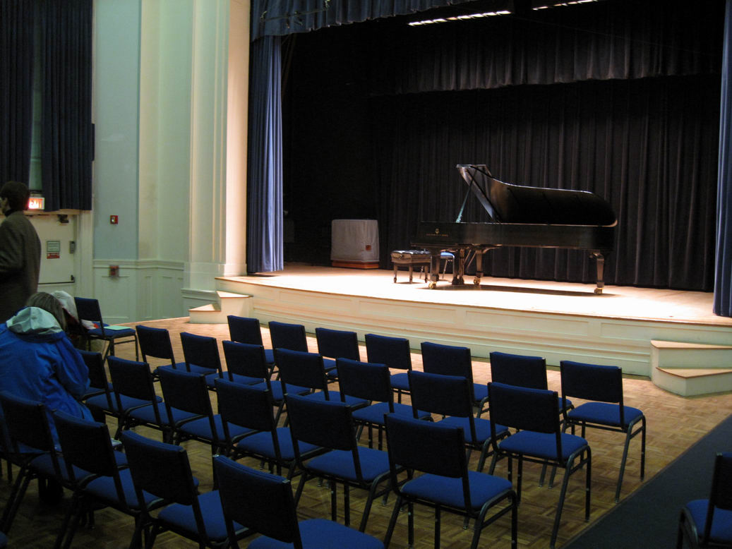
Don’t forget about stage curtains
Williams Hall at New England Conservatory has ~300 seats and is very reverberant.
But piano performance is beautiful because of the absorbent stage.

Slide 48
Conclusions
ISO3382 analyses for Clarity are based on obsolete theories of hearing. The evolution of the ear and brain demands that the direct sound be audible.
Current hall designs are turning live performances into spectacles for tourists, driving audiences to movies and recordings.
Current classroom design and sound reinforcement strive for loudness over engagement, understanding, and remembering.
The ancient Greeks knew better.

Slide 49
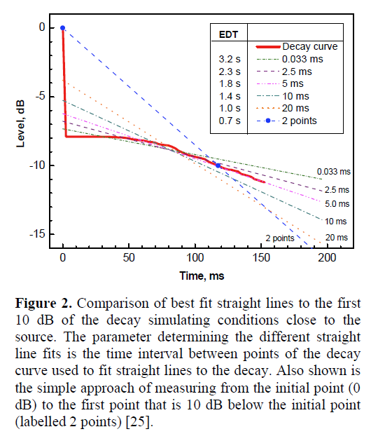
John Bradley’s critique of EDT
Jordan’s original definition of EDT used two points. He thought of EDT as a method of determining the direct to reverberant ratio (D/R).
Schroeder misunderstood the purpose of the measure, and re-defined it using linear regression. As currently used EDT ignores the direct sound.
EDT is a widely quoted international standard. It is not at all clear what it means perceptually, as the earliest reflections are bound to the direct sound.

