Slide 1
LOCALIZATION, LOUDNESS, AND PROXIMITY
D Griesinger
David Griesinger Acoustics, Cambridge, Massachusetts USA
www.davidgriesinger.com

Slide 2
We have heard a lot about the sound of halls. Where is the Music?
This talk is about how we perceive music as separate from the hall.
And the vital importance of stream separation by pitch in the human ability to perceive information from sound.
And why pitch based stream separation abruptly fails at a the Limit of localization distance – the LLD.
And about LOC, a measure that predicts from a binaural impulse response where the LLD will be found.

Slide 3
The ability to localize a sound depends on detecting the direct sound, which alone carries the ITD and ILD.
Detecting the direct sound enables localization and proximity.
If a sound is perceived as close our attention is involuntarily drawn to it.
Separating the direct sound of a source from interference and reverberation is a problem that evolution has spent millions of years learning to solve!

Slide 4
Sounds that are close and precisely localized attract attention!
Drama directors have known this for centuries.
Cinema and opera directors demand that characters sound close to the listeners.
Experiments in lecture rooms show that students acoustically close to a teacher get better grades.
The ability to separate sounds into independent neural streams has been studied by hearing scientists, but has been neglected by acoustic science.
In most rooms there is a distinct distance from sound sources where localization abruptly fails. We have named this the “Limit of Localization Distance” or LLD.

Slide 5
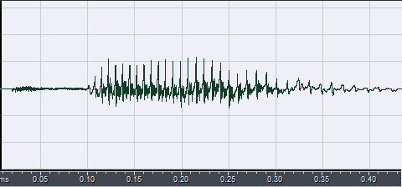
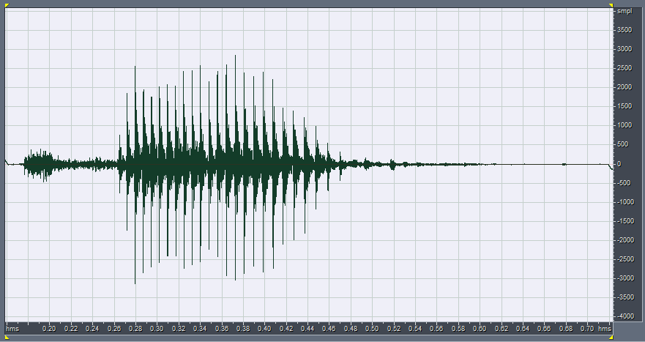
How does the ear and brain separate direct sound from reflections, and when does the ability fail?
Localizing sound is critically dependent on auditory stream separation. Fine summaries of this work can be found in:
  Andrew J. Oxenham PMID: 18974203 and in Josupeit & Hohmann, JASA 142, 35 (2017)
Separation by pitch is a critical aspect of stream separation. It depends on amplitude pulses.
The information in both speech and music is encoded in the upper harmonics of a fundamental frequency, and both have amplitude waveforms that contain sharp pulses. These pulses are created by the harmonic phases.
An autocorrelator or comb filter tuned to the fundamental frequency of these pulses can separate a particular sound from other sounds and from noise.
But the pitch must be accurate, ideally to about 0.3%, the human JND for the pitch of harmonic tones.
“Ten” at frequencies below 1000Hz “Ten” at frequencies above 1000Hz

Slide 6
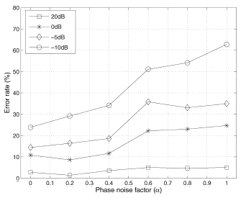
The importance of phase
Aarabi et al studied the effect of altering the phases of the upper harmonics of speech on the intelligibility of words in noise.
He replaced the original phases of spoken words with a random variable that varied from zero to +- pi.
When the mix was half original and half random the error rate more than doubled for all levels of noise.
His experiments verify our findings that the phases of the upper harmonics of speech (and music) are vital to our abilities to separate signals from noise.
There is a distinct point where phase distortion causes separation to suddenly fail.

Slide 7
Sound streaming and the background stream
Successfully separated sources form multiple “foreground” streams.
  We can consciously follow at least three at the same time, but can switch to others at will.
Sounds that cannot be localized or separated form a single stream with special properties; the “background stream.”
  The background stream is perceived as distinctly separate from the foreground streams, and is often perceived as fully surrounding.
When there are no localized foreground streams all the sound we hear is perceived as a single foreground stream.
  We can hear directional properties. For example, In concert halls the sound with eyes closed is mostly somewhat elevated and in front. With eyes open we see the musicians in front, and hear them in front.
We believe that too much hall research focuses on the sound of halls with eyes open and in seats where you cannot hear the instruments distinctly.

Slide 8
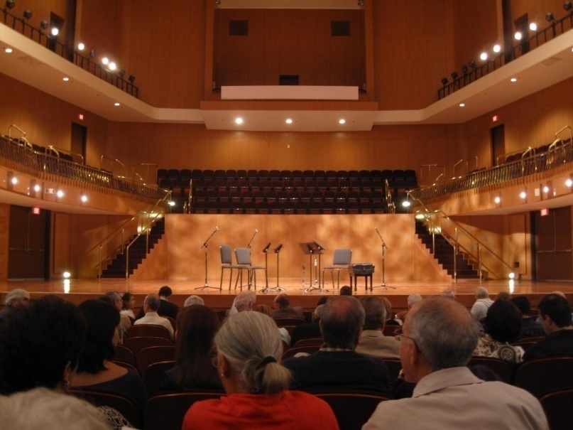

We can demonstrate the LLD and foreground streams with binaural recordings
With eyes open the sound in both seats is perceived as similar. But the brain knows the difference. The sound in row K is less exciting, and easier to forget.
A binaural recording of a string quartet from this seat in Row F. The sound reverberant but clear and present
A binaural recording directly behind in Row K
The sound is distant and mushy.
Row K is just five rows farther back. But the ear can no longer detect the direct sound. All you can hear is reverberation.
Row K is behind the LLD!

Slide 9
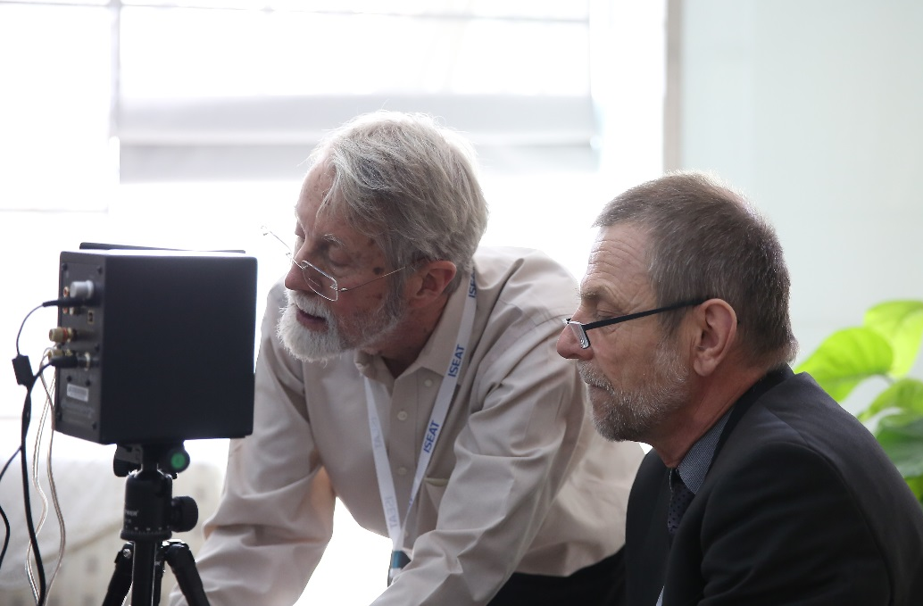
Binaural playback reveals another difference
When we play these recordings with crosstalk cancellation or earphones individually equalized at the eardrum we can hear the dramatic difference in the envelopment of the hall when we switch from row F to row K.
  When the direct sounds are audible the hall impression is strong and enveloping.
  When localization fails the sound is all reflections, and is perceived as mostly in front of the listener.
You can easily hear this this difference with our binaural recordings and crosstalk cancellation.
We have made a Windows app that cancels the crosstalk from two loudspeakers, creating virtual sound sources directly at a listener’s ears. You are instantly transported to the halls in our recordings.
You are welcome to ask for the software.

Slide 10
Summary: Envelopment and the background stream
Proximity is perceived when sounds can be localized.
Sounds that can be localized are grouped by direction and timbre into one or more “Foreground Streams”
When there are foreground streams reverberation and sounds that cannot be individually localized blend together to form a single “Background Stream.”
  The background stream is perceived as distinctly separate from the direct sound, and is loud and enveloping. It fully surrounds the listener.
This is the sound we call “Envelopment”. Seats beyond the LLD are reverberant but not really enveloping.
When there are NO individually localizable sounds the whole scene forms a single stream – a diffuse foreground stream. It is around the listener, but mostly frontal.
  We can perceive the directional properties of this stream. This is the sound that has been studied in most concert halls.

Slide 11
Reverberation is a special type of masker
It is the regular periodic pulses in the amplitude waveform that distinguishes the direct sound component from the reflections that follow.
We need to construct acoustic measurements that predict in what seats localization will be possible.
How can we make such measures?

Slide 12
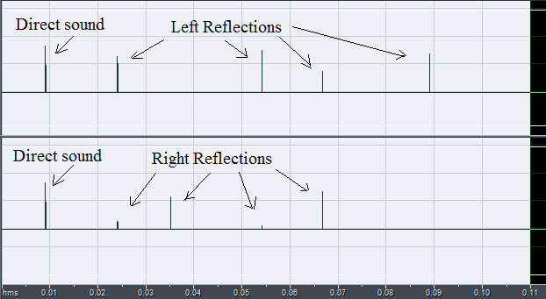
Impulse responses are misleading!
Here is an impulse response created more or less randomly.
  Direct sound is followed by five reflections from different directions.
The graph looks very simple. You can see the direct sound as separate.
But this is not what the ear hears!
Impulse in the left ear
Impulse in the right ear

Slide 13
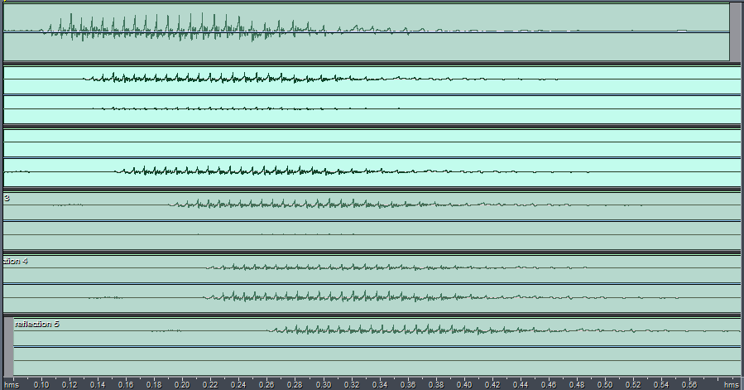
The ear receives each reflection as a delayed copy of the original
Each reflection creates a delayed stream of sound that adds to the total loudness, but reduces our ability to localize the source. This picture shows each component.
Detecting the ITD and ILD of the direct sound takes time. Your need to detect about five of the amplitude pulses to localize the sound.
This picture separates each reflection into tracks that are summed to make the sound we hear.
The direct sound is in the top track. You can easily see the amplitude pulses that make source separation possible.
As reflections arrive from different directions the loudness increases,
but the added reflections randomize the amplitude pulses of the direct sound. The direction information may be lost.

Slide 14
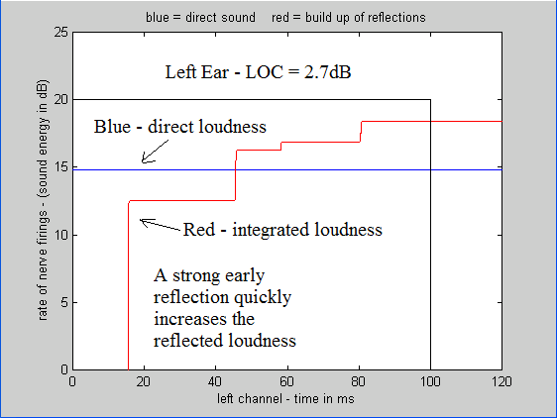
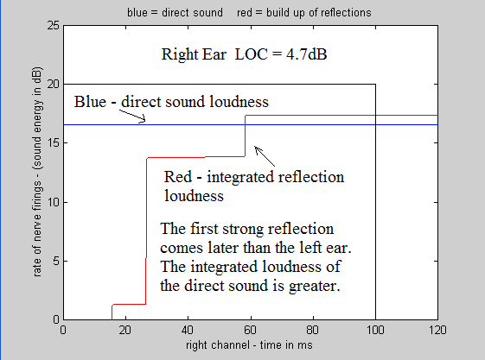
The ear integrates LOUDNESS, not pressure
If we want to know how the ear hears the direct sound in the presence of reflections we need to plot the integrated LOUDNESS of direct sound versus the integrated LOUDNESS of the reflections. I say loudness because the ear responds to the logarithm of pressure, not the pressure.
  Our measure for localizing the direct sound, LOC, separately plots the loudness of the direct sound and the build up of the reflections above 1000Hz inside a 100ms window.
  The loudness – the integrated neural activity – of the direct sound is given by the area under the blue line inside the black window. Similarly, the loudness of the reflections is given by the area under the red curve inside the black window. LOC is the ratio of the direct sound area to the reflection area in decibels.
  LOC predicts the direct sound in our test example will be just barely localized (with male speech.) It is.

Slide 15
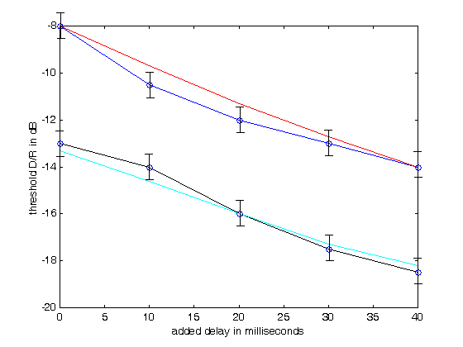
LOC was developed from a data set of male speech in a field of decaying three dimensional reverberation.
Reverberation times of 1 second and 2 seconds were tested with five different pre-delays
Data for the threshold of localization as a function of pre-delay and reverberation time was obtained from students in Helsinki and Japan.
The blue curve shows the D/R of the threshold of localization for a 1 second RT. The black curve shows the threshold for a 2 second RT.
The red and cyan curves show the prediction by LOC.

Slide 16
LOC was developed to predict localization of male speech with pauses between each word.
The source – male speech – is special:
  1. The source has strong low frequency periodic pulses.
  2. The onsets of each syllable are relatively abrupt.
  3. The pauses between each word limit the masking of the onset of following words by reverberation from previous words.
Does LOC work with other sounds?

Slide 17
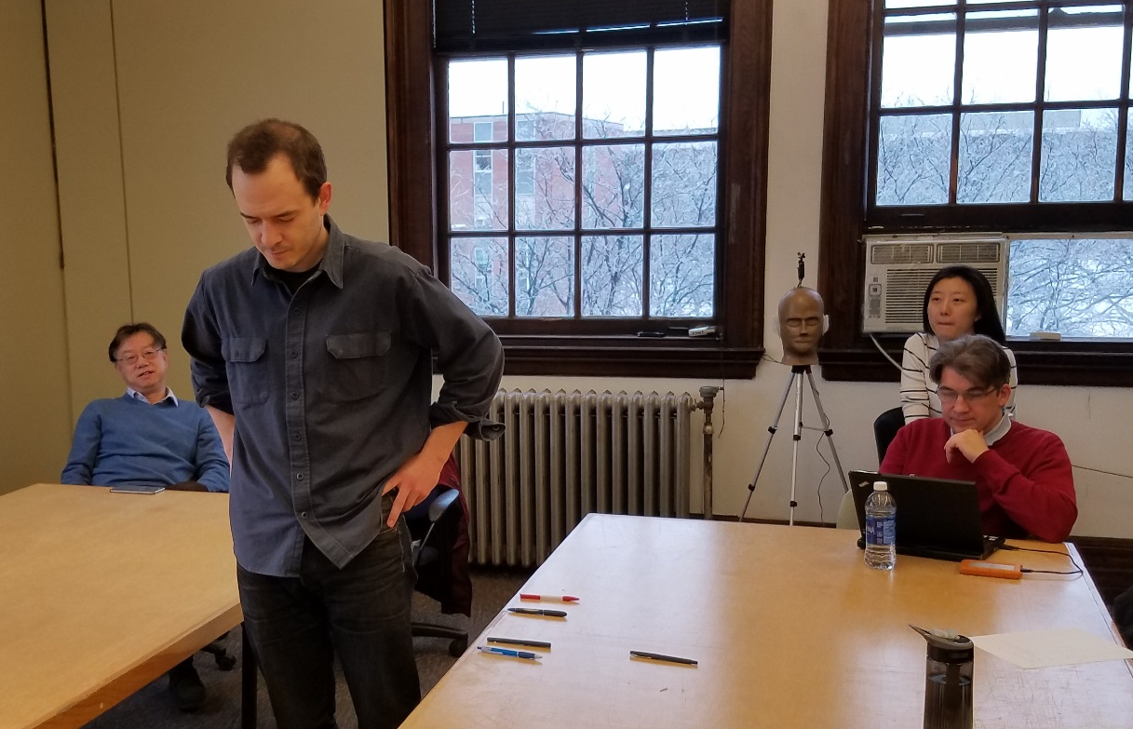
LOC works well in halls with music from a small ensemble.
We found LOC values greater than +3dB predicted good localization in several large spaces using a subset of Lokki’s electronic orchestra as a source: violin 1, violin 2, soprano, viola, and cello.
We did the experiment in a small classroom at Rensselaer University (RPI), using just the violin 1 and 2 tracks from Lokki’s recordings. The LLD found by the listeners was several feet in front of the LLD predicted by LOC. WHY?
Each listener dropped a pencil at the point where localization was lost. There was considerable agreement about where the LLD was found.

Slide 18
Reflections come sooner in small rooms, and violin music does do not resemble male speech.
Violins play an octave or more higher.
Violin notes usually have a gradual onset, taking 50 milliseconds or more to come to full volume.
The small room at RPI was reverberant, making it likely that reverberation from a previous note would mask the onset of a following note.
All three of these factors affect the position of the LLD.
But the LLD still exists, and it is important for predicting the clarity of music and speech to know where it will be found.

Slide 19
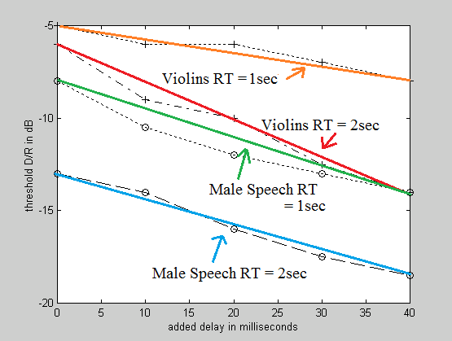
Localization data from violins
We made a binaural test signal consisting of notes from Lokki’s violin 1 track alternating left and right +-20 degrees.
With a one second reverberation time a nearly six decibel increase in the direct to reverberant ratio over male speech is needed to localize violins. This increase is needed because of the slower onset, which means the reflections have a much greater chance of masking the direct sound.
Adding pre-delay increases the ability to localize, but not very much.
With a two second reverberation time localizability increases more steeply with pre-delay than it does with male speech.
We would expect from hearing theory that the window for detecting the amplitude pulses is shorter when fundamental frequencies are higher.

Slide 20
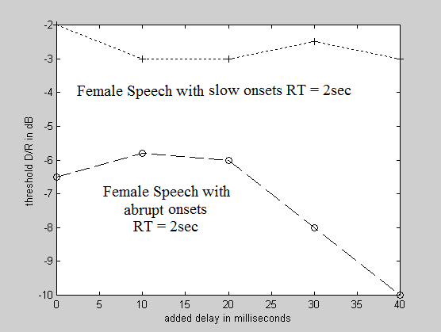
Localizing female speech in rooms
We repeated the experiment in the previous slide with female speech instead of violins.
We found that the threshold for localization was strongly dependent on the speed of the attack of each syllable.
With slow onsets the D/R had to be greater than minus 3dB if a syllable was to be localized, even with a 2 second RT. Adding pre-delay made little difference.
With abrupt onsets localization improved by 5dB. There was little improvement with pre-delay less than 20ms, indicating that there was still substantial onset delay.
The slope of the improvement after 20ms suggests that the window for detecting amplitude pulses is smaller when fundamental periods are higher in frequency than male speech and many orchestral instruments.

Slide 21
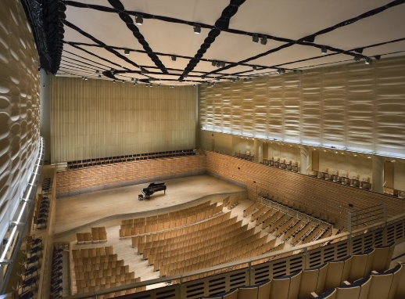
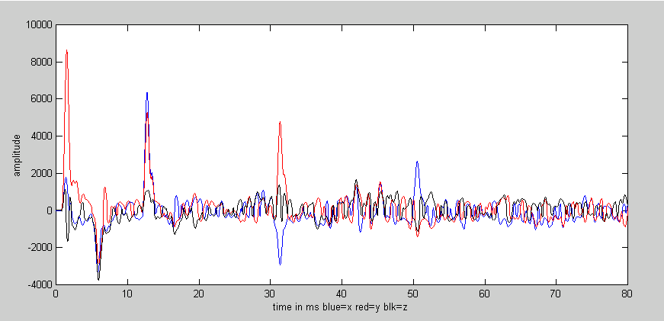
LOC depends on detecting the direct sound. What is “Direct Sound”?
We recently had the opportunity to test LOC in the EMPAC auditorium at Rensselaer University. Which has an unoccupied RT ~ 1.8 seconds at 1000Hz.
The results were surprising. Lokki’s small ensemble was localized and present in most seats, even in the balcony and at the back of the hall. Values of LOC were mostly above +3dB.
A 3D impulse response from seat R20. Red = front/back
Blue = left/right
Black = up/down
The impulse responses show a strong floor reflection 5ms after the direct sound. A great deal of floor was visible under the seats in front of the measurement positions. It is not likely that this reflection will be present when the hall is occupied, so the proximity we heard might not be heard in concerts.
The current LOC calculation treats this reflection as part of the direct sound. Is this correct?

Slide 22
Experiments with direct sound and prompt reflections
The experiments showed that early reflections 5ms or less from the direct sound add to the direct sound loudness and increase the ability to localize.
  Reflections at 6ms do not increase localization and begin to alter timbre.
  Reflections at 7ms and later add to the reverberant loudness, and are detrimental both to timbre and localization.
We added a cross-fade to the LOC code to correctly account for the effects of these early reflections.
  New Matlab code for LOC is on the author’s web site.
These discoveries are not new. Churches have been using them with pulpits for centuries.

Slide 23
Discussion
We have found that the ability to sharply localize sources in halls and rooms depends on many factors besides the timing and strength of the early reflections.
  The speed of the attack of each new sound matters. Many musical instruments have sharp attacks, but many do not.
It is not necessary that every syllable in a stream is localizable.
  Probably less than a third will make the whole stream proximate and attention grabbing.
The reverberation time matters, as does the score and tempo of the music.
  Short notes excite reverberation very little, and tend not to be masked by previous notes. But strong held notes build up the reverberation, and can sometimes mask everything.
    We heard a concert in a church of the Schubert octet. Any time the French horn played the strings became inaudible.
    STI may be a useful companion to LOC for predicting the clarity and presence of some kinds of music.
We have binaural recordings from halls and rooms all over the world.
  In some of these the whole orchestra is either localizable or it is not. In others, particularly surround halls, instruments close to the conductor can be localizable while the rest of the orchestra is lost.

Slide 24
Conclusion
Much of the work presented at this conference has focused on the sound in halls in test positions beyond the LLD.
  We believe that the first priority should be the ability to hear the music with clarity and engagement (with eyes closed.)
The best way to learn about proximity and localizing the music in halls is by listening.
Our binaural recordings of live concerts in halls around the world make the effects discussed in this presentation immediately audible.
  Our new crosstalk cancelling system requires only that you sit and listen.
I am preparing a You Tube video on how to use the crosstalk code. All you need is two speakers, a Windows computer, and an ASIO sound card.
  I will send my PowerPoint with excerpts of the binaural recordings to anyone at this conference who asks for them.

Slide 25
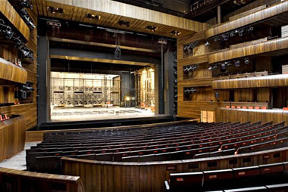
The new 1200 seat Oslo opera house
The first recording is from the standing room area at the rear of the first balcony. The words are clear, the sound dry but engaging.
The second recording is from the front of the first balcony. The sound is richer and more reverberant, but the words are mostly missing.
The last recording is from the front of the third balcony. The sound is warm, but the singers are distant and not engaging.

