Slide 1
Recent concert hall research findings and a method to equalize headphones to an individual at the eardrum
David Griesinger

Slide 2
Recent Concert Hall Experiments
Matthew Neal and Michelle Vigeant measured and reproduced many famous halls in their lab.
They found that 85% of the preference could be ascribed to the perception of “Proximity” – the perception that the musicians were localizable and close to the listeners.
Neil claimed there is no current measure for “proximity”
This implies that all the previous work on hall acoustics provides only 15% of preference.

Slide 3
Proximity depends on the ability to localize individual instruments.
Proximity depends on the ability to separate instruments from each other and from reflections and reverberation.
This is the cocktail party effect, but with the added factor of the time delay between the onset of sounds and the arrival of reflections.
Separating speech and instruments with a definite pitch – depends on the periodicity of the signal, and the envelope fine structure of the upper harmonics.
We have a measure, LOC, that predicts the ability to separate sources in a reverberant environment from a binaural impulse response.

Slide 4
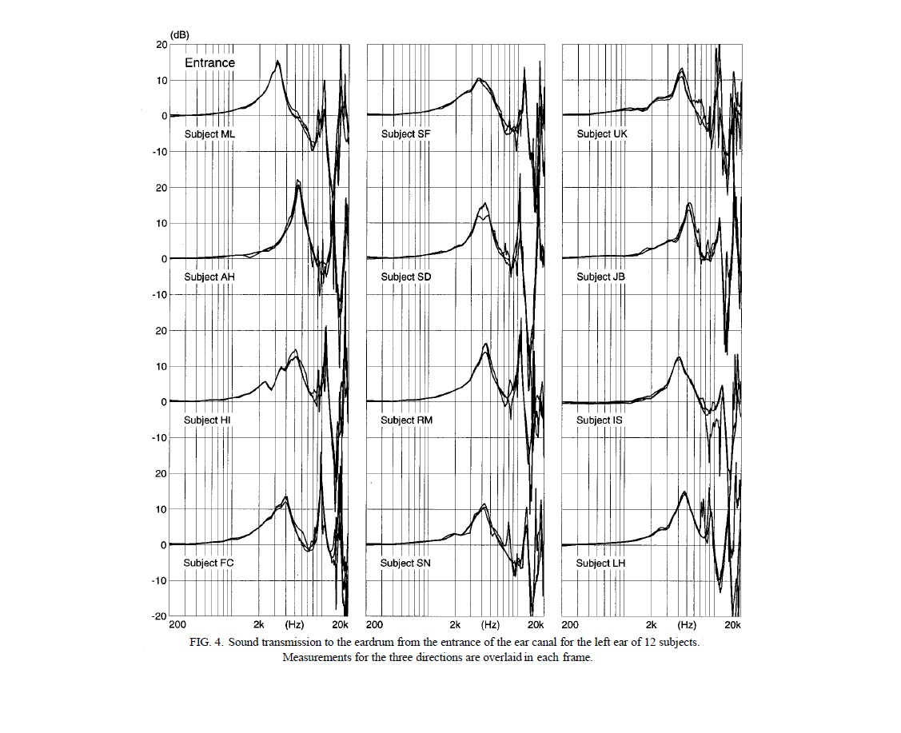
Binaural recordings allow us to test acoustic measures, but if we wish to hear them we must account for ear canal resonances!
What we perceive depends on the spectrum at the eardrum, not at the ear canal entrance!
Hammershøi measured the sound transmission from the entrance of the ear canal to the eardrum for three sound directions and 12 subjects. They differ from each other by more than +-10dB between 1000Hz an 6000Hz.
If we wish to accurately reproduce sound to an individual we need to duplicate their individual resonances from outside the ear canal!

Slide 5
We have developed a simple listening test to match the spectrum at the eardrum from pair of headphones to the spectrum from a frontal loudspeaker.
The result is frontal localization without head-tracking, and accurate timbre in the frontal plane.
Playing binaural recordings after our
equalization is startlingly real.
In this talk we will show why individual headphone equalization at the eardrum makes such an improvement to the sound.
We will also briefly describe a simple transaural system that can accomplish the same goal without individual equalization

Slide 6
Spectra at the eardrum are critical to sound localization
Our brains quickly compare the spectra and level differences at the eardrum to a set of stored localization maps. The best match predicts the sound direction.
Over time the brain updates our individual localization maps by comparing detected spectra to visual data.
Spectral differences due to source direction are typically measured at the ear canal entrance, but we are deaf to these spectra. They are modified by the ear canal resonances, which are highly individual.
Differences between individuals can be more than +-10dB between 1000Hz and 7000Hz.

Slide 7
We do not hear the spectra that allow us to localize sound because once a direction is found the brain corrects for the timbre. But if we move rapidly past a sound source we can hear the timbres that allow us to localize it.
I once heard a gliding whistle when I walked at about 3.5 mph under an overhead ventilator slot that emitted broadband noise.
This is the uncorrected sound of the vertical HRTFs when they are not corrected.
The sound was correctly localized – even at higher speeds.
But no timbre shift was perceived when walking slowly under the slot at less than two miles per hour.
When there is sufficient time our brains correct the timbre, but the correction takes time – in this case about half a second.

Slide 8
We can use headphones to play binaural recordings with accuracy if they reproduce our individual ear canal resonances!
We use equal loudness tests to measure and reproduce these resonances.
Subjects listen to a series of 1/3rd octave noises that alternate between a test frequency and a reference frequency at 500Hz. They adjust the loudness of the test band to match the loudness of the reference band.
They do this first for a frontal loudspeaker, and then for a headphone. The difference is the equalization that matches a headphone to their particular ears.
The result is frontal localization without head tracking, and natural timbre.
Binaural recordings equalized to be frequency linear from the front play with extraordinary realism.

Slide 9
Researchers keep searching for universal headphone equalizations
Hammershøi and Møller investigated whether the ear canal influenced the directional dependence of the human pinna system.
They concluded that measuring the sound at the blocked entrance to the ear canal captured all the directional dependence of the HRTF functions.
They recommended that headphones be equalized at the ear canal entrance!
But the frequency spectrum that we measure at a blocked or open ear canal entrance is not the frequency spectrum at the eardrum.
The only timbre the brain can perceive is the timbre at the eardrum, and this is highly individual!

Slide 10
Fortunately the DBX RTA1 became available
About 1980 I decided to measure the sound spectrum at the eardrum from a frontal loudspeaker, and compare it to the spectrum from a headphone.
The DBX could plot response curves, store them, and subtract the two measurements from each other. I loaded the results into an equalizer. The result was spectacular. Frontal localization and natural timbre.
A Rane 32 band 1/3 octave EQ
I used the setup for on-location recording for thirty years.
I made the he purple probe from a length of wire insulation and an electret microphone. It was not comfortable, but it measured my eardrum spectrum accurately.

Slide 11
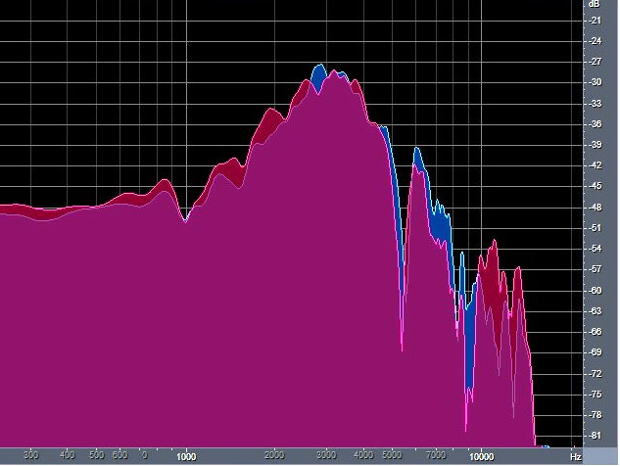
The spectrum at the ear canal entrance depends on the pinna and the concha, which alter the spectrum as a function of direction. But the spectrum is further modified by the ear canal resonances.
To reproduce natural hearing we need to measure the sound pressure from outside the head to the eardrum, and reproduce this spectrum when we play music.
The most important direction to measure is from the front, because this is where we need to hear most accurately!
My ear canal resonances increase the pressure at the eardrum by 18dB at 3000Hz. This greatly increases the sensitivity of my hearing.
This graph shows the pressure at my eardrums from a source 40 centimeters in front of my head. Left ear is blue, the right ear is red.

Slide 12
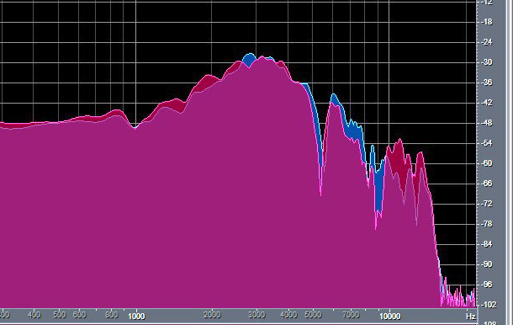
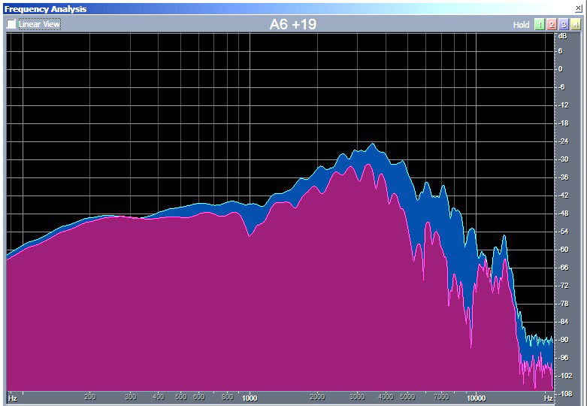
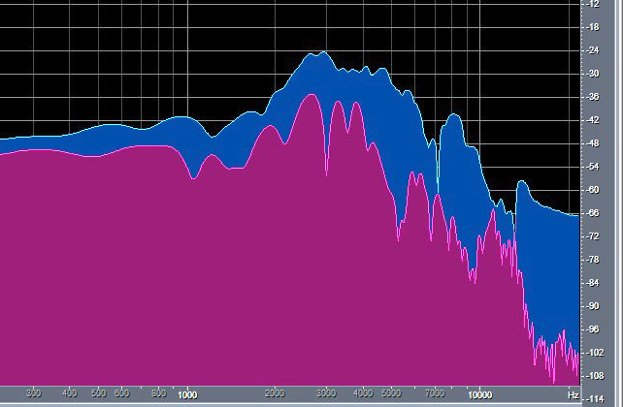
The timbres my brain uses to detect azimuth and elevation are highly audible
Eardrum spectrum from the front Eardrum spectrum 30 degrees left Eardrum spectrum 60 degrees left
My brain recognizes these individual timbres to perceive sound as frontal and outside the head.
When played with headphones the direction changes, but the timbre is the same!

Slide 13
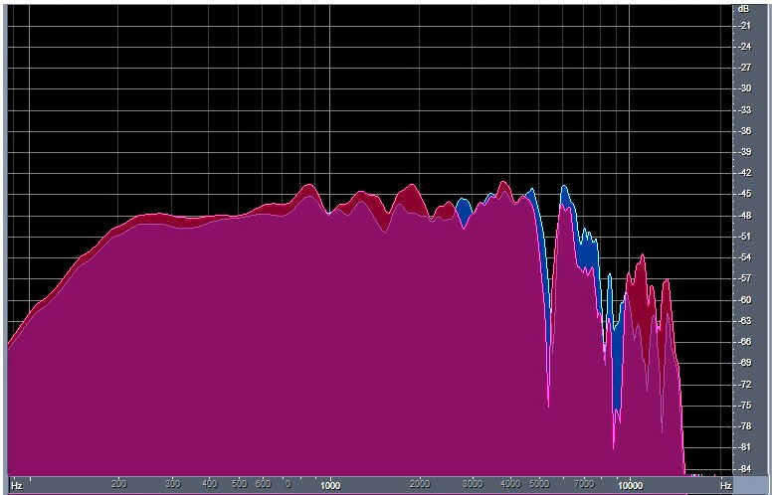
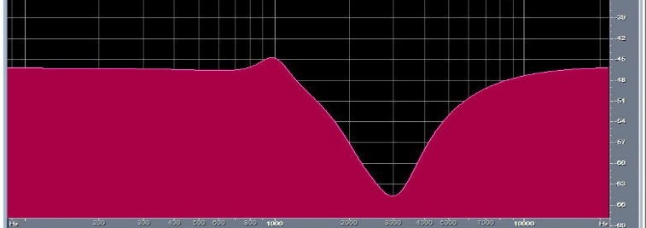
We can more easily study the directional dependence of sources if we use a parametric filter to make the frequency spectrum from the front as linear as possible.
+
=
A four section parametric equalizer
F Q dB
2.5 -10
2.5 -13
3 3
990 3 4
Pressure at my eardrums from a frontal source.
My eardrum pressure from a frontal source after equalization.
We use this equalization to make our binaural recordings.

Slide 14
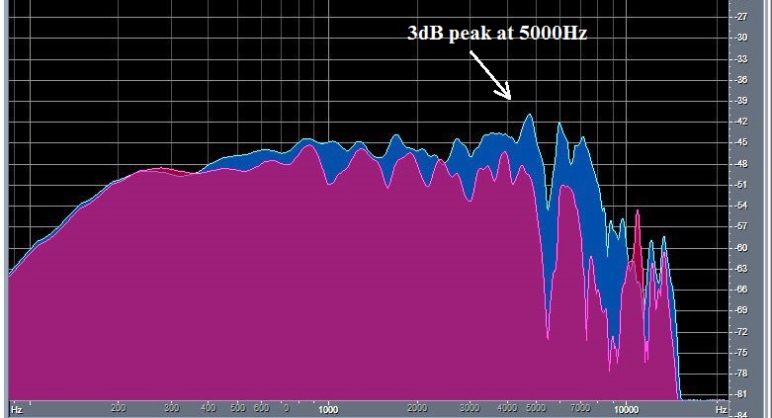
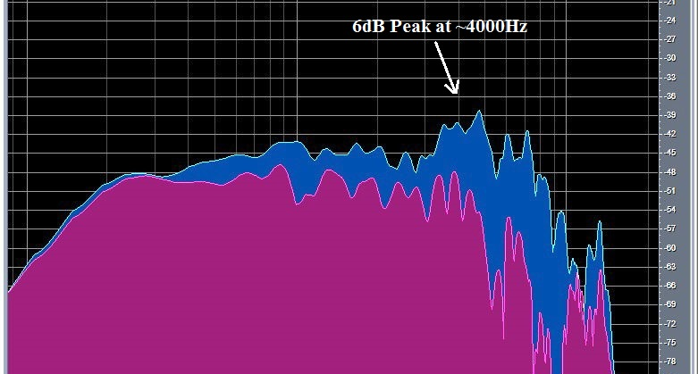
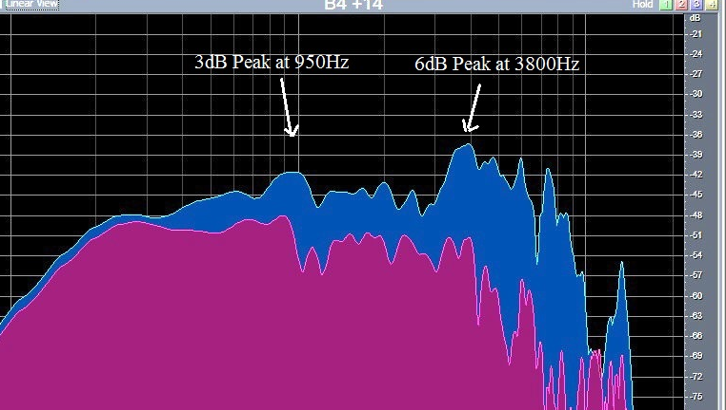
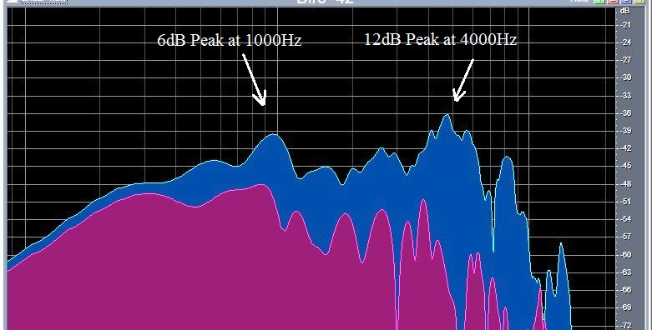
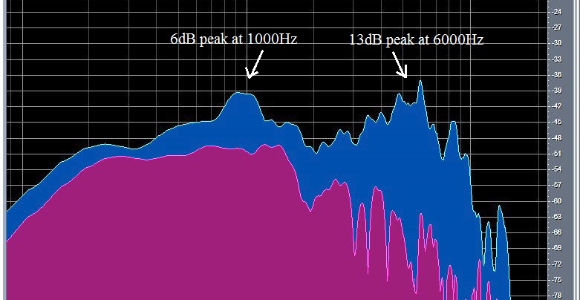
The author’s frontally equalized eardrum pressure as a function of angle in the horizontal plane. The peaks you see here are highly audible, and are important components of localization!
Front spectrum is flat
15 degrees right has a 3dB peak
30 degrees right has a 6dB peak
45 degrees, 3dB at 950, 6dB at 3800
60 degrees, 6dB at 1000, 12dB at 4000
90 degrees 6dB at 1000, 13dB at 6000
When I play these noises with crosstalk cancellation or equalized headphones the peaks in the spectra are inaudible, and localization is precise.

Slide 15
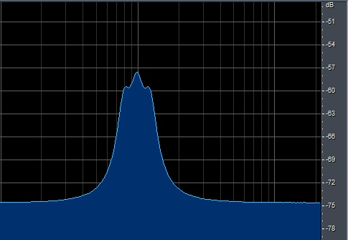
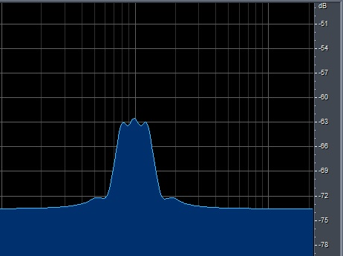
The app uses a synch function to reduce interactions between bands, and writes an impulse responses which can be plotted.
A combination of three bands, 800Hz, 1000Hz, and 1250Hz at +10dB without interaction compensation. They raise the level by 15dB.
The same three filters with our app have sharper skirts and the correct level, +10dB.

Slide 16
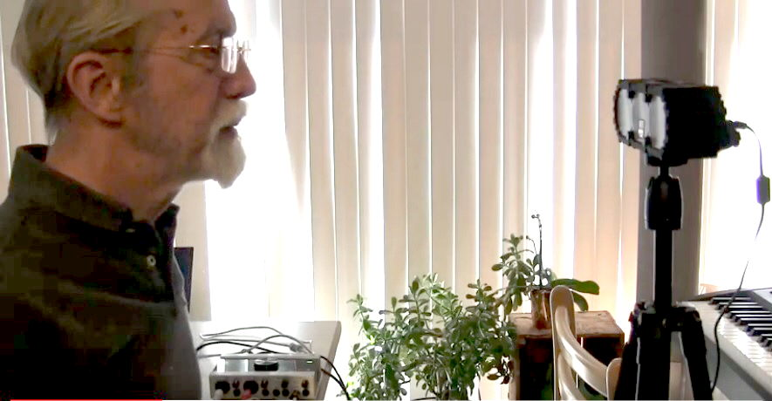
Headphone equalization by listening for equal loudness.
There is an IEC standard that uses tones to find equal loudness curves.
A reference tone at 1000Hz alternates with a tone at another test tone once per second. The subject adjusts the level of the test tone until it is equally loud as the reference.
The standard states that most subjects can repeat these measurements with an accuracy of +- 1dB.
We have developed apps that use the IEC method to equalize headphones, using 1/3rd octave noise bands and a reference band at 500Hz.
Our apps provide a 28 band graphic equalizer with filters with a Q of 5. The equalizer is first used to equalize the loudspeaker. It is then used to find the listener’s personal equal loudness spectrum, and then used to find the headphone equal loudness at the eardrum.
We find the headphone equalization by subtracting the loudspeaker equal loudness data from the headphone data. Music then sounds great!

Slide 17
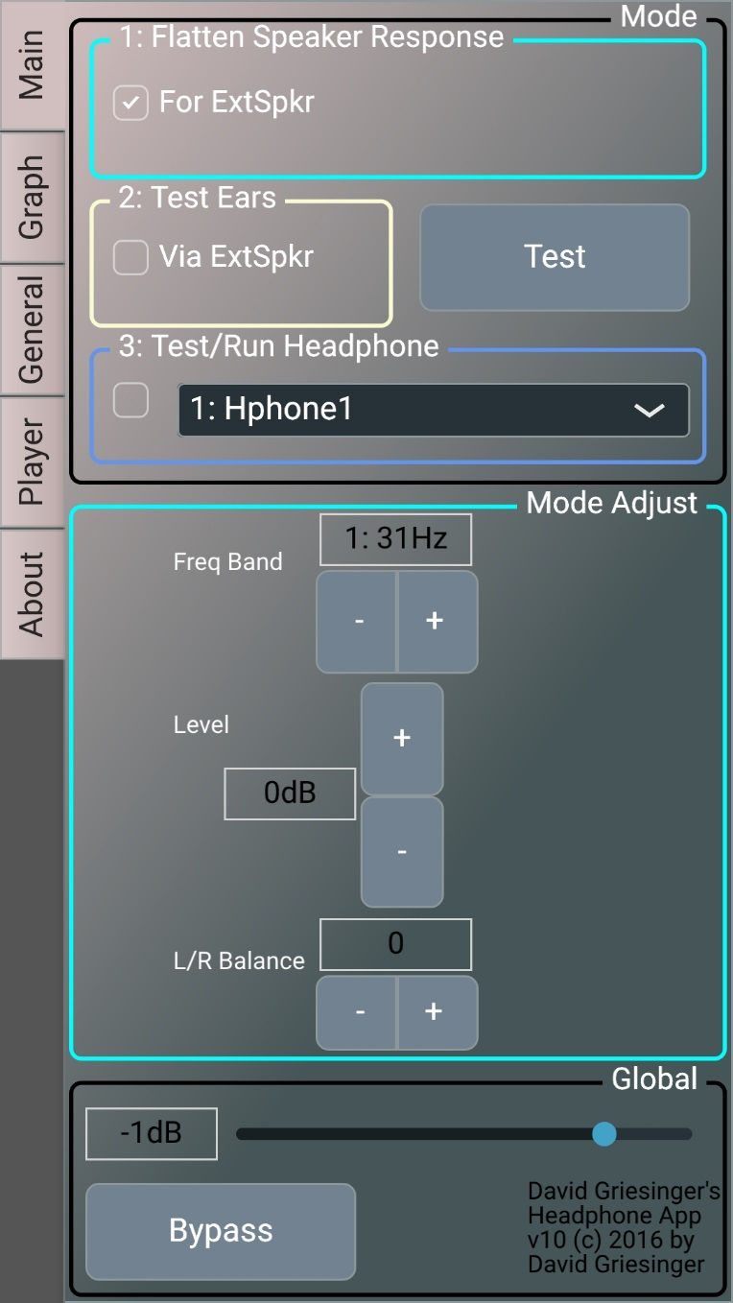
Here is a screen-shot of our app for a cellphone.
1. You start by checking the “Flatten Speaker Response” box. Plug in your speaker and Click “Test.” The app sends stereo pink noise to your external speaker. Use the equalizer buttons to adjust the frontal response of the speaker to flat.
2. Then check “Test Ears” and click “Test”.
The app sends alternating noise bands to your speaker. Adjust each test band to be equally loud.
3. Then unplug the speaker and plug in your phones. Check “Test/Run Headphone” and Click “Test.” Adjust for the alternating noise bands to have the same loudness just as you did with the speaker.
When you are satisfied with the data, unclick “Test,” and play music. The app includes a full file player. The app also makes a graph of your eq.
To hear the difference without the equalization, click “Bypass.”

Slide 18
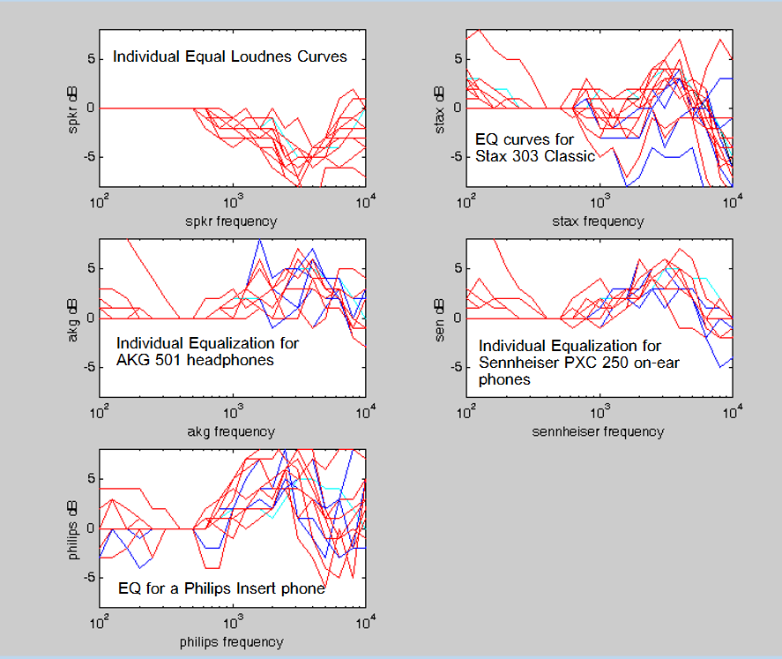
The data you get is all over the place!

Slide 19
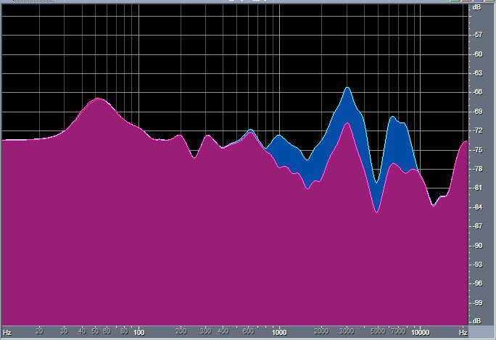
The app can write a .wav impulse response file for any of the data in the equalizer. These can be plotted with Audition.
Here is the spectrum of the response correction for my Apple earbuds.
My hearing is weaker in the left ear than the right by about 5dB above 1000Hz. Adjusting the balance control when finding the headphone equal loudness corrects the imbalance.
When I listen to music the sound is perfectly balanced.

Slide 20
Crosstalk cancellation creates virtual headphones just outside the listener’s ears
Our crosstalk cancellation system uses simple filters in the time domain. The crosstalk filters can be user-adjusted to fine tune them to an individual, but the default settings work well.
We also correct for the +-30 degree HRTF of the listener, which gives better performance for sources above and behind.

Slide 21
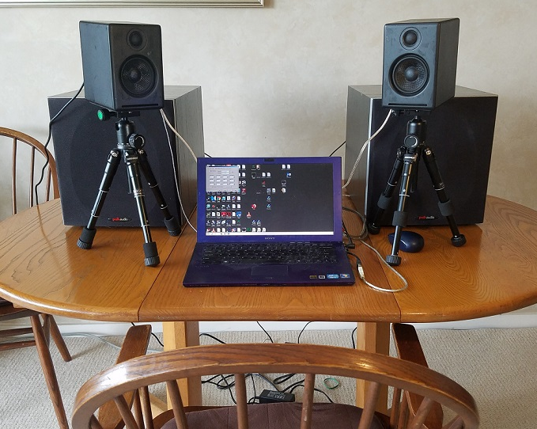
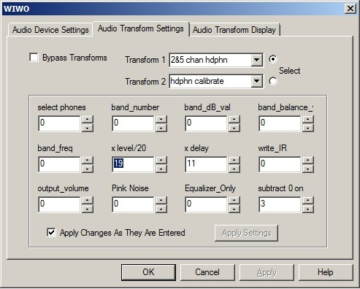
Reproducing binaural recordings with crosstalk cancellation
Here is the control panel for our Windows headphone and crosstalk app. It also can be used for headphone equalization. There is a YouTube video showing how to use it.
The crosstalk application is available from the author by request.

Slide 22
If there is time a I will demonstrate the crosstalk system after this session.
The End

