Slide 1
Measuring and optimizing clarity in large and small spaces
David Griesinger
David Griesinger Acoustics
www.davidgriesinger.com

Slide 2
A talk originally given at the Acoustical Society of America in December 2013
Since that time we have decided that the word “Proximity” better fits the perception that we describe as “Clarity”.
In the future we will use “Proximity”, but we have kept the word “clarity” in this powerpoint.

Slide 3
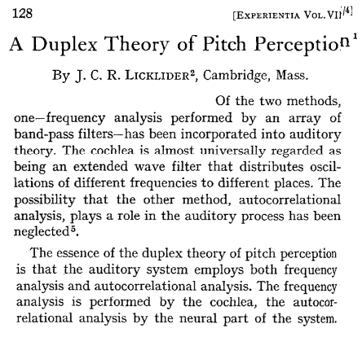
J. C. R. Licklider 1951L

Slide 4
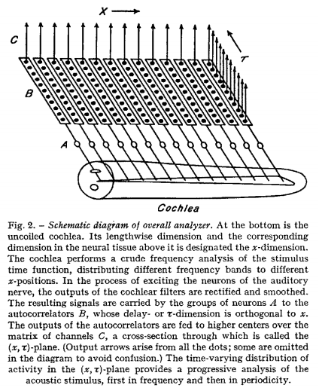
Licklider’s model explains much more than pitch perception.
Our nearly identical model was developed to understand distance, clarity, source separation, and presence

Slide 5
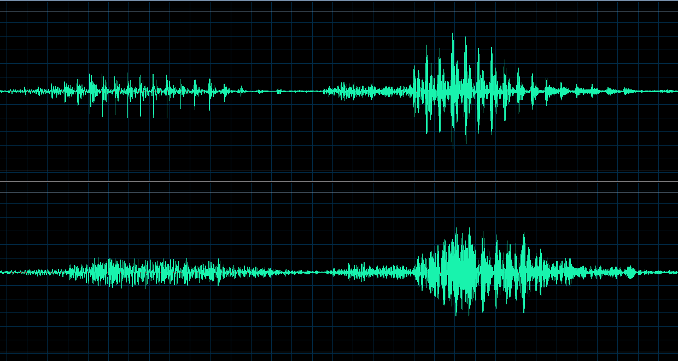
What is “Presence”? It is fine structure!
“one two” with coherent phase.
With randomized phase
Our model shows the advantages of this fine structure.
News Hour + Noise News Hour+Reverberation
(Sanders Theater at Harvard)

Slide 6
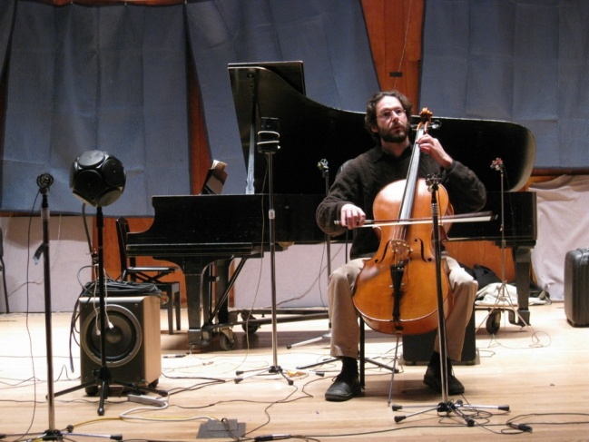
The Physics of Presence matters because it shows you how to make better sound
Experiments at the Longy School of Music, an ~300 seat hall in Cambridge
The original stage was highly reflective. The sound on stage and in the audience was not clear.

Slide 7
Results of the experiments:
The predictions from the model were verified
We found that clarity is lost when too many early reflections in the first 100ms of the onsets of notes randomize the phases of harmonics above 1000Hz.
The earlier reflections arrive the more they randomize phase.
Clarity is preserved when only a few reflections arrive in the first 100ms.
But when there are too many, Clarity abruptly disappears.

Slide 8
The conventional fix did not work!
Current wisdom predicted that putting a small shell around the musicians would improve clarity.
Stronger early reflections were supposed to help.
But when we tried this suggestion, clarity was reduced.
Early reflections were already too strong.

Slide 9
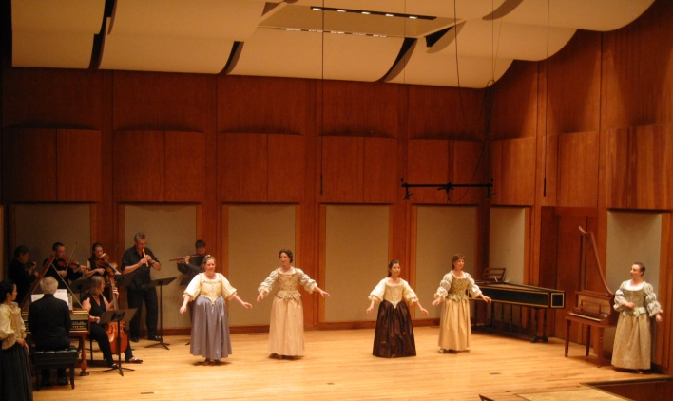
The final design was dictated by these experiments
The earliest and strongest reflections are from the back wall and side walls of the stage.
Reducing their strength through absorption on stage improved the sound throughout the hall.

Slide 10
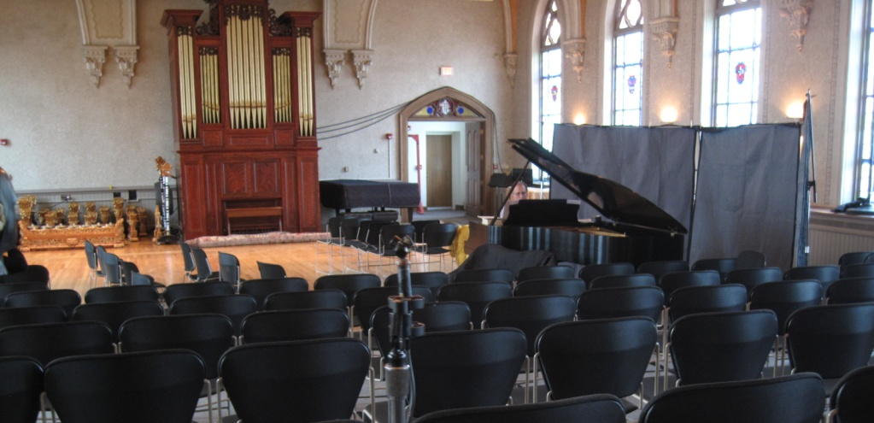
Experiments at Holy Cross in Worcester
An ~200 seat long shoebox hall with >2s RT and twice the volume of Longy. Clarity was non-existent. We experimented with putting musicians along the side wall with absorption behind. Clarity improved.

Slide 11
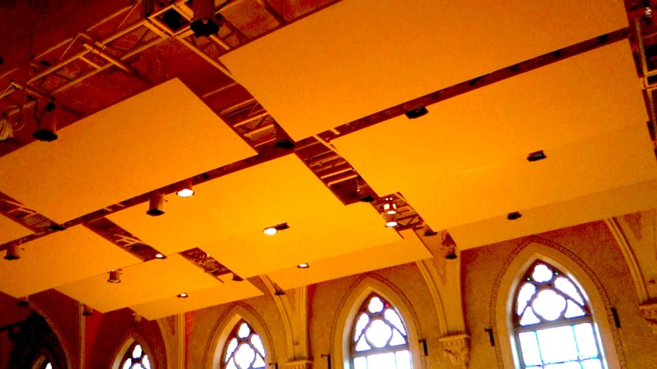
The final design
The audience surrounds the musicians. Overhead clouds of 2” fiberglass are open on both sides.
The clouds attenuate ceiling reflections and reduce the overall reverberant level.
Curtains behind the musicians await installation.
Music professors and audiences greatly appreciate the new hall.
Click on the picture for a panorama.

Slide 12
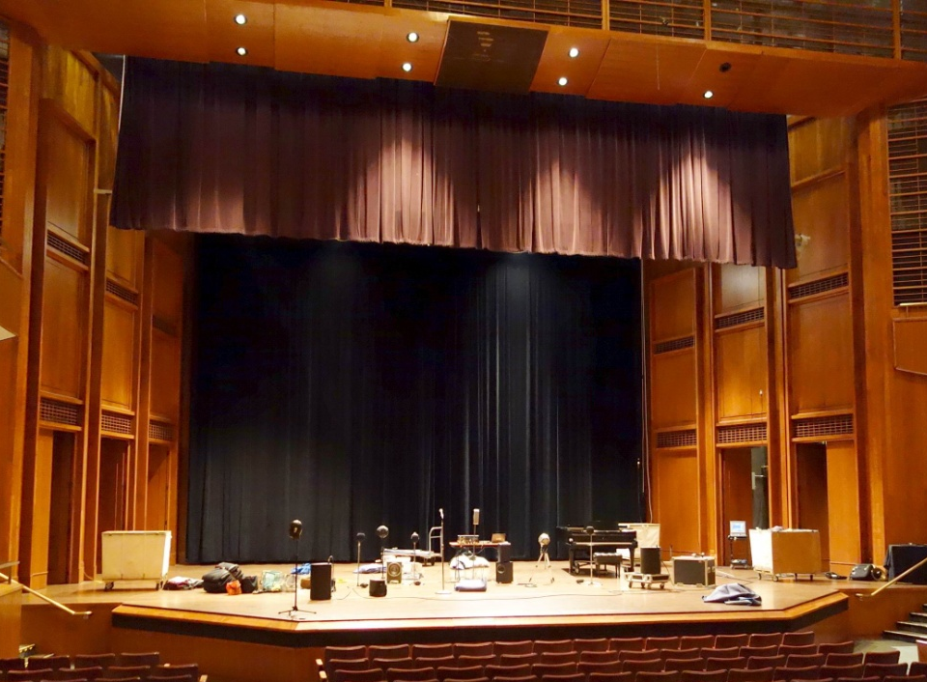
Experiments at Bucknell University
The hall has ~1200 seats, and RT > 2s. We set up an electronic soprano and string quartet using Tapio Lokki’s techniques. 2/3rds of the way back the instruments were impossible to localize and separate. The hall manager also complained that speech intelligibility was poor and amplified performances were loud and muddy. The stage was highly reflective.
Adding an absorbing curtain on the stage rear wall and an absorbing valence in front of the proscenium dramatically improved clarity and increased the perception of reverberance. The differences were captured with dummy head microphones, and could be heard later by the dean.

Slide 13
These sonic differences are not subtle!
Clarity and Presence originate in the physics of the sound wave –
their presence or absence can be heard by anyone, even from a monaural loudspeaker.
but you have to close your eyes!
Orchestra Row V bare stage
Orchestra Row V with curtains
Balcony row A bare stage
Balcony row A with curtains

Slide 14
Speech Reinforcement in Bucknell
We tested a simple PA: just a microphone and a near-by horn-loaded monitor speaker.
The speech was crisp and clear throughout the hall.
The standard PA with two proscenium speakers created an impossible muddle in most seats.

Slide 15
Jordan Hall at New England Conservatory A renowned 1000 seat recital hall
The historical 45’x17’ proscenium valence was removed in 1994 as part of a renovation.
The change in sound was decried by many local musicians and conductors. (As the removal of the same curtain from Carnegie Hall was also decried.)
We decided to see what would happen if we put it back.

Slide 16
A 42’ by 12’ absorbing valence was hung above the stage
We also covered most of the floor and parquet with blankets to emulate an audience, and set up our electronic orchestra on stage.
Without the valence localization and clarity were lost at about row I in the orchestra.
With the valence the sound was clear all the way to the back of the hall. (Most, but not all, of the balcony seats were also improved.)

Slide 17
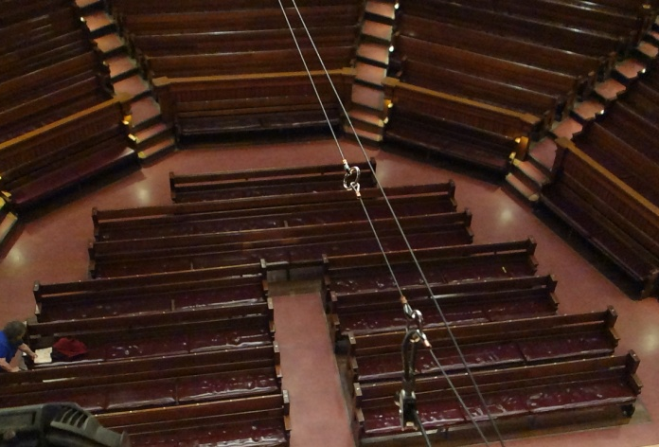
Sanders Theater at Harvard University a 1200 seat lecture/music hall.
The historic absorbing seat cushions used by Sabine to determine the properties of reverberation were thrown out in ~1974, and were replaced by hard vinyl over rubber. The RT went from ~1.8s empty at 2000Hz to 2.6s.
Speech clarity was drastically reduced – an unfortunate situation for a lecture hall. A long series of inadequate sound systems were installed in attempts to rectify the problem.

Slide 18
We tested the effects of the old cushions with a truck-load of absorbing blankets.
We emulated a half-full audience with blankets, and installed the electronic orchestra and a one-speaker PA.
We compared speech and musical clarity with the simple PA versus the house system, with and without additional blankets in the balcony.
The clarity of speech and music improved significantly throughout the hall when blankets were installed in the balcony.
Under all conditions the one-speaker PA performed better in the orchestra and Mezzanine seats than the house PA, and performed adequately in the balcony.

Slide 19
Sonic presence in classrooms
Sounds perceived as close to a listener demand and hold attention – ideal conditions for learning.
Many classrooms and most sound reinforcement systems reduce or eliminate the perception of presence.
Loudness can be reinforced without loss of presence if the reinforcement arrives within five milliseconds of the direct sound from the talker.
The best solution is room acoustics with low RT and low ambient noise.
Where these conditions do not exist, a reinforcement system such as an amplified podium can work better than a complex, multi-speaker system.

Slide 20
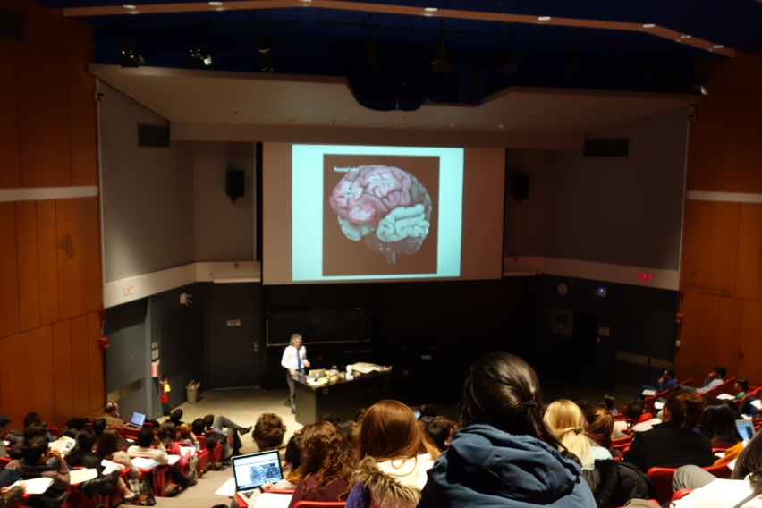
“Presence” in Harvard Science Center C a 200 seat room with an overhead cluster
Professor from front row
Professor from rear of hall
Professor from rear with PA
We can measure the phase coherence and the perception of presence with our hearing model – see the next slide.

Slide 21
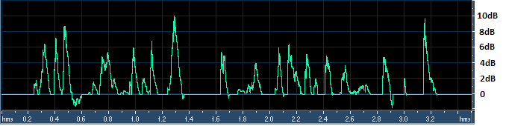
Results: Clarity ratios with live speech
Clarity with no microphone in the front of the hall.
In the rear of the hall with no microphone.
Amplified:
In the front of the hall with the microphone.
In the rear with the microphone.
Amplification often reduces clarity.

Slide 22
And Violins?
Can harmonic phase coherence help explain the differences between instruments?

Slide 23
Conclusions
Clarity and presence depend on the audibility of the fine structure in the direct sound.
Particularly in the first 100ms
The earlier a reflection comes in this interval the more it reduces clarity.
Absorbing or re-directing the earliest and strongest reflections can often improve a hall or a classroom.
Moving the listeners close to the source is also always helpful.
Presence and attention are enhanced when reinforcement arrives within 5ms of the direct sound – and corresponds to the visual direction of the talker.
Amplifying each instrument or talker separately is highly recommended.
Measurement techniques based on ear models that include harmonic phase, or emulate its effects, are sorely needed.

