Slide 1
The physics of auditory proximity and its effects on intelligibility and recall
David Griesinger
David Griesinger Acoustics
dgriesinger@Verizon.net
www.davidgriesinger.com

Slide 2
The Limit of Localization Distance: The LLD
We propose in this talk that one of the most important acoustic measures of hall quality can be found by the number of seats in which performers or speakers have “proximity”, the perception that they are close and can be sharply localized.
The distance within which sharp localization is perceived can be easily mapped by walking around while listening to a live or electronic ensemble.
With luck we will demonstrate finding the LLD

Slide 3
What is “Auditory Proximity?”
To quote Lokki et al concerning concert halls:
“An interesting fact is that neither Definition and Reverberance nor EDT (early decay time) and C80 explain preference at all. In contrast, preference is best explained with subjective Proximity along with Bassiness, Envelopment, and Loudness to some extent. Further there is no objective measure that correlates to Proximity and overall average of preference.”
He finds the only perceptual attribute that correlates with preference for all listeners is unnamed, and currently un-measurable. He calls it “Proximity”
I have been calling it “Engagement”, “clarity”, or “Presence”.
I believe it is measurable

Slide 4
Why did we not discover “Proximity” sooner?
Proximity describes the perception that a sound source is sonically close to the listener.
You must listen for it without a visual image!
To study proximity in a laboratory your reproduction system must be able to reproduce it!
Almost all current laboratory systems cannot.

Slide 5
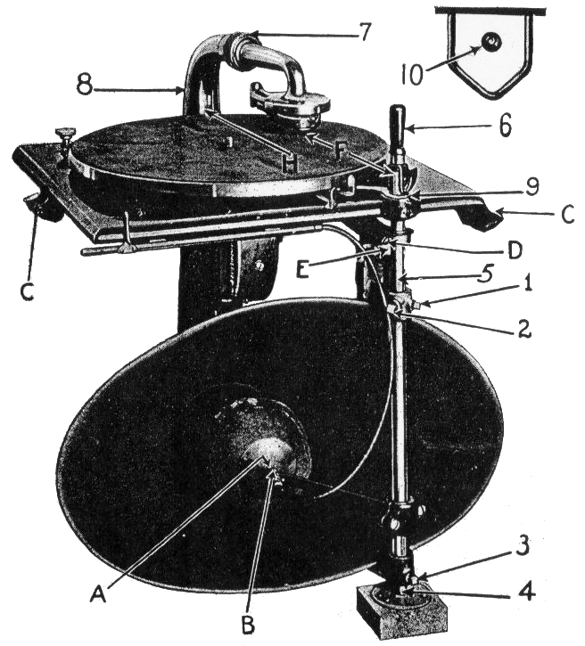
To reproduce “Proximity” the rule is simple: you need one linear phase speaker for each voice.
Edison, through meticulous A/B tests, succeeded with his “diamond disk” phonograph.
I heard one of these phonographs, and found it completely convincing. The soprano was right there in front of me.
Research with electronic orchestras by Hamasaki, Woszczyk, and Campbell found the same thing.

Slide 6
Lokki succeeds in detecting proximity by following these rules:
One loudspeaker array and an independent anechoic track for each instrument.
And reproducing each instrument through a single loudspeaker as close as possible to the original azimuth.

Slide 7
The Limit of Localization Distance, or LLD
If you walk away from an ensemble with your eyes closed, at first the sound is clear and each instrument is sharply localized
But at a particular distance the sound completely changes. It becomes a muddy ball.
This is the limit of Localization Distance, or LLD.
We will demonstrate it with Lokki’s Mozart violins.

Slide 8
“Close” and/or “attention- grabbing” might be also descriptors for “proximity”
Sounds that have proximity are perceived as close to a listener
Both in natural hearing and in a sound mix.
Sounds with proximity “pop forward” out of background sounds, and other instruments in a recording.
Our brains involuntarily pay attention to close sounds. They predict danger.

Slide 9
How can we detect a sound as present and close?
Humans can distinguish when a sound is close or far in under a tenth of a second.
The ability is preserved even when loudness and spectrum are constant.
No current hearing model can explain the distance perception effect.
That is not all. No current hearing model can duplicate our abilities to understand speech in noisy environments – a vital ability for survival.
Something vital is missing from standard models of hearing!

Slide 10
The missing element is Harmonic Phase
The evidence is overwhelming! Nearly all creatures communicate with sounds that contain rich harmonics of fundamental frequencies.
Squeaks, growls, whistles, and buzzes, are universal with animals, and human speech relies on voiced vowels.
Why?
Because harmonics carry information about the pulse that created them!
Once in each fundamental period these harmonics align in phase to create a replica of this original pulse.

Slide 11
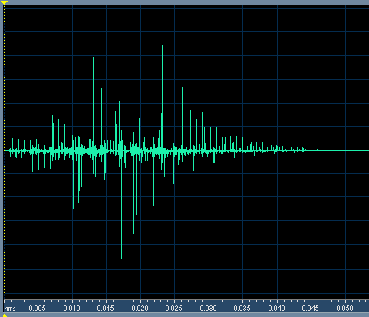
Example of early reflections on Speech
This impulse response has C50 and C80 = infinity. STI = 0.96, and RASTI = 0.93.
The second half of this sentence is convolved with this IR. The second half sounds muddy and distant because the IR randomizes the phase of harmonics above 1000Hz!!!
left
right

Slide 12
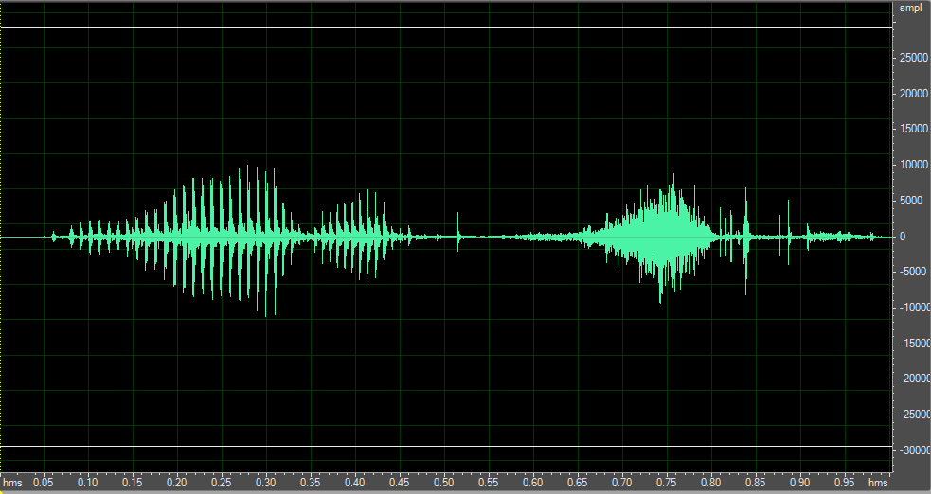
The amplitude spikes created by upper frequencies in voiced speech cut through noise and reverberation
The syllable “one” voiced and then whispered, high-pass filtered at 1000Hz, with equal RMS level.

Slide 13
More important: these phase spikes allow the ear to separate different sound sources into independent neural streams!
Humans are as much as 20dB better at extracting speech from noise than any ASR system.
Most current ASR systems ignore the phase of signals above 1500Hz!
The spikes in the upper harmonics of speech and other tones precisely define the period of the fundamental that created them.
A simple filter that precisely matches the period of each fundamental can separate signals from each other and from noise.
Separating signals from each other requires a precise ability to perceive PITCH.
It is no surprise that human pitch perception is far better than can be explained by current hearing models!

Slide 14
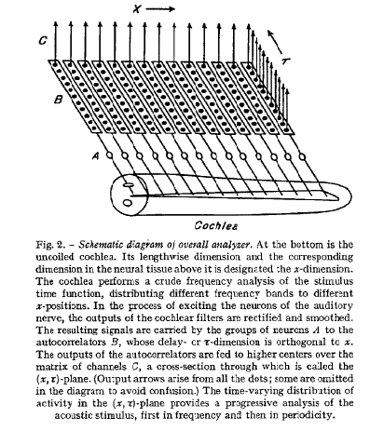
The mechanism for perceiving pitch was proposed by J. C. R. Licklider in 1951
Licklider proposed that our acuity of pitch perception could only be explained by an autocorrelator located as close as possible to the hair cells.
He did not recognize that this circuit can also separate sources.
We believe this circuit is directly below the hair cells in the spiral ganglia.
Before signals are sent to the auditory nerve they have already been separated from each other by pitch.

Slide 15
The autocorrelator in the organ of Corti also enables source separation
Which is essential to surviving cocktail parties and enjoying polyphony.
We can separate two simultaneous talkers from each other if their vocal pitches are different by as little as half a semitone!
With too many early reflections it becomes much more difficult to separate or localize these signals.
C and C# mixed
After separation by pitch
With reverb

Slide 16
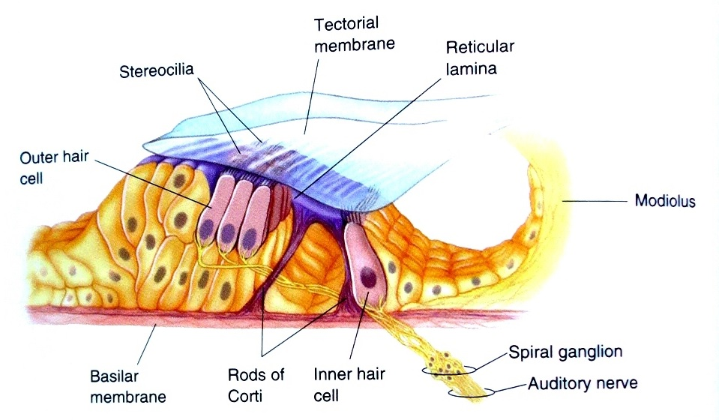
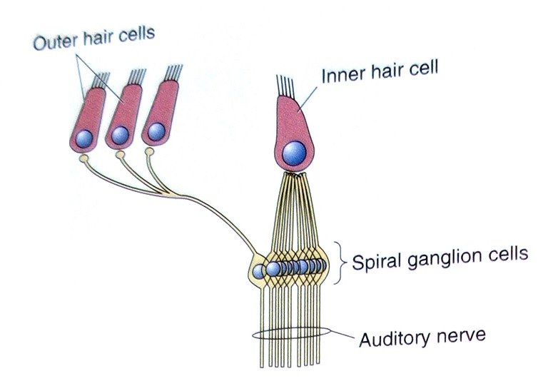
The Organ of Corti
Contains ~3000 inner hair cells, ~15,000 outer hair cells, and 30,000-60,000 spiral ganglia.
The inner hair cells detect basilar motion, the outer hair cells control the membrane sensitivity, and the spiral ganglia auto-correlate.

Slide 17
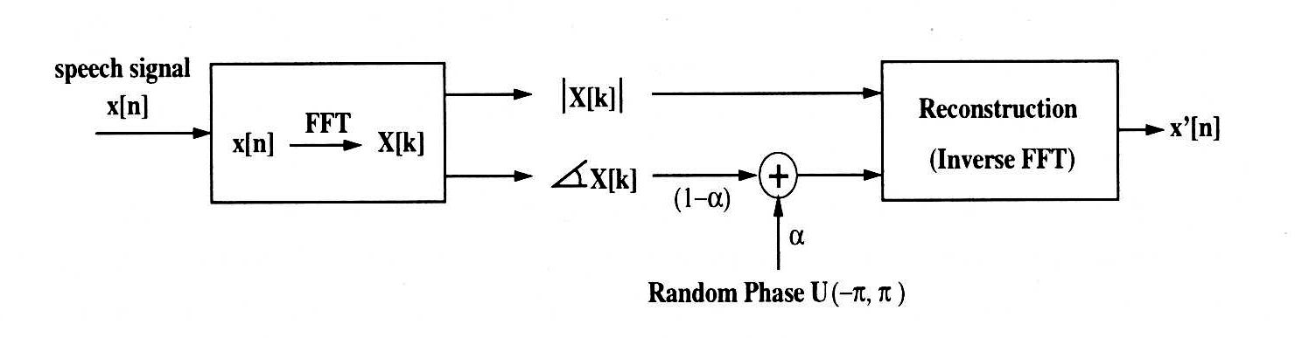
Aarabi et al studied the effects of phase randomization on word recognition
A random phase function was added to standard word lists with various amounts of added noise.

Slide 18
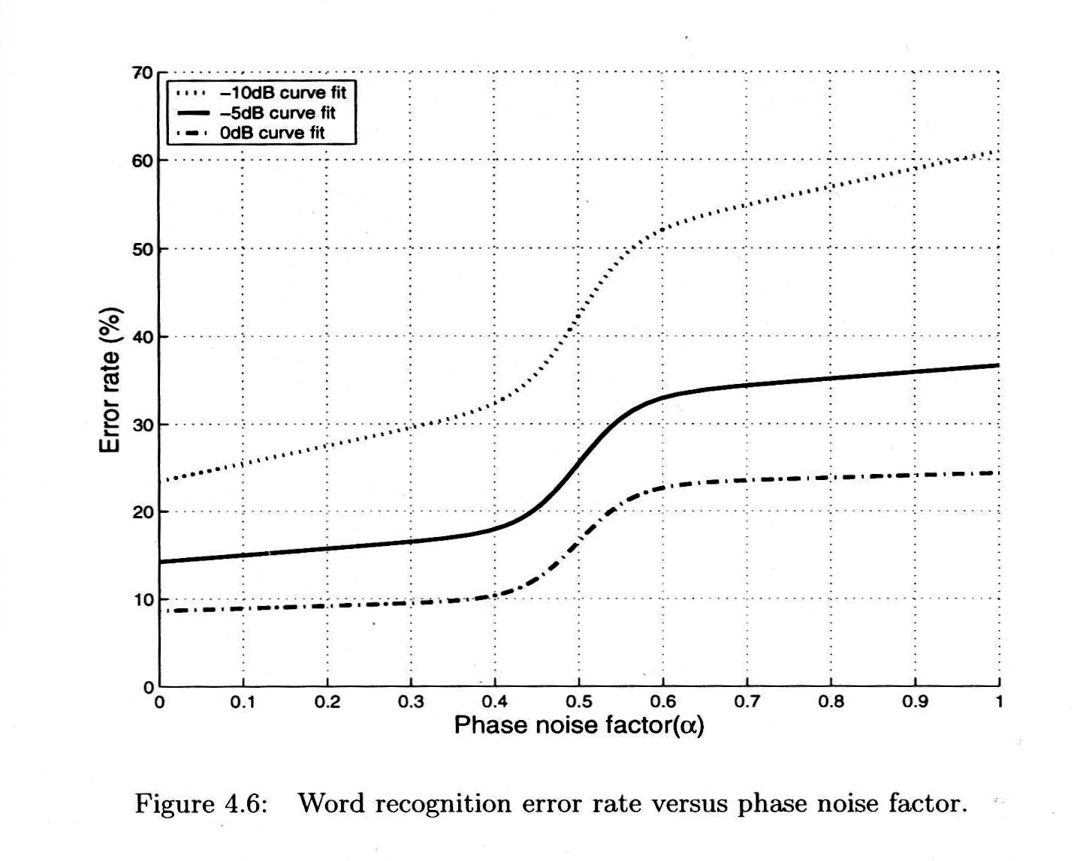
The effect of phase in the presence of noise was dramatic
In all cases the error rate jumps up rapidly when the peak phase modulation is ~+- 90 degrees

Slide 19
Word recognition vs recall
Aarabi has shown that phase randomization can dramatically increase word recognition error rates in the presence of noise.
But word recognition is only a first step. We need to recall what we heard at a later time!
The primary determinant of recall is attention!
Randomization of phase decreases proximity, and lack of proximity decreases attention.

Slide 20
How can we measure and predict Proximity?
A practical autocorrelator of the type Licklider proposed needs to be about 80ms long to achieve human pitch acuity.
A minimum of five equally spaced taps is required.
With this knowledge we have developed a measure, LOC, that predicts when a sound source becomes distant and not localizable.

Slide 21
Our measure, LOC, uses the ability to sharply localize sound as a proxy for near/far.
We determined the threshold of localization of voiced speech in reverberation as a function of D/R and pre-delay. RT values of 1 second and two seconds were tested.
For a 2s RT the threshold of localization can be as low as -17dB!
We developed the function LOC to predict this data. The red and cyan lines show the accuracy of the fit.
The LOC measure has been tested in real rooms and halls with useful results.

Slide 22
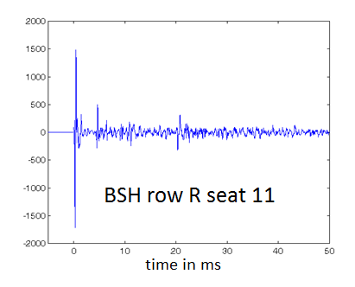
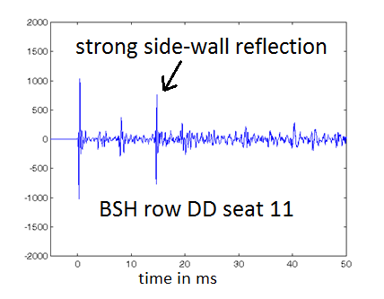
Example: Two seats in Boston Symphony Hall
C80 = 0.85dB IACC80 = .68 LOC = 9.1dB
C80=-0.21 IACC80 = 0.2 LOC = -1.2dB
C80 predicts no difference. IACC predicts row DD sounds better. LOC finds row R 10dB better! (It is)

Slide 23
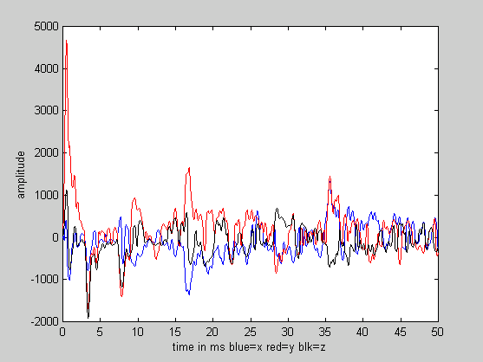
Binaural experiments in Boston Symphony Hall
We measured about 8 seats in under 40 minutes
Here is a 2kHz Soundfield plot from seat DD 11
Note the strong side-wall reflections at 17ms and 37ms. These are clearly doubles – from the wall and the under-balcony ceiling.

Slide 24
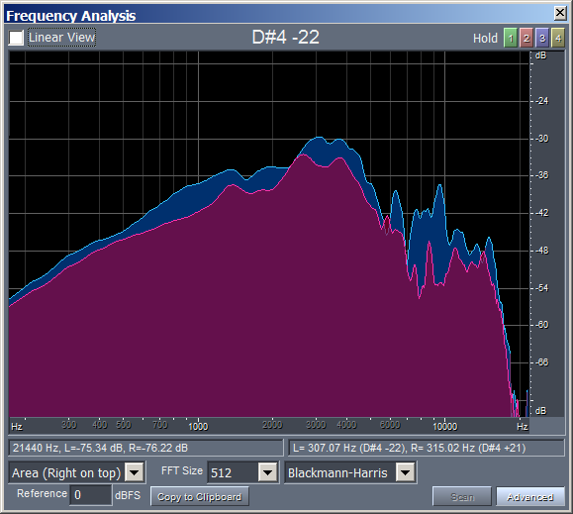
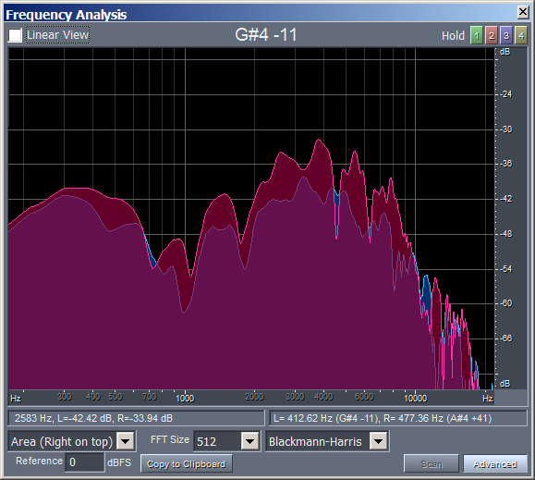
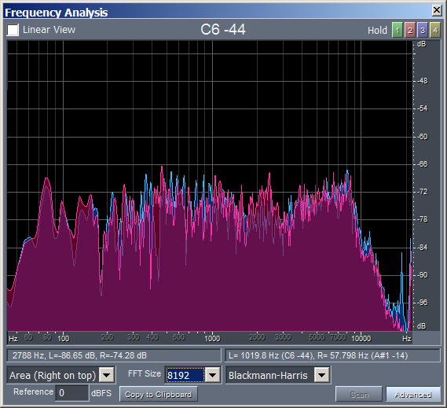
The measured data needs to be equalized to compensate for the source and the dummy
We can equalize the data by assuming the hall sound is flat at about 160ms.
direct sound first lateral reflection 160ms reverberation
Spectra measured at seat DD 11 after equalizing the reverberation

Slide 25
We can create an ensemble from a single binaural measurement by modifying the direct sound
Since the anechoic tracks for each instrument are un-correlated, we can use the same reflection and reverberation data for each instrument.
We can also compensate for the loudspeaker directivity and alter the reverberation time to approximate a full hall.

Slide 26
A Matlab script creates three separate binaural tracks with generic equalization
1. A binaural track for the direct sound only.
2. A binaural track for the first reflection only.
3. A binaural track for the reverberation without the first reflection.
The tracks can be heard in any combination on individually equalized headphones, with the ability to modify the loudness and equalization of each track.

Slide 27
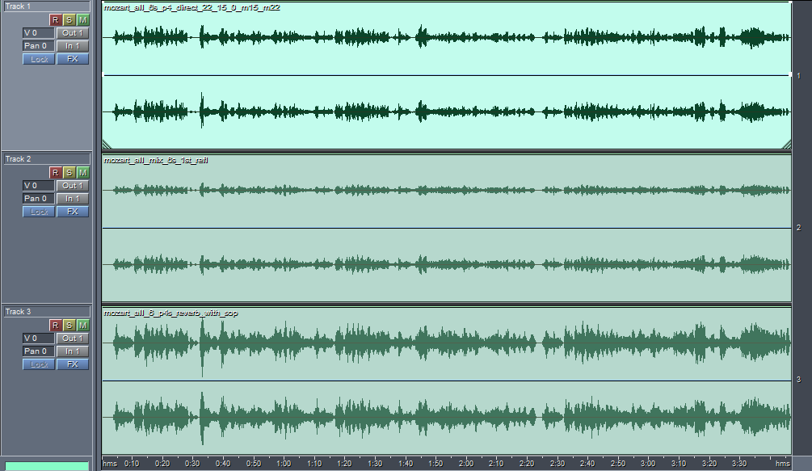
We can A/B compare different combinations on individually equalized headphones For seat DD11:
Direct Only
1st Refl Only
Direct+1st
Reverb Only
All Together
All no 1st
There is an enormous improvement in proximity when we delete the first lateral reflection.

Slide 28
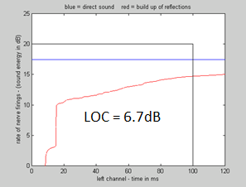
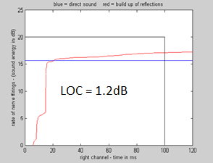
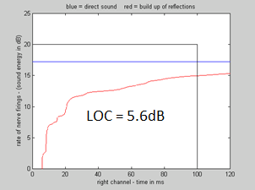
Is the difference in sound from deleting the first reflection measurable with LOC?
LOC measurements in seat DD 11
LOC in the left ear in seat DD 11 LOC in the right ear LOC in the right ear with no 1st reflection
We learned that the perception of “Proximity” is best predicted by the measured LOC value in the lesser of the two ears. A LOC value of 1.2 dB is unacceptable, and a value of 5.6 is good.

Slide 29
Conclusions
Proximity – the perception that a source is acoustically close - is an important determinant of attention and recall.
The presence or absence of Proximity in particular seats can be determined by listening for the localization of instruments in a small (electronic) ensemble.
The ear detects proximity through the phase coherence of upper harmonics in the direct sound, which are randomized by early reflections.
Binaural technique with individual headphone equalization is a practical standard against which other hall research techniques can be judged.
Headphones can be non-invasively equalized to match individuals through loudness matching.
Existing binaural data can be balanced and equalized to yield a very good snapshot of the sound of an ensemble in a particular seat.
This data can be further manipulated to discover why the sound is good, or how to improve it if it is not.
Using these techniques we find the first-order lateral reflections in Boston Symphony Hall are excessive.
In every seat tested they are either inaudible, or they reduce or eliminate proximity.
Deleting them improves both the clarity of the music and the sound of the hall with no decrease in loudness.

