Slide 1
The physics of auditory proximity and its effects on intelligibility and recall
David Griesinger
David Griesinger Acoustics
dgriesinger@Verizon.net
www.davidgriesinger.com

Slide 2
Recent concert hall preference tests by Neil et al
At the ISRA conference in Amsterdam last October Matthew Neil et al described blind listening tests of an electronic orchestra in famous concert halls.
They found that more than 75% of the preference could be explained by a single perception:
“Proximity”
“And,” he said, “There is no measure for proximity.”

Slide 3
What is “Auditory Proximity?”
To quote Lokki et al concerning concert halls:
“An interesting fact is that neither Definition and Reverberance nor EDT (early decay time) and C80 explain preference at all. In contrast, preference is best explained with subjective Proximity along with Bassiness, Envelopment, and Loudness to some extent. Further there is no objective measure that correlates to Proximity and overall average of preference.”
He found that only one perceptual attribute that correlates with preference for all listeners is unnamed, and currently un-measurable. He called it “Proximity”
I have been calling it “Engagement”, “clarity”, or “Presence” since 2004. It is measurable.

Slide 4
The Limit of Localization Distance: The LLD
We propose in this talk that one of the most important acoustic measures of hall quality can be determined by the percentage of seats where listeners perceive performers as “Proximate,” or close and sharply localized.
We find that in halls proximity disappears all at once at a particular distance. We call it the “Limit of Localization Distance” or LLD.
The distance within which sharp localization is perceived can be easily mapped by walking around while listening to a live or electronic ensemble with eyes averted.

Slide 5
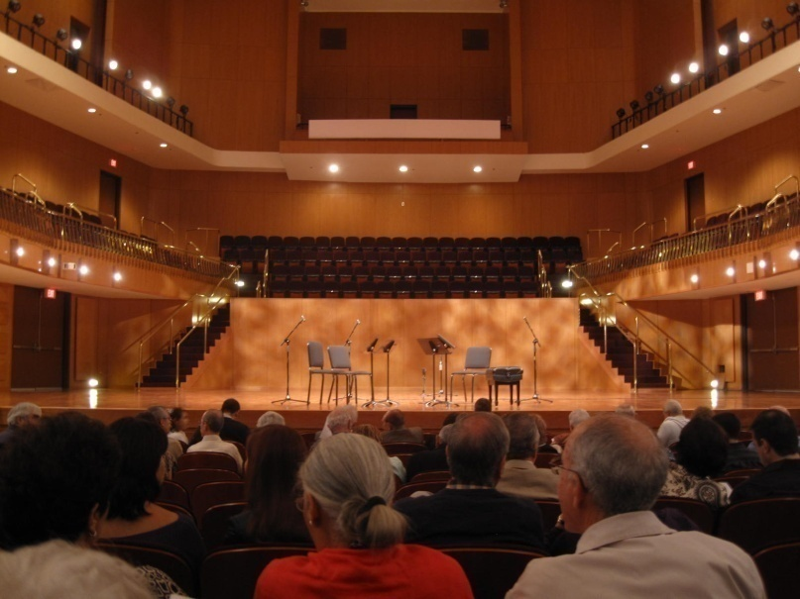
A shoebox hall in Puerto Rico demonstrates the Limit of Localization Distance (LLD)
The first recording was made from row F, just behind the woman in the picture.
The second recording was made just five rows further back in row K.
This is what happens when the strength of early reflections exceeds a critical limit.

Slide 6
Finding the Limit of Localization Distance, or LLD
If you walk away from an ensemble with your eyes averted, at first the sound is clear and each instrument is sharply localized.
But at a particular distance the sound completely changes. It becomes a muddy ball. This is the limit of Localization Distance, or LLD.
We find the LLD using five speakers and Lokki’s anechoic recordings of Mozart. We use a first violin, second violin, viola, cello, and a soprano.
With electronic instruments you don’t need to close your eyes, since you cannot see which instrument is playing.
The effect can be demonstrated with just two violins.

Slide 7
When sound is perceived as close to a listener it demands attention. Muddy sound can be easily ignored.
Carl Wieman and Katherine Perkins assigned college students randomly to seats in a large classroom for “Physics in Everyday Life.”
They were divided into four groups based on distance to the teacher.
Class participation, quiz results and grades were tracked.
Students in the front half of the room did better in all aspects – more participation, more questions, and better grades by a full grade level.
At the semester break the seat positions were switched, but the previously front students retained their advantage.

Slide 8
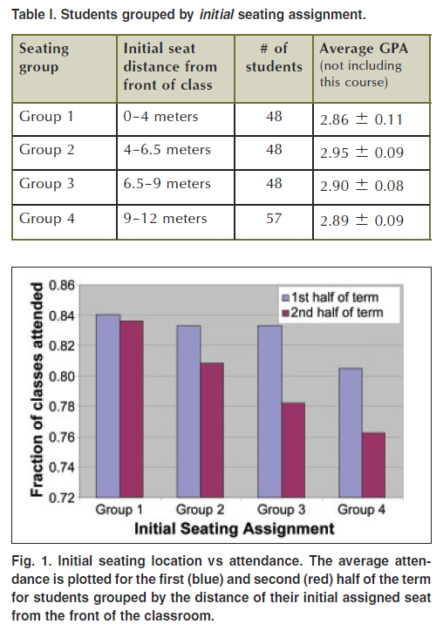
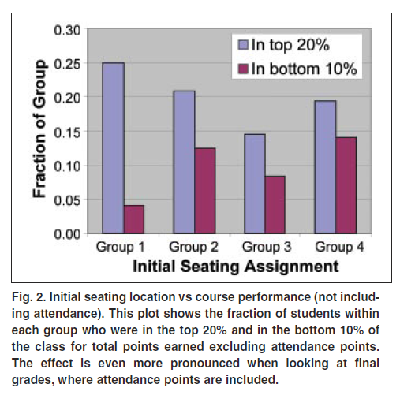
Weiman’s results are alarming!
What can explain these results? Is it visual closeness or acoustic closeness?

Slide 9
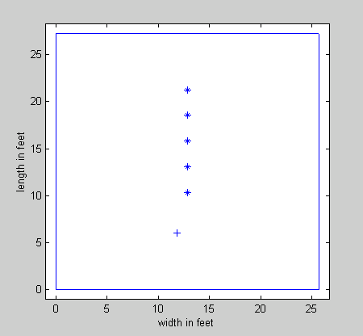
A 27’x25’x10’ room with surface absorption of 0.15 and RT 0.34s
A room was modeled with a single sound source and five receiver positions.
The intelligibility measured by STI is very good in all positions.
LOC greater than +3dB predicts good proximity. LOC less than zero predicts poor attention.
Receiver pos.
STI LOC
.75 -2.3dB
.73 -3.4dB
.74 -2.7dB
.74 0.3dB
.75 4.0dB
21.3’
18.5’
15.8’
13.8’
10.4’
9.5’
Teacher
6’
A small room with a 3.4 second RT has excellent STI – but the teacher is heard with proximity only in the front.

Slide 10
What can be done?
In concert halls absorbing the back wall reflection or the ceiling reflection can make an enormous difference.
These reflections are the strongest and come the soonest.
But in this room these measures improved LOC by only 1dB.
The best solution for this classroom is to increase the average absorption to 0.3
Impractical perhaps – but effective.

Slide 11
A 27’x25’x10’ room with surface absorption of 0.3 and RT 0.26s
Receiver pos.
The intelligibility measured by STI is constant and very good.
LOC is excellent to fair in all positions.
STI LOC
.84 2.4dB
.85 1.4dB
.85 2.4dB
.85 5.1dB
.85 8.5dB
21.3’
18.5’
15.8’
13.8’
10.4’
9.5’
Teacher
6’
A small room needs a lot of absorption if proximity is to be high in all the seats.

Slide 12
Why did we not discover “Proximity” sooner? There are two reasons.
Proximity describes the perception that a sound source is sonically close to the listener.
You must listen without a visual image!
To study proximity in a laboratory your reproduction system must be able to reproduce it!
Many previous experiments used a single speaker or just two speakers to reproduce an entire orchestra!

Slide 13
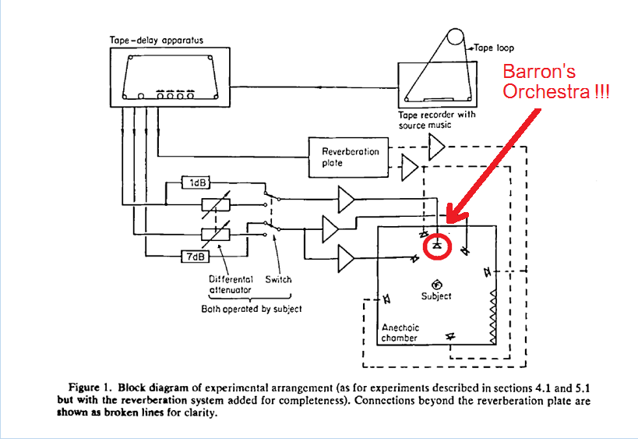
Barron and Marshall Spatial Impression and the effect of early reflections Journal of Sound and Vibration. (1981) 77(2), 211-232
Barron and Marshall’s classic paper on spatial impression used only a single speaker to reproduce a whole orchestra. The orchestra image was totally unrealistic. This is a very serious error.
They found adding lateral reflections widened the image. They used the term “Apparent Source Width” (ASW) to describe what they thought was an improvement to the sound.
ASW has since been quoted as beneficial to hall acoustics in nearly every article and text book.
But ASW reduces localization, eliminates proximity, and decreases envelopment.
Most standard ISO 3382 measures were developed with similar experiments.

Slide 14
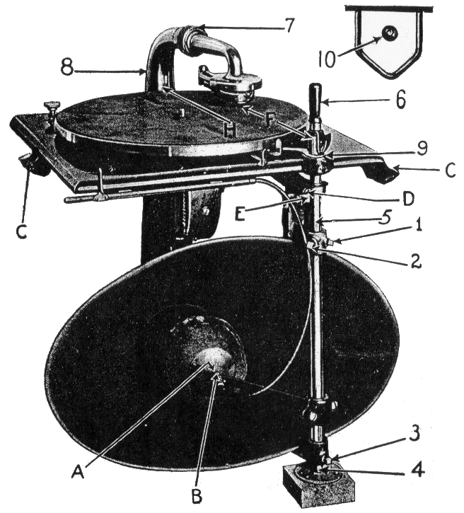
To reproduce “Proximity” the rule is simple: you need one linear phase speaker for each voice.
Edison, through meticulous A/B tests, succeeded with his “diamond disk” phonograph.
I heard one of these phonographs, and found it completely convincing. The soprano was right there in front of me.
Research with electronic orchestras by Hamasaki, Woszczyk, and Campbell found the same thing.

Slide 15
Lokki and Neil succeeded in detecting proximity by following the same rules:
Reproducing each instrument through a single loudspeaker as close as possible to the original azimuth.
And using an independent anechoic track for each instrument.

Slide 16
“Close” and/or “attention- grabbing” might be also descriptors for “proximity”
Sounds that have proximity are perceived as close to a listener
Both in natural hearing and in a sound mix.
Sounds with proximity “pop forward” out of background sounds, and other instruments in a recording.
Our brains involuntarily pay attention to close sounds. They may predict danger.
They are also easier to interpret and remember.

Slide 17
How do we detect a sound as present and close?
Humans can distinguish when a sound is close or far in under a tenth of a second.
The ability is preserved even when loudness and spectrum vary.
No current hearing model can explain the distance perception effect.
That is not all. No current hearing model can duplicate our abilities to understand speech in noisy environments – a vital ability for survival.
Something vital is missing from standard models of hearing!

Slide 18
The missing element is periodic pulses in the sound pressure.
Nearly all creatures communicate with sounds are created by periodic bursts of pressure or tension that create strong periodic pulses in the sound waveform.
Squeaks, growls, whistles, and buzzes, are universal with animals, and human speech relies on voiced vowels.
Why?
Because the phases of the harmonics of pulses preserve the pulses that created them!
Once in each fundamental period the harmonics align in phase to create a replica of the original pulse.

Slide 19
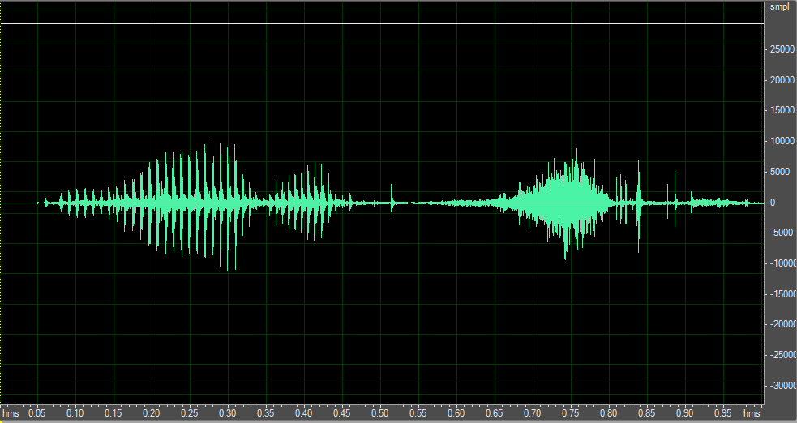
The amplitude spikes in the upper harmonics of voiced speech cut through noise and reverberation
The syllable “one” voiced and then whispered, high-pass filtered at 1000Hz, with equal RMS level.

Slide 20
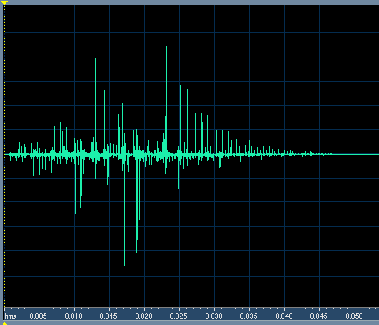
But reflections can eliminate these periodic pulses
This impulse response has C50 and C80 = infinity. STI = 0.96, and RASTI = 0.93.
The second half of this sentence is convolved with this IR. The second half sounds muddy and distant because the IR randomizes the phase of harmonics above 1000Hz!!!
left
right

Slide 21
More important: the phase spikes in speech or music allow the ear to separate different sound sources into independent neural streams!
The spikes in the upper harmonics of speech and tones combine to recreate the periodic pulses that created them.
A filter that precisely matches the period of each fundamental can separate these signals from each other and from noise.
Humans are as much as 20dB better at extracting speech from noise than any most computer speech recognition systems. (ASR)
Many earlier ASR systems ignored the phase of signals above 1500Hz!
Separating speech signals from each other requires the ability to precisely determine the period or pitch of speech. Evolution has provided humans with this ability.
Musicians can tune their instruments with an accuracy of one or two parts in a thousand. People with no musical training can do almost as well!

Slide 22
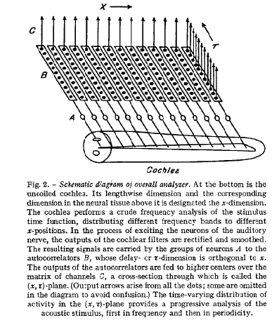
A mechanism for perceiving pitch was proposed by J. C. R. Licklider in 1951
Licklider proposed that our acuity of pitch perception could only be explained by an autocorrelator located as close as possible to the hair cells.
He did not propose that this circuit could also separate sources from each other.
We believe this circuit is most likely directly below the hair cells in the spiral ganglia.
Before signals are sent to the auditory nerve they may have already been separated from each other by pitch.

Slide 23
The autocorrelator in the organ of Corti also enables source separation
Which is essential to surviving parties and enjoying polyphony.
We can separate two simultaneous talkers from each other if their vocal pitches are different by as little as half a semitone!
Without the peaks created by the phases of harmonic tones we cannot separate or localize these signals.
After separation by pitch
C and C# mixed

Slide 24
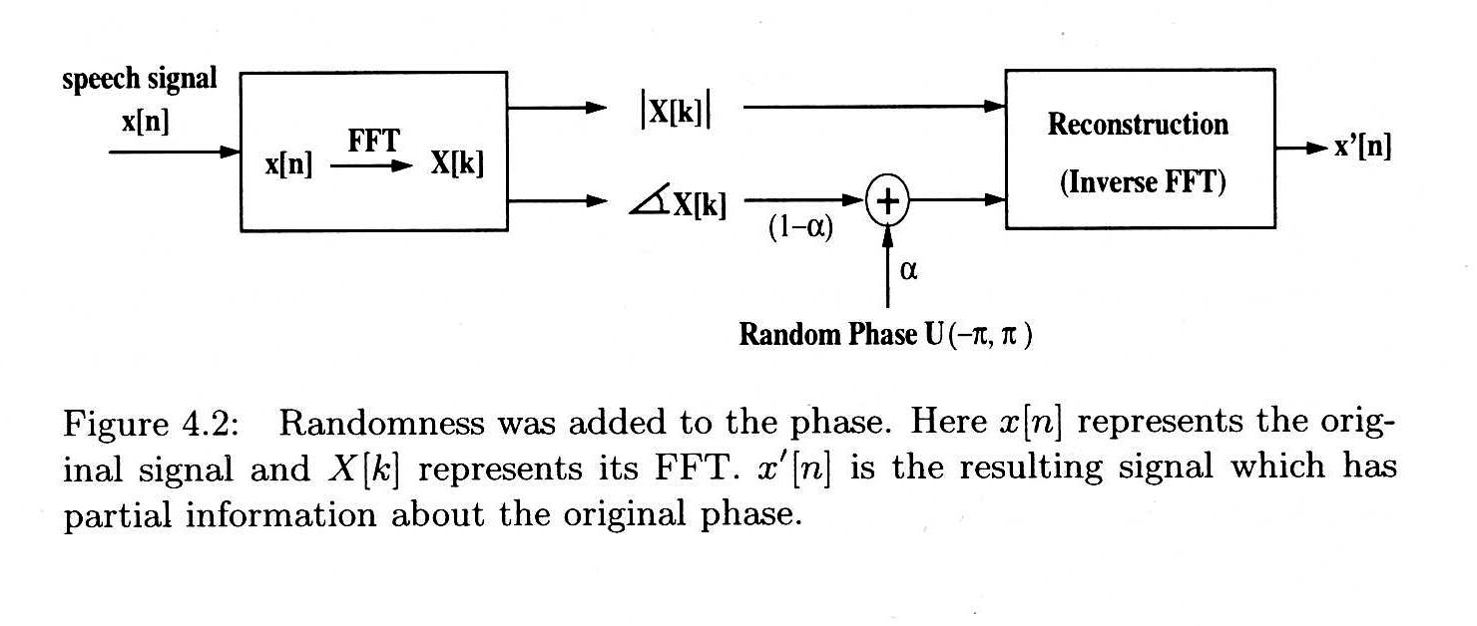
Aarabi et al studied the effects of phase randomization on word recognition
A random phase function was added to standard word lists with various amounts of added noise.

Slide 25
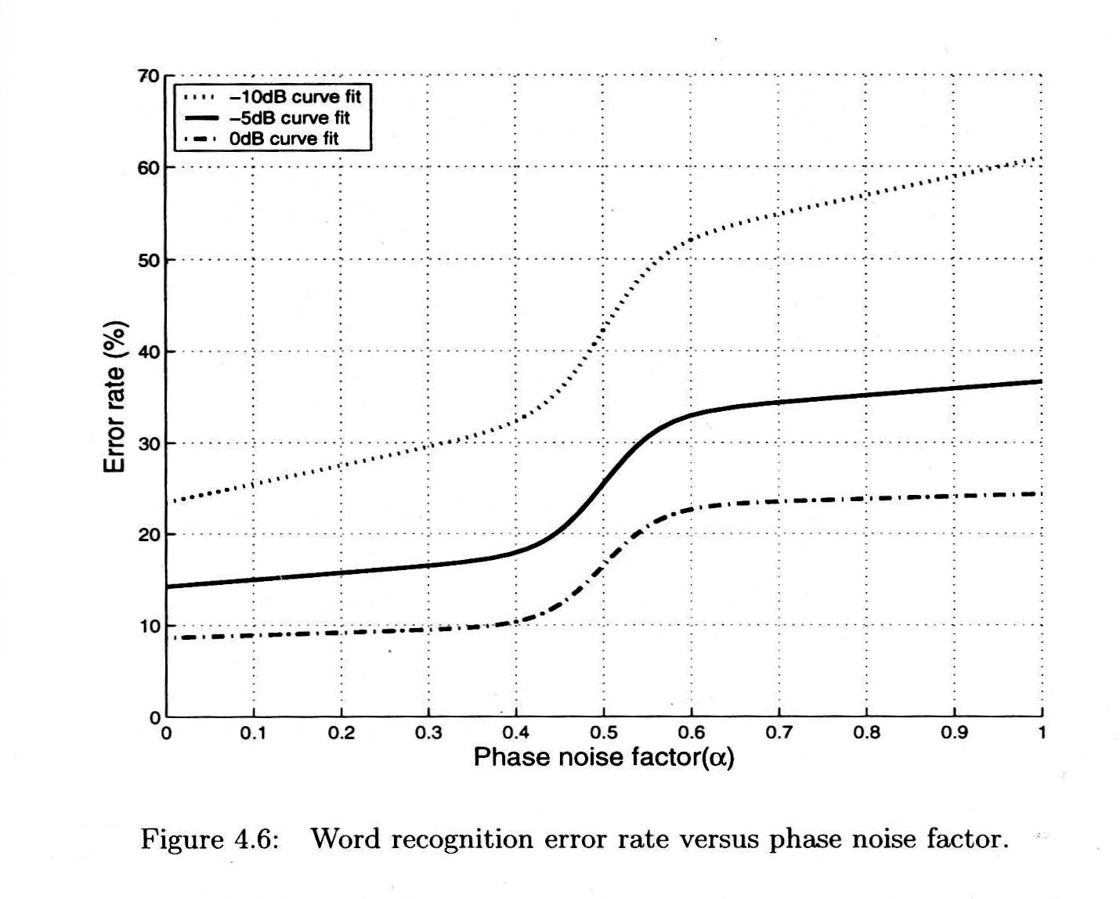
The effect of phase noise on the error rate of speech was dramatic
In all cases the error rate jumps up rapidly when the peak phase modulation is +- 90 degrees

Slide 26
Word recognition vs recall
Aarabi has shown that phase randomization can dramatically increase errors in word recognition in noisy environments.
But word recognition is only a first step. We need to recall what we heard at a later time!
A primary determinant of recall is attention!
Randomization of phase decreases proximity, and lack of proximity decreases attention and recall.

Slide 27
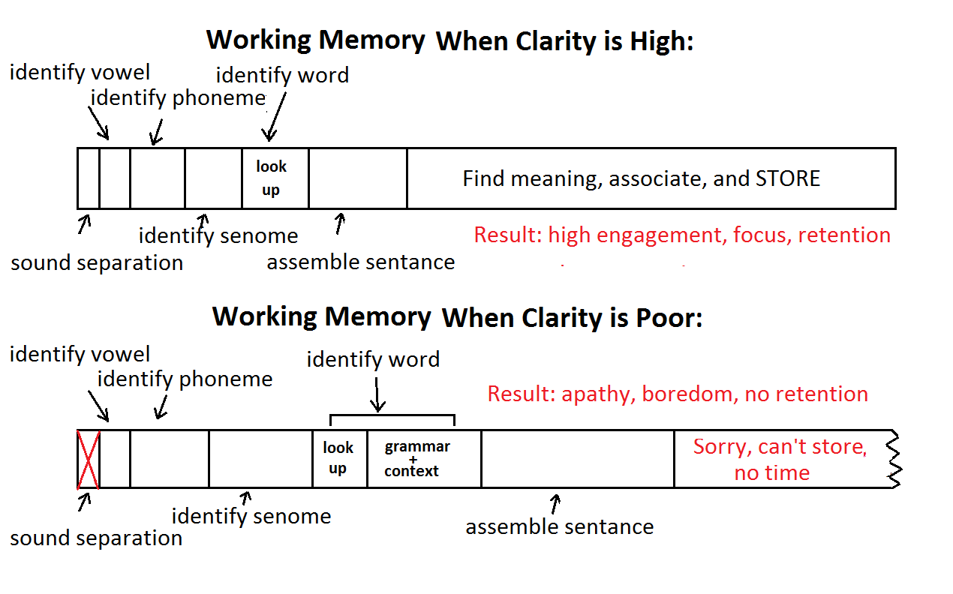
Classrooms and opera: where working memory is limited and clarity is essential.
We can hear the words – but we can’t remember what was said!

Slide 28
How can we measure and predict Proximity?
A practical autocorrelator of the type Licklider proposed needs to be about 80ms long to achieve human pitch acuity.
A minimum of five equally spaced taps is required.
With this knowledge we have developed a measure, LOC, that predicts when a sound source becomes distant and not localizable.

Slide 29
Our measure, LOC, uses the ability to sharply localize sound as a proxy for near/far.
We determined the threshold of localization of voiced speech in reverberation as a function of D/R and pre-delay. RT values of 1 second and two seconds were tested.
For a 2s RT the threshold of localization can be as low as -17dB!
We developed the function LOC to predict this data. The red and cyan lines show the accuracy of the fit.
The LOC measure has been tested in real rooms and halls with useful results.

Slide 30
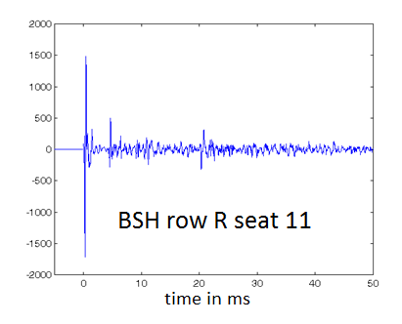
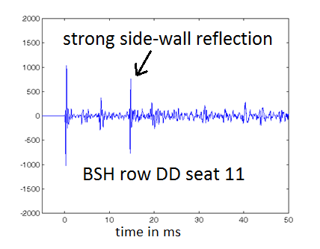
Example: Two seats in Boston Symphony Hall
C80 = 0.85dB IACC80 = .68 LOC = +9.1dB
C80=-0.21 IACC80 = 0.2 LOC = -1.2dB
C80 predicts these seats should sound the same, and IACC predicts that row DD should sound better.
LOC finds row R is better by 10dB!

Slide 31
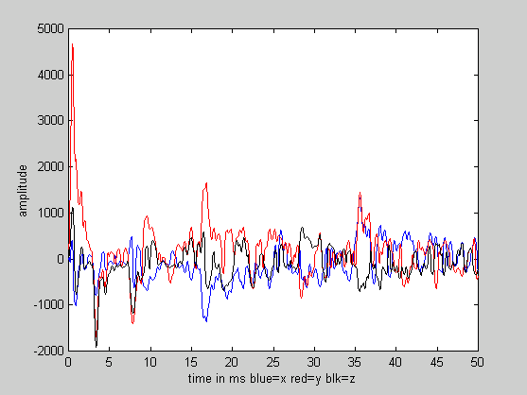
Binaural experiments in Boston Symphony Hall
We measured 7 seats in under 40 minutes
Here is a 2kHz Soundfield plot from seat DD 11
Note the strong side-wall reflections at 17ms and 37ms. These are clearly doubles – from the wall and the under-balcony ceiling.

Slide 32
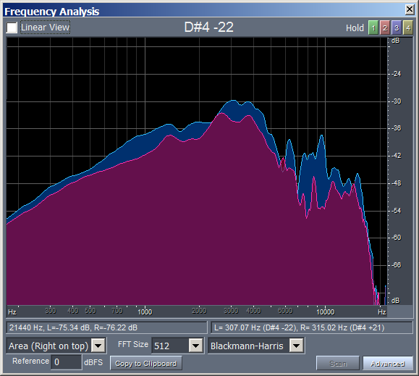
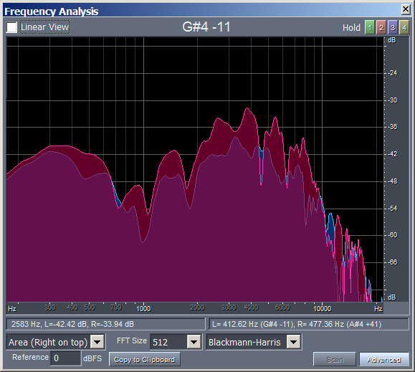
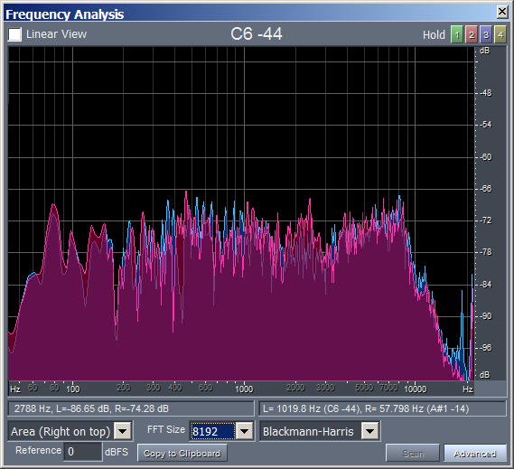
The measured data needs to be equalized to compensate for the source and the dummy
We can equalize the data by assuming the hall sound is flat at about 160ms.
direct sound first lateral reflection 160ms reverberation
Spectra measured at seat DD 11 after equalizing the reverberation

Slide 33
We use a single binaural measurement to auralize a small ensemble.
We modify the ILD and ITD of the direct sound in the measurement to give the instruments distinct azimuths.
Since the anechoic tracks for each instrument are un-correlated, we can use the same reflection and reverberation data for each instrument.
We can also use mathematics to compensate for the loudspeaker directivity, and to alter the reverberation time of the hall.

Slide 34
A Matlab script creates three separate binaural tracks.
1. A binaural track for the direct sound only.
2. A binaural track for the first reflection only.
3. A binaural track for the reverberation without the first reflection.
If we play all three tracks together through individually equalized headphones the sound at that seat is re-created.
We have live binaural recordings in these seats, and the accuracy of the recreation is quite good.
With a sound mixer we can find WHY the seat is good or poor by modifying the loudness and equalization of each track.

Slide 35
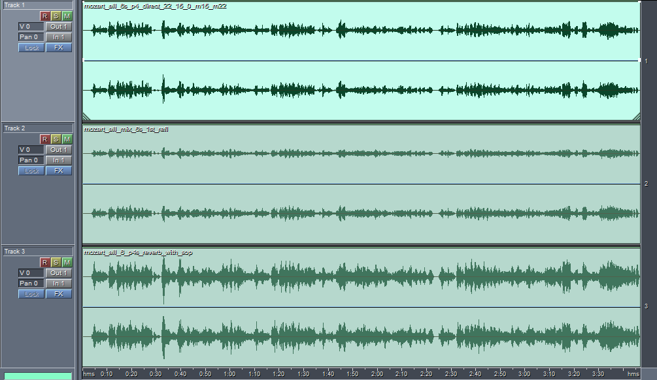
We can A/B compare different combinations on individually equalized headphones For seat DD11:
Direct Only
dd_11_direct.mp3
1st Refl Only
dd_11_first_refl.mp3
Direct+1st
Reverb Only
dd_11_reverb.mp3
All Together
All no 1st
There is an enormous improvement in proximity when we delete the first lateral reflection.

Slide 36
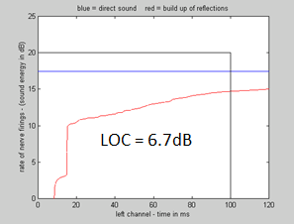
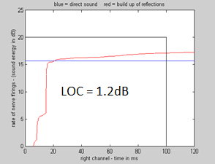
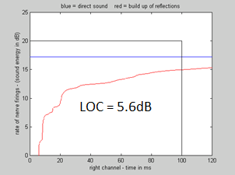
Is the difference in sound from deleting the first reflection measurable with LOC?
LOC measurements in seat DD 11
LOC in the left ear in seat DD 11 LOC in the right ear LOC in the right ear with no 1st reflection
We learned that the perception of “Proximity” is best predicted by the measured LOC value in the lesser of the two ears. A LOC value of 1.2 dB is unacceptable, and a value of 5.6 is good.

Slide 37
We can A/B compare different combinations on individually equalized headphones For balcony row 2 seat 26:
Direct Only
b2_23_direct.mp3
1st Refl Only
b2_23_1st_refl.mp3
Direct+1st
Reverb Only
b2_23_reverb.mp3
All Together
All no 1st
There is an a subtle improvement in sound when we delete the first reflections from the floor.

Slide 38
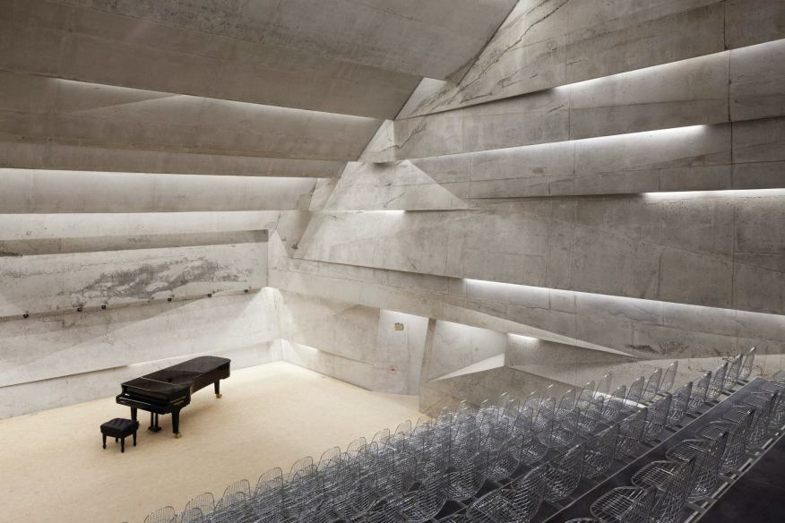
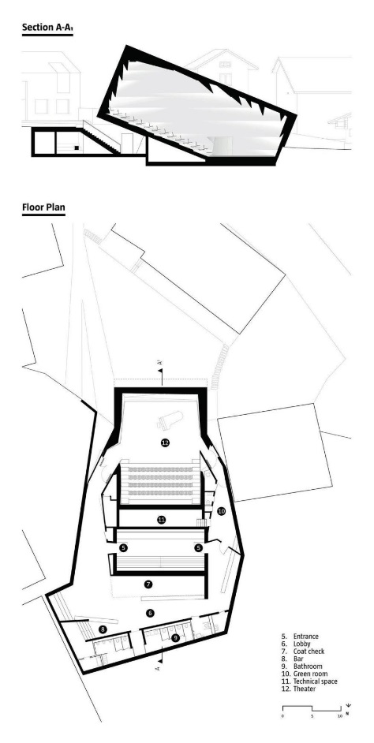
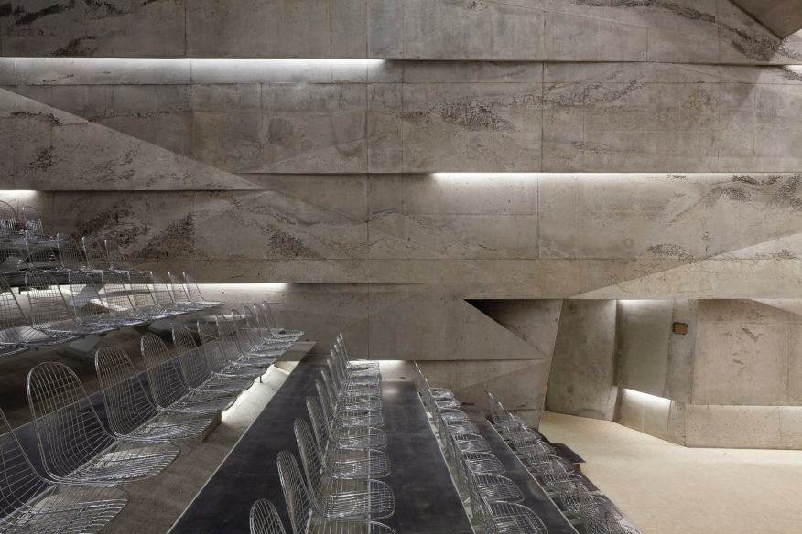
An unusual hall in Bleibach Germany
All First reflections have been directed away from the audience
The hall is a small tilted shoebox. Normally early reflections would be too strong.
The design is intended to provide unusual clarity in combination with a long reverberation time.
Sight lines are also unusually good, and there is no seat-back absorption of bass.

Slide 39
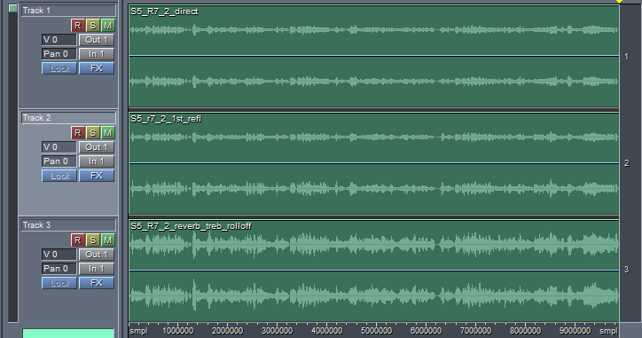
We can A/B compare different sound combinations for this unusual small shoebox hall in row 7 seat 9
Direct Only
1st Refl Only
Direct+1st
Reverb Only
All Together
All no 1st
There is an improvement in the sound when the first reflection at 2.6ms is present!
It successfully augments the direct sound.

Slide 40
Conclusions
Proximity – the perception that a source is acoustically close - is an important determinant of attention and recall.
The presence or absence of Proximity in particular seats can be determined by listening for the localization of instruments in a small (electronic) ensemble.
The ear detects proximity through the phase coherence of upper harmonics in the direct sound, which are randomized by early reflections.
Binaural technique with individual headphone equalization is a practical standard against which other hall research techniques can be judged.
Headphones can be non-invasively equalized to match individuals through loudness matching.
Existing binaural data can be balanced and equalized to yield a very good snapshot of the sound of an ensemble in a particular seat.
This data can be further manipulated to discover why the sound is good, or how to improve it if it is not.
Using these techniques we find the first-order lateral reflections in Boston Symphony Hall are excessive.
In every seat tested they are either inaudible, or they reduce or eliminate proximity.
Deleting them improves both the clarity of the music and the sound of the hall with no decrease in loudness.

Slide 41
DGSonicFocus: Apps that equalize headphones to match the spectrum at the eardrum from a frontal source.
Ear canals are very different for each individual!
Thus the frequency response at the eardrum from the front is also very different.
When headphones are worn these ear canal resonances change dramatically.
With headphones what we hear is very different from our natural hearing.
In-head localization and incorrect timbre results.
Our DGSonicFocus apps match headphones to these individual hearing resonances!
The result is frontal localization and correct timbre.

Slide 42
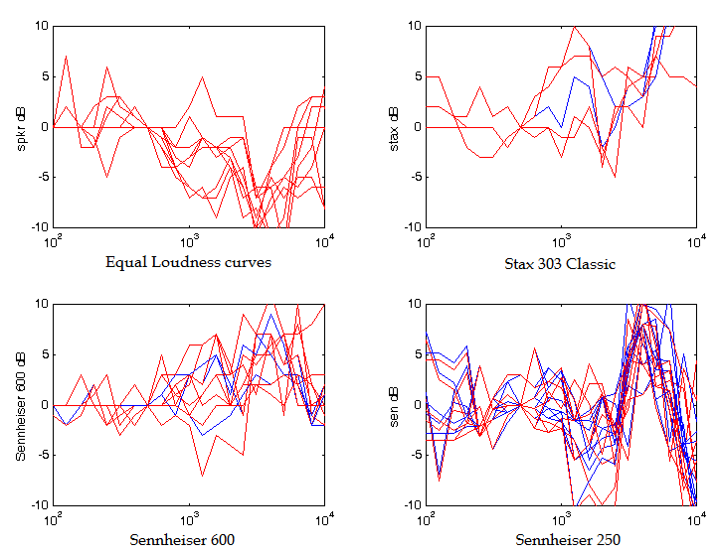
Similar data from acoustics graduate students at Rensselaer University

Slide 43
Individual headphone equalization is critical because the ear canal resonances are very different for each person!
我们将展示十个听音员用Sennheiser 600听到的声音。
We will demonstrate the timbre perceived by ten listeners from a pair of Sennheiser 600 headphones.
每段声音首先是1秒的粉噪，随后是该听音员从耳机中听到的5秒的声音。
One second of pink noise will be followed by 5 seconds of the spectrum perceived for each listener from the headphone.

Slide 44
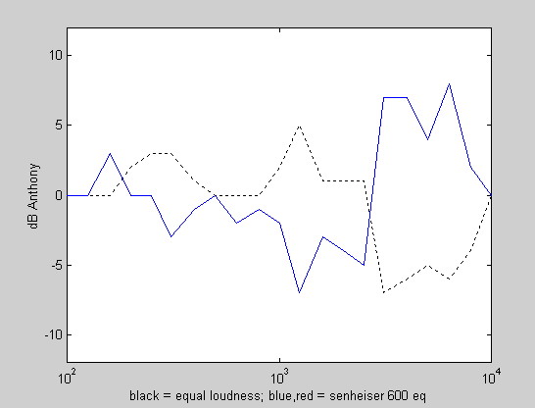
Anthony
Timbre Perceived
Correction Needed
黑色曲线是扬声器的等响曲线，蓝色曲线是耳机所需的均衡。听到的声音是蓝色曲线的逆曲线。
Black is the personal equal loudness to a loudspeaker
Blue is the correction needed for the headphone
The timbre perceived is the inverse of the blue curve.

Slide 45
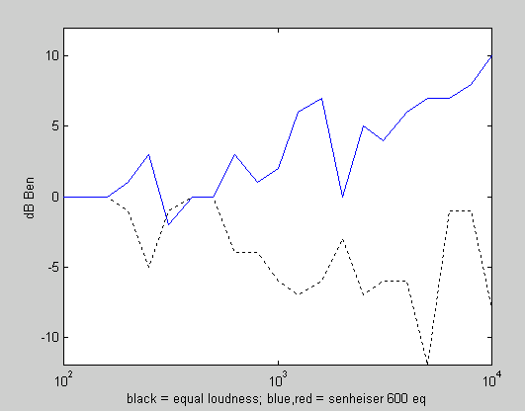
Ben
Timbre Perceived
Correction Needed
黑色曲线是扬声器的等响曲线，蓝色曲线是耳机所需的均衡。听到的声音是蓝色曲线的逆曲线。
Black is the personal equal loudness to a loudspeaker
Blue is the correction needed for the headphone
The timbre perceived is the inverse of the blue curve.

Slide 46
David
Timbre Perceived
Correction Needed
黑色曲线是扬声器的等响曲线，蓝色曲线是耳机所需的均衡。听到的声音是蓝色曲线的逆曲线。
Black is the personal equal loudness to a loudspeaker
Blue is the correction needed for the headphone
The timbre perceived is the inverse of the blue curve.

Slide 47
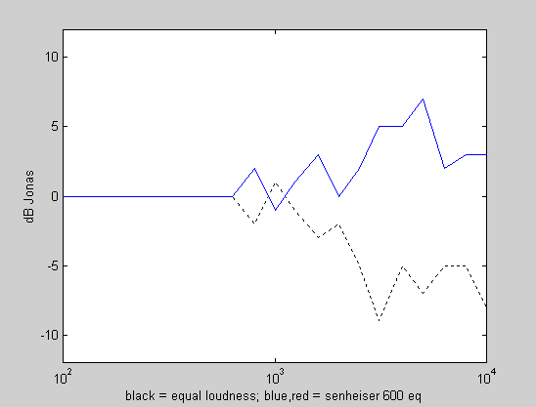
Jonas
Timbre Perceived
Correction Needed
黑色曲线是扬声器的等响曲线，蓝色曲线是耳机所需的均衡。听到的声音是蓝色曲线的逆曲线。
Black is the personal equal loudness to a loudspeaker
Blue is the correction needed for the headphone
The timbre perceived is the inverse of the blue curve.

Slide 48
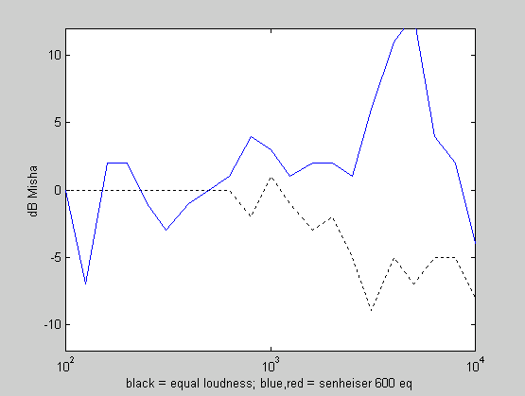
Misha
Timbre Perceived
Correction Needed
黑色曲线是扬声器的等响曲线，蓝色曲线是耳机所需的均衡。听到的声音是蓝色曲线的逆曲线。
Black is the personal equal loudness to a loudspeaker
Blue is the correction needed for the headphone
The timbre perceived is the inverse of the blue curve.

Slide 49
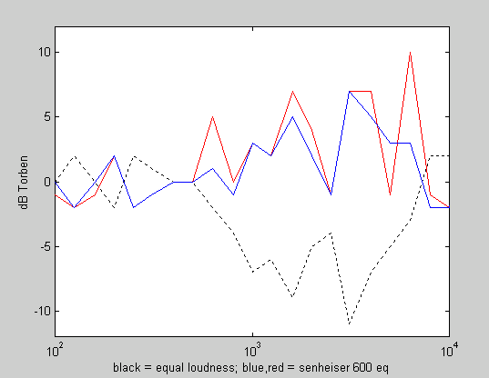
Torben
Timbre Perceived
Correction Needed
黑色曲线是扬声器的等响曲线，蓝色曲线是耳机所需的均衡。听到的声音是蓝色曲线的逆曲线。
Black is the personal equal loudness to a loudspeaker
Blue is the correction needed for the headphone
The timbre perceived is the inverse of the blue curve.

