Slide 1
The physics of auditory proximity and its effects on intelligibility and recall
David Griesinger
David Griesinger Acoustics
dhgriesinger@gmail.com
www.davidgriesinger.com

Slide 2
Introduction
I am a Physicist, recording engineer, singer, and former horn player who likes inventing new devices and discerning explanations for puzzling audio phenomena.
In this presentation I will revew some of the mechanisms that allow us to play musical instruments with precision and to distinguish small differences in pitch and timbre.
Our abilities to communicate with each other by sound depend not only on the spectra of speech and music, but also on our remarkable abilities to separate signals from each other and from noise. In rooms and halls we find that these abilities often fail abruptly at a particular distance from the source. Beyond this distance attention and much of our ability to recall what we heard is compromised.
In the past science has concentrated on the spectra of speech and music, while largely ignoring the amplitude waveforms. When periodic peaks in amplitude waveforms are perceived multiple sources can be separated by their pitch. When this is possible we have the perception of “Proximity,” a major component of preference and recall. This talk will show how our hearing detects and uses these waveforms.

Slide 3
Why are we able to play violins?
We are able to play violins because evolution has given us tools to separate sounds by pitch.
Musicians can play instruments with a pitch accuracy of a few hundredths of a semitone. Why did this ability evolve? There is evidence from stone tools that at least by 300,000 years ago hominids had language. Decoding language requires hearing it clearly.
It has been known since the 1890s that human speech uses variations in the spectrum of the upper harmonics of these tones to encode vowels.
But spectra are only part of the story. Humans can separate two monaural speech streams that differ in their fundamental frequency by only a quarter of a semitone. Whereas two people whispering at the same time are totally unintelligible.
Accurate determination of the fundamental frequency (f0) of sound streams is essential to human (and probably animal) communication. At the end of the talk we will arrive at a point where we will be happy to listen to two violins at the same time.

Slide 4

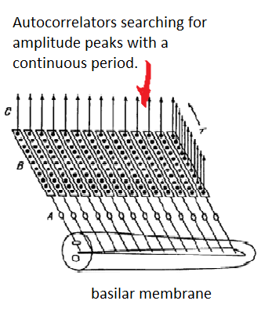
A mechanism for perceiving pitch was proposed by J. C. R. Licklider in 1951
  Licklider proposed that our acuity of pitch perception could only be explained by an array of “auto correlators” located as close as possible to the hair cells.
  These neural circuits would find the fundamental frequencies of signals by detecting the regular timing between amplitude waveform peaks on the basilar membrane.
  He did not suggest that the same circuitry could also separate signals with different f0s from each other, but it can! We believe these circuits evolved to separate speech from noise and other speakers.
  We believe this circuit is most likely in the spiral ganglia directly below the hair cells in the basilar ligament.
Before signals are sent to the auditory nerve they may have been already separated from each other by pitch.

Slide 5
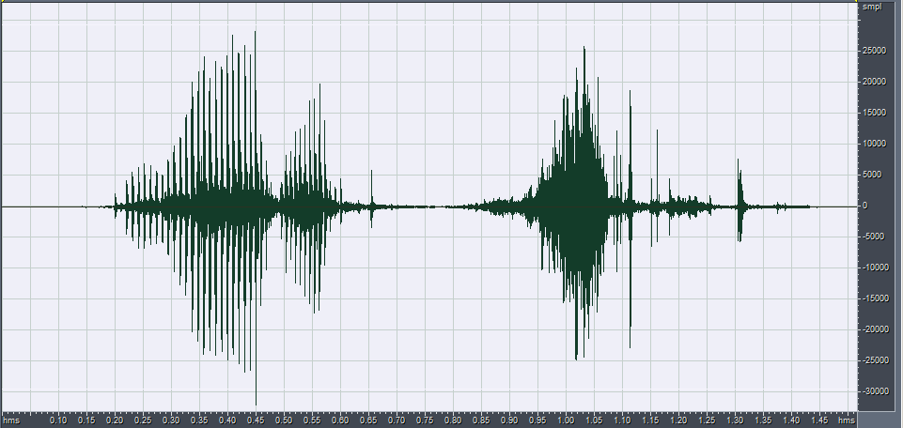

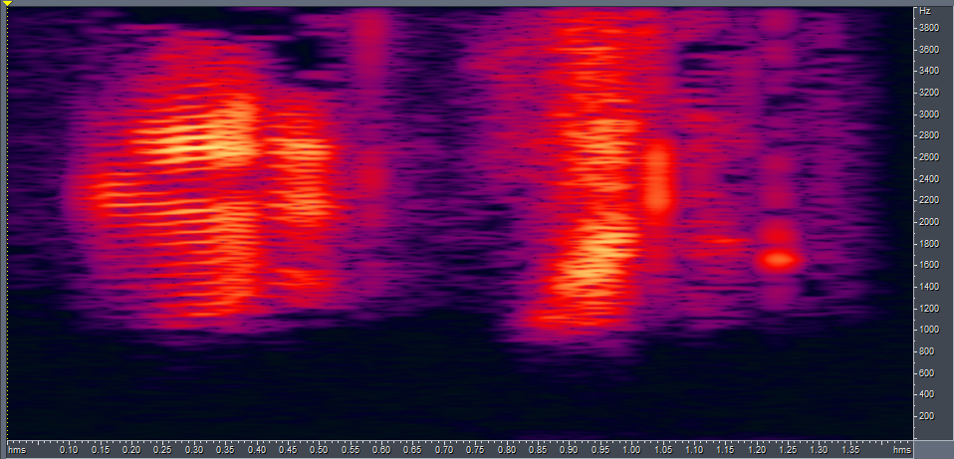
Amplitude Waveforms show far more information about speech signals than Spectra. Our ears use this information!
Amplitude waveforms from voice and a whisper high pass filtered at 1000Hz
Spectra from the voice and the whisper 1000Hz to 4kHz. The spectra look similar. The amplitude waveforms look very different.

Slide 6
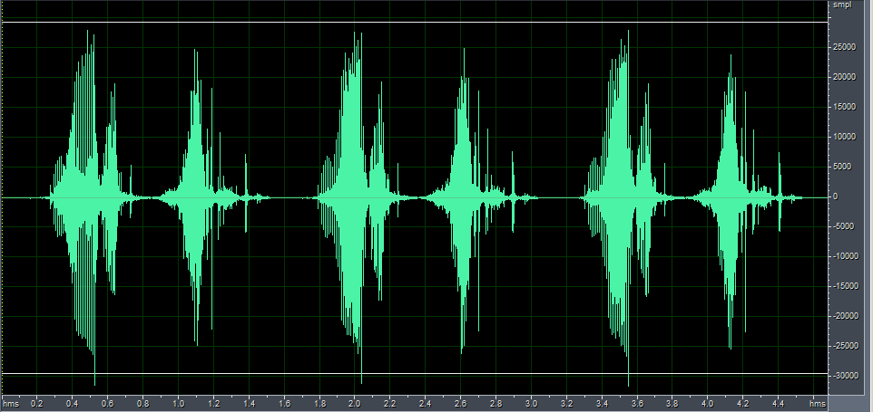
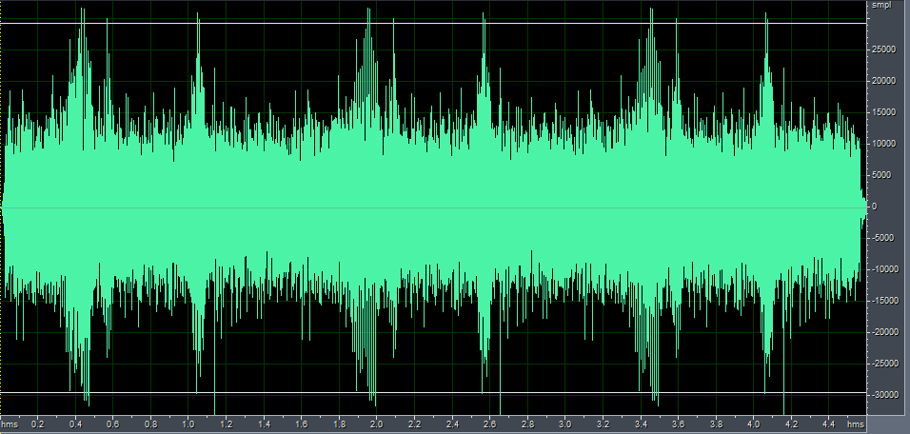
The periodic amplitude spikes in the upper harmonics of voiced speech cut through noise and reverberation
The syllable “one” voiced and then whispered, high-pass filtered at 1000Hz, with equal RMS level. When noise is added the whisper is unintelligible.

Slide 7
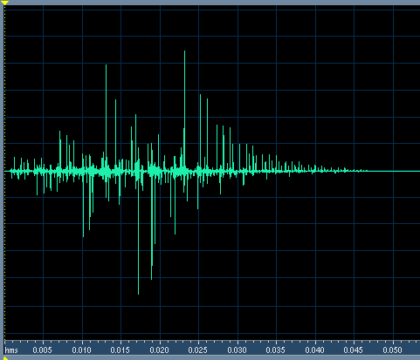
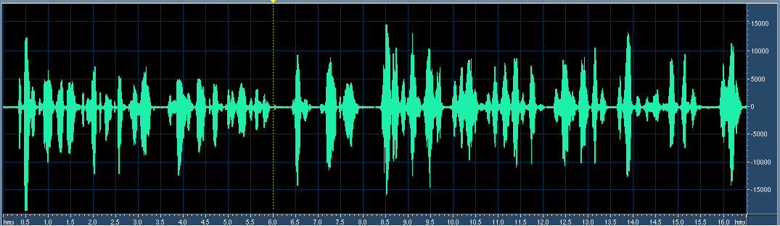
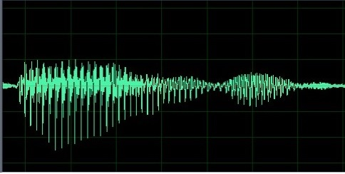
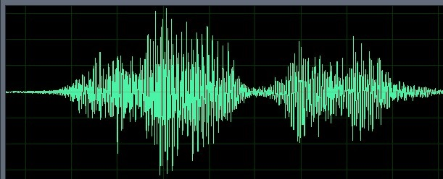
Reflections can eliminate these periodic pulses. The result is muddy. Muddy sound is hard to separate from other sounds and noise.
We added the reflections at the right to the second half of a sentence. The first half sounds clear and nearby. The second half sounds muddy and distant because these reflections randomize the phases of harmonics above 1000Hz.
Clear Speech with regular pulses Muddy speech – no regular pulses

Slide 8
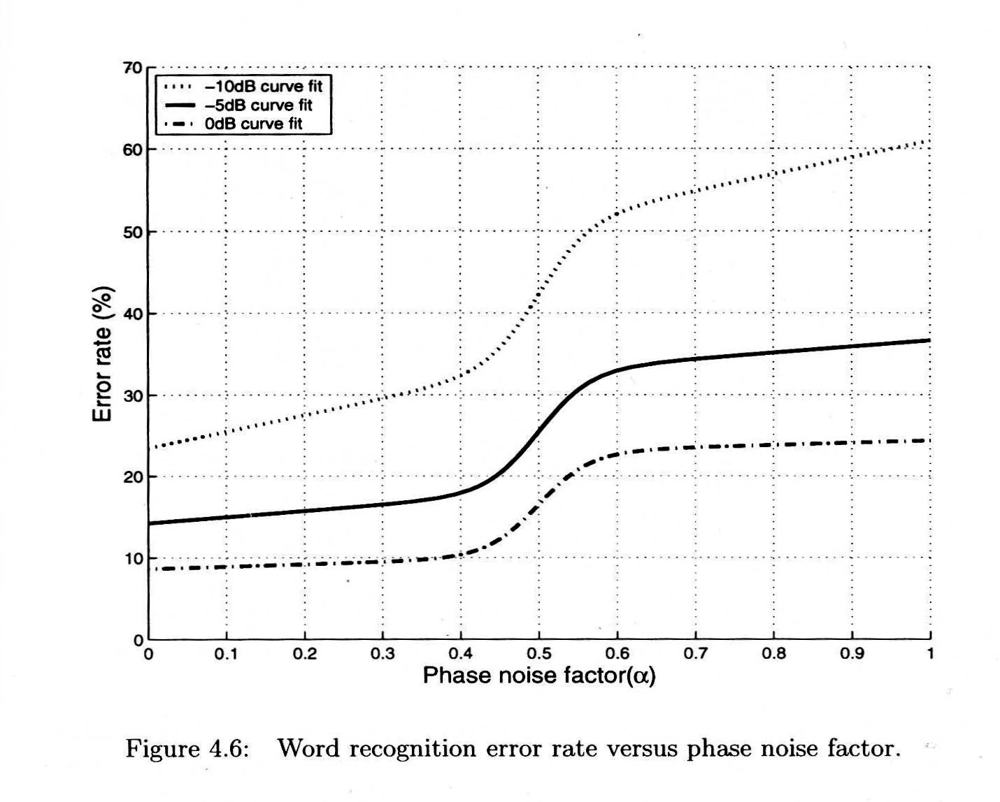
Aarabi et al studied the effects of phase randomization on word recognition
Sounds can have amplitude noise and/or phase noise. Phase noise, sometimes known as jitter, makes signals sound distant and difficult to separate from noise.
Aarabi’s Subjects listened to standard word lists with three signal to noise ratios, 0dB, -5dB, and -10dB. He found that the error rate doubles when the phase is 50% original and 50% random noise.

Slide 9
Word recognition vs recall
Aarabi showed that phase randomization can dramatically increase errors in word recognition in noisy environments.
But word recognition is only a first step. For a message to be useful we need to recall what we heard!
A primary determinant of recall is attention!
Randomization of phase decreases what we now call “Proximity”, and lack of proximity decreases attention and recall.

Slide 10
What is “Auditory Proximity?”
Lokki et al performed preference tests using an electronic orchestra in concert halls in Scandinavia. “Disentangling preference ratings of concert hall acoustics…” (2012)
He found that the one perceptual attribute that correlated with preference for all listeners was unnamed, and was then un-measurable. He called it “Proximity”
“An interesting fact is that neither Definition, Reverberance, C80 or EDT (early decay time) explain preference at all. Preference is best explained with Proximity. Further there is no objective measure that correlates to Proximity and overall average of preference.”
At the ISRA conference in Amsterdam October of 2019 Matthew Neil et al described blind listening tests of an electronic orchestra in famous concert halls. They found that more than 75% of the preference could be explained by a single perception: “Proximity”
We have been calling the proximity perception “Engagement”, “Clarity”, or “Presence” since 2004. We have a measure for it we call “LOC”.

Slide 11
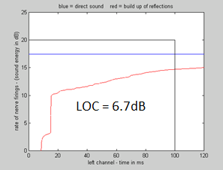
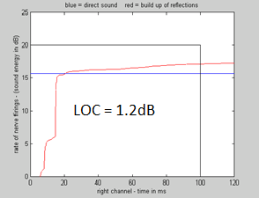
We have a method that uses a binaural impulse response to predict the presence or absence of proximity.
Our measure, LOC, compares the sum in decibels of the direct sound and the reflections in a 80ms window. LOC is an objective measure that predicts the perception of proximity.
In the pictures below the direct sound is plotted in blue, and the strength of the sum of the reflections is plotted in red. The difference between the area below the blue line and the area under the red line in the 80ms window is the value of LOC in dB. A value for LOC of +3dB predicts good proximity.
In this seat reflections build slowly. Proximity is excellent.
In this seat there is a strong early reflection at about 18ms. The reflected energy builds up quickly, and the sound is muddy.

Slide 12
The Limit of Localization Distance: The LLD
We find that proximity is not a continuous perception. A source is either proximate, or it is not.
In most halls proximity disappears over a distance of one meter at a particular distance from the sound sources. We call this the “Limit of Localization Distance” or LLD.
The LLD can be easily mapped by walking around while listening, but not looking at, a live or electronic ensemble.
We propose that the availability of seats where listeners perceive performers as close or “Proximate” is an important measure of hall quality.

Slide 13
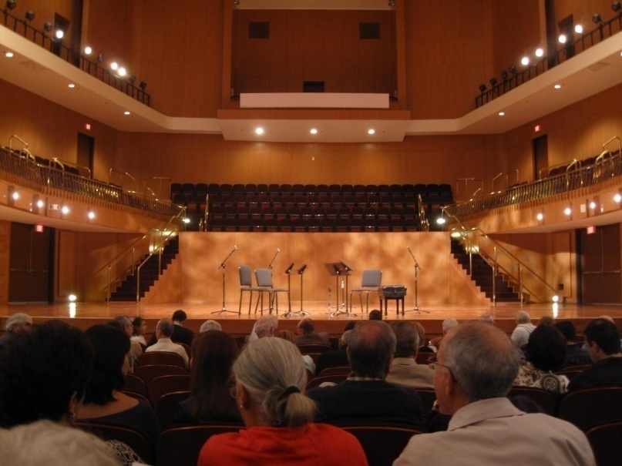
We can hear the difference in sound in front of and behind the LLD in a shoebox hall in Puerto Rico.
This recording was made from row F, just behind the woman in the picture.
The four instruments are clear and separate. The sound is bright, clear, and spacious in spite of the reverberation.
The next recording was made just five rows further back in row K.
The sound is blended and muddy. There are too many early reflections!

Slide 14
Finding the Limit of Localization Distance, or LLD
If you walk away from an ensemble with your eyes averted, at first the sound is clear and each instrument is sharply localized.
But at a particular distance the sound completely changes. It becomes a muddy ball. This is the limit of Localization Distance, or LLD.
We find the LLD using five speakers and Lokki’s anechoic recordings of Mozart. We use a first violin, second violin, viola, cello, and a soprano.
With electronic instruments you cannot see which instrument is playing, so you don’t need to close your eyes.
Two violins are sufficient to find the LLD. In front of the LLD you can localize each instrument. Behind the LLD the sound blends together.

Slide 15
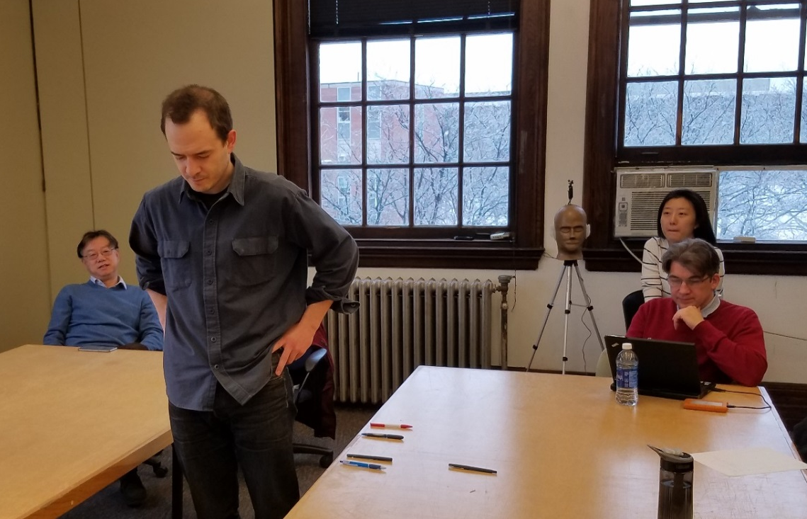
LOC predicts the LLD well in halls with music from a small ensemble, but with just two violins in a small room the LLD was about two feet closer.
But there was substantial agreement about where the LLD was found.
We did an experiment in a small classroom at Rensselaer Polytechnic Institute (RPI), using just the violin 1 and 2 tracks from Lokki’s recordings.
Each listener dropped a pencil at the point where localization was lost. They agreed on where localization failed.
The LLD found by the listeners was several feet in front of the LLD predicted by LOC.
By experimenting with binaural recordings we found that violins are somewhat more difficult to localize than speech or woodwinds.
There is a paper on my web-page that describes recent improvements to LOC, along with Matlab and stand alone Windows C language code for calculating it. See the URL below the picture.
https://www.dropbox.com/sh/p9ufove0e5moy6s/AACL1sA853AYfzs6CgJ8MLAYa?dl=0

Slide 16
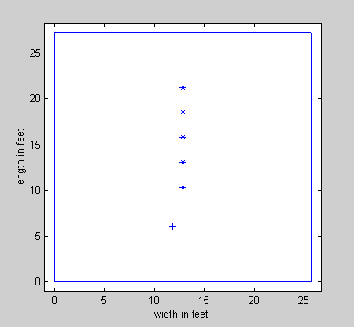
STI , the speech transmission index, is a standard way of measuring intelligibility in halls and classrooms. We calculated both STI and our measure for proximity, LOC, in a 27’x25’x10’ room with surface absorption of 0.15 and RT 0.34s.
The room was modeled with a single sound source (+) and five receiver positions. (*)
The intelligibility as measured by STI is very good in all positions. Only the first position has good Proximity. The difference is easy to hear.
LOC greater than +3dB predicts good proximity. LOC less than zero predicts poor proximity and attention.
Receiver pos.
STI LOC
.75 -2.3dB
.73 -3.4dB
.74 -2.7dB
.74 0.3dB
.75 4.0dB
21.3’
18.5’
15.8’
13.8’
10.4’
9.5’
Teacher
6’
A small room with a 0.34 second RT has excellent STI – but the teacher is heard with proximity only in the front seat.

Slide 17
This model classroom is greatly improved by increasing the average absorption to 0.3
When you listen to the sound clips the improvement in proximity compared to the previous slide is very clear.
LOC is excellent to fair in all positions.
The intelligibility measured by STI also increases.
Receiver pos.
STI LOC
.84 2.4dB
.85 1.4dB
.85 2.4dB
.85 5.1dB
.85 8.5dB
21.3’
18.5’
15.8’
13.8’
10.4’
9.5’
Teacher
6’
A small room needs a lot of absorption if proximity is to be high in all the seats.

Slide 18
Why did we not discover “Proximity” sooner? There are two reasons.
1. -Proximity describes the perception that a sound source is sonically close to the listener.
  If your eyes are open you often cannot detect the absence of Proximity. If you see a source clearly you are sure you are hearing it clearly.
2. - To study proximity your reproduction system must be able to reproduce it! This requires a single loudspeaker for each instrument or voice, and preferably an anechoic recording.
Proximity was not discovered until recently because earlier experiments did not use individual instruments.

Slide 19
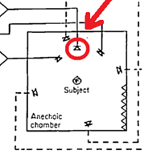
Barron and Marshall
Spatial Impression and the effect of early reflections
Journal of Sound and Vibration. (1981) 77(2), 211-232
Barron and Marshall’s classic paper on spatial impression used a single speaker to reproduce a whole orchestra. The orchestra recording had no proximity. Many later experiments repeated this arrangement.
They all found that adding lateral reflections widened the image. They used the term “Apparent Source Width” or ASW to describe what they thought was an improvement to the sound.
Barron’s orchestra
ASW has since been quoted as beneficial to hall acoustics in nearly every article and text book.
But ASW by definition eliminates sharp localization and decreases proximity.

Slide 20
Lokki and Neil succeeded in detecting proximity by following the same rules:
Reproducing each instrument through a single loudspeaker as close as possible to the original azimuth.
And using an independent anechoic track for each instrument.

Slide 21
“Close” and/or “attention- grabbing” might be also descriptors for “proximity”
Sounds that have proximity are perceived as close to a listener.
  Our brains involuntarily pay attention to close sounds. They may predict danger!
  They are also easier to interpret and remember.
  Both in natural hearing and in a sound mix, sounds with proximity “pop forward” from other instruments and background sounds. This is well known by sound engineers, cinema directors and opera conductors.

Slide 22
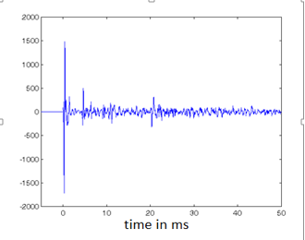
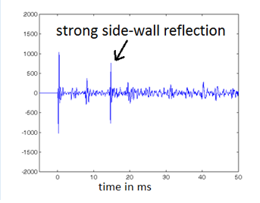
Where do we like to listen to violins?
LOC = 9.1dB
LOC = 1.2dB
Here are impulse responses from two seats in a large concert hall, one near the middle of the hall, and one near a side wall. C80 (a current measure for clarity) says they should both sound good. But LOC says the seat in the center sounds much better! (It does!) Both seats share the rich reverberation of this hall, but avoiding the side wall is a good strategy.
In many small halls there is a strong reflection from the back of the stage which reduces the number of seats with proximity. Adding absorption to the back and side walls can help a lot without much reduction of the reverb time.

Slide 23
Where do we like to play violins?
Musicians can learn a lot about their playing by listening to the reverberation of the space around them. This is difficult in small spaces because their own playing masks the sound of the room. As rooms get larger there is enough time between the direct sound of the instrument and the reflections that our brains can separate the room sound into an independent perception, and issues of balance become apparent.
Learning to listen to the sound of the room is vital to achieving balance in chamber music. We did experiments at the Cleveland Institute by electronically adding some late reverberation to a large dry studio room. The teachers and the students said it helped their playing and their balance. These experiments turned into products which have been relatively successful.
Very large halls can seem anechoic to performers. While visiting the Theatre Colon in Buenos Aires I jumped up on the stage and sang. It was like singing into a vacuum.
When we electronically add a bit of late reverberation in halls and opera houses it is important to have speakers in the stage area that give just enough feedback to the performers without compromising the acoustics in the hall.

Slide 24
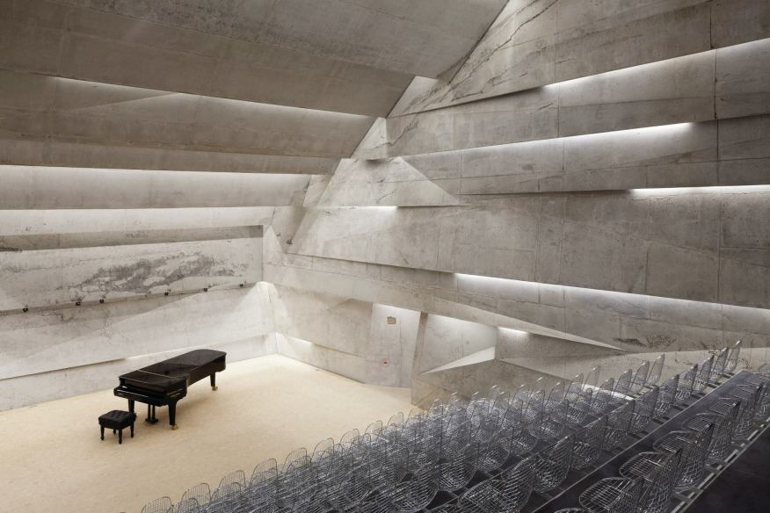
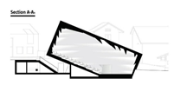
A small hall in Bleibach Germany
All first order reflections have been directed away from the audience by the jagged wall design.
The hall is a small shoebox. Normally early reflections would be too strong.
This design provides unusual clarity in combination with a long reverberation time.
Sight lines are also unusually good, and the wire seats provide no seat-back absorption of bass.
The acoustics get rave reviews.

Slide 25
Brooks Hall at The College of the Holy Cross in Worcester MA
I contributed to the re-design of a shoebox hall that was once a chapel in the College of the Holy Cross. It had been converted into a concert hall, with a stage in one end and seats on risers from the front to the rear. I made measurements to find the LLD – which was about at the first row of seats.
I recommended that the performance area be moved to the center of the North side wall, with the audience on amphitheater style risers around that center. This would bring the audience much closer to the stage. But I felt the reverberation would still be too strong, and come too quickly.
So I recommended that they install what looked like reflectors over the orchestra area, but instead of reflecting sound, they would absorb it. The goal was to reduce the strength of the reverberation without changing the reverberation time.
Much to my surprise they did it, and it worked!

Slide 26
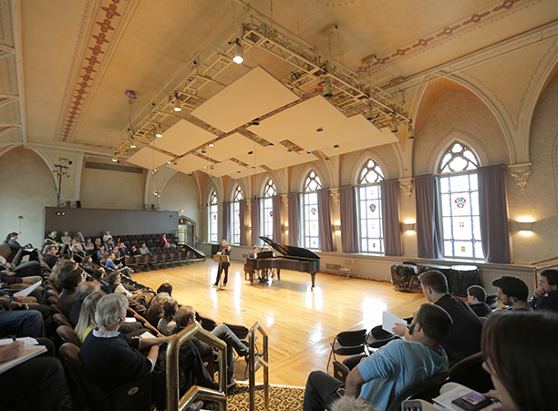
The opening concert at Brooks Hall
Schubert Lieder
Piece by Osvaldo Golijov
More: https://www.classical-scene.com/2014/02/01/new-brooks-hall/
I recorded the opening concert binaurally from two positions. Shirish Korde, chair the music department at that time said “We love this hall.” The sound was proximate in every seat.

Slide 27
Conclusions
Proximity – the perception that a source is acoustically close - is an important determinant of attention and recall.
The presence or absence of Proximity in particular seats can be determined by listening for the localization of individual instruments in a small ensemble.
The ear detects proximity through the phase coherence of upper harmonics in the direct sound, which are randomized by early reflections.
Proximity in halls and rooms is lost within one meter of a particular distance from the source. This is the LLD, or Limit of Localization Distance.
We have developed a physical measure, LOC, that predicts the presence or absence of Proximity from a binaural impulse response.
More information on these subjects can be found from the author’s website:
www.davidgriesinger.com

