Slide 1
Where not to install a reverberation enhancement system
David Griesinger
www.davidgriesinger.com
dhgriesinger@gmail.com

Slide 2
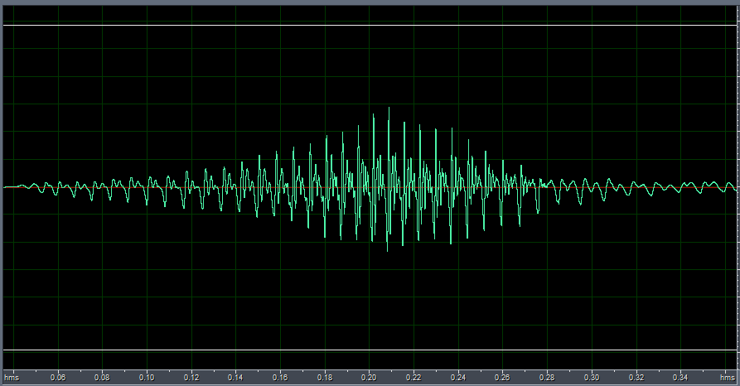
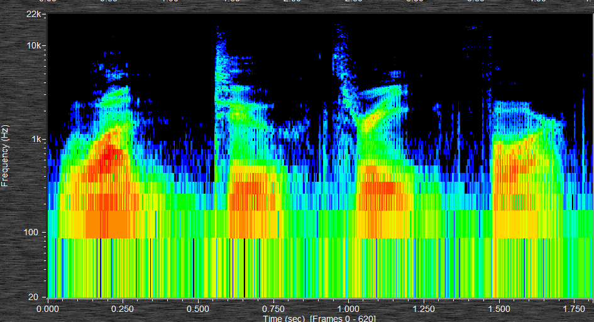
Acoustics => Communication
For hundreds (perhaps thousands) of years Acoustics were defined by the ability to transfer information through sound.
Most information in speech is encoded in the spectrum of harmonics above 800Hz.
But spectrum is not enough to understand speech in noisy or crowded environments. You also need WAVEFORM!
Waveform of “one” Note the obvious periodic pulses. We hear them as “Proximity”
Spectrum of “one, two, three, four”

Slide 3
The pulses are created by the phases of the harmonics. They help us separate information from noise and other signals.
Aarabi added white noise to speech and tested for word recognition as a function of phase noise.
When the phase noise reached +-pi/2 the error rate more than doubles.
Reflections, particularly early reflections, randomize phase.

Slide 4
Intelligibility is not the same as Recall!
Many studies have investigated the effects of noise masking on the ability to recall speech.
Example: (Tepring Piquado)
Masking of individual words by speech babble at a level of -2dB results in 88.8% accuracy of single word detection.
but near complete loss of recall of a specific word and the preceding word in a sentence.
All this research shows that Recall requires a higher standard of acoustics than is measured by intelligibility.
Signals where phase is preserved sound proximate. They hold attention, are easier to parse, and easier to remember later.

Slide 5
Attention is Key!
Attention devotes the whole of working memory to a single task of comprehension and recall.
Without attention recall becomes difficult even in good conditions.
Attention is influenced by many factors
Considerable evidence indicates that SOUND is one of them!

Slide 6
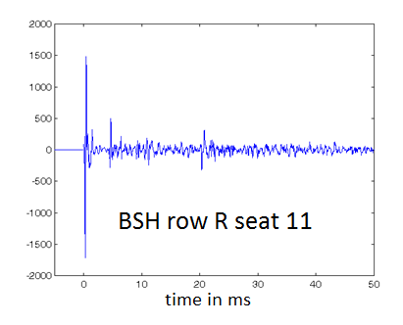
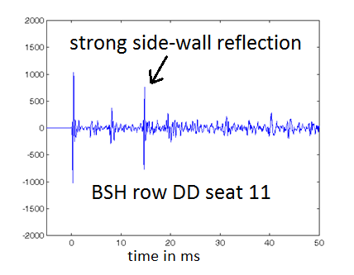
C80 and C50 do not measure what the ear hears as Clarity or Proximity! . Our measure LOC gets it right!
We can listen and measure binaurally two seats in Boston Symphony Hall
This one sounds good!
This one soundsMuddy!
C80 = 0.85dB IACC80 = .68 LOC = 9.1dB
C80=-0.21 IACC80 = 0.2 LOC = -1.2dB
C80 predicts no difference. IACC predicts row DD sounds better. LOC finds row R 10dB better!

Slide 7
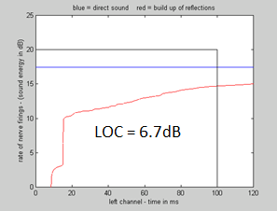
A one dB increase in reflection level can change sound from proximate to distant
Predicting where proximity will be lost in a space requires a physiologically based measure with high accuracy!
No current ISO standard measure comes close to the required accuracy.
Our binaural measure LOC is by far the best.
LOC estimates the audibility of the direct sound by comparing the logarithm
of the direct sound to the integrated logarithm of the reflections in a 100ms
window.
A value above +3dB of LOC predicts attention. LOC integrates the logarithms of reflections in a 100ms window compares the value the level of the direct sound to the integrated logarithm of the reflections as they build up.

Slide 8
Proximity, Phase, Period, and Localization
Reflections alter the sharp pulses shown in the previous slides, but they are still there.
We have found that the ear is not sensitive to the height or position of these pulses, but to their period.
The human acuity to period is better than a third of a percent!
Detecting period takes time! 50ms to 100ms depending on the frequency.
If period is constant over this time frame a signal can be proximate even in a highly reverberant environment. But it is not accurately localizable.
Harmonics have different azimuths.
There is a reason for plain chant, Baroque singing and string playing.
Speech and most music are NOT sufficiently monochromatic!

Slide 9
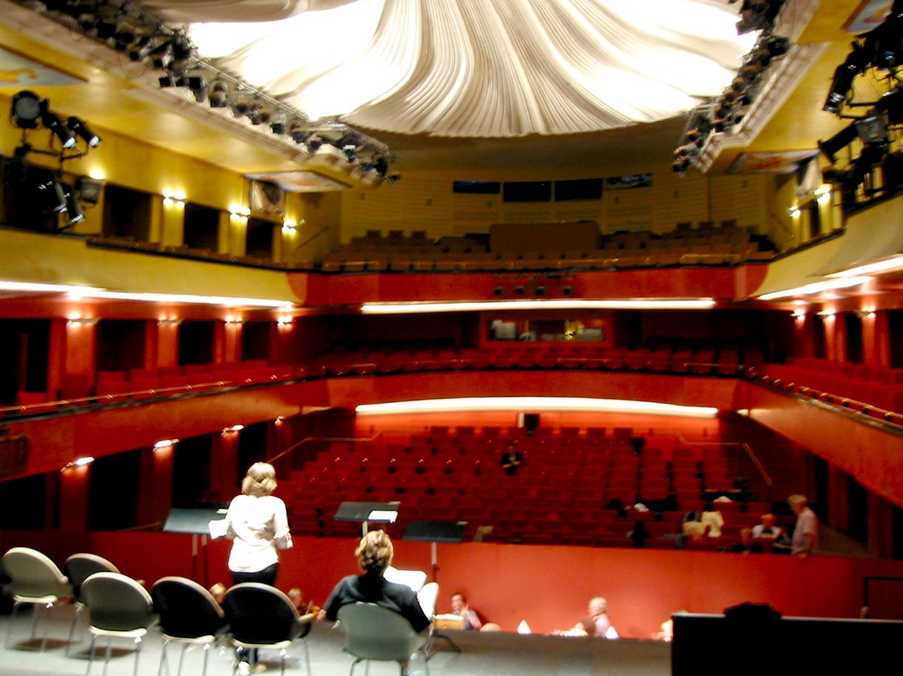
How do we know that proximity focuses attention? Ask drama directors!
We were asked to improve loudness and intelligibility of the actors.
64 Genelec 1024s, two line array microphones and a gate to remove reverberation from the inputs were used.
Five drama directors listened to a live performance of Chekhov with the system on/off every 10 minutes.
The result was unanimous – “It works, we don’t like it!” “The system increases the distance between the actors and the audience. If audience can’t quite hear the words they will pay ever closer attention. This is what we want.”

Slide 10
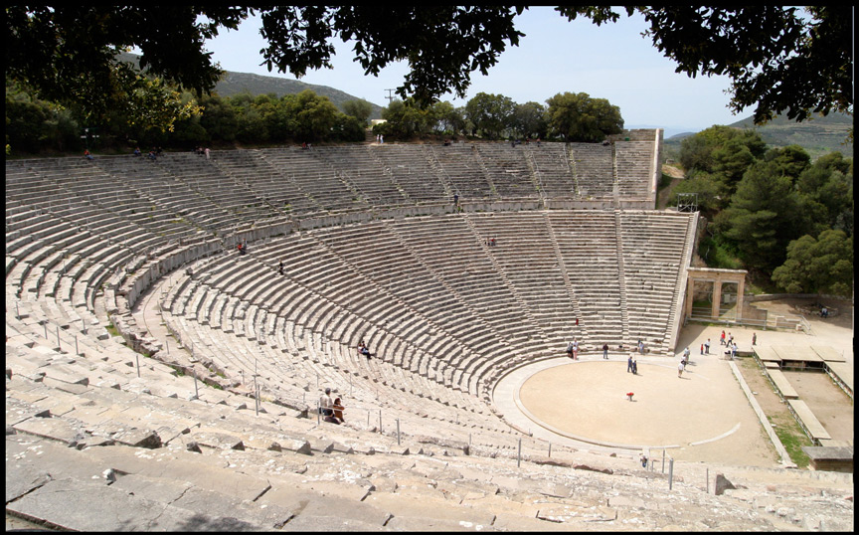
What does this mean for speech and music venues?
The Greeks knew more than a thousand years ago that the direct sound conveys localization, proximity, and attention
In Epidaurus the direct sound dominates all 15,000 seats, and the sonic and visual sources coincide.
With the advantage of low background noise and undamaged hearing every word is dramatic and forceful.

Slide 11
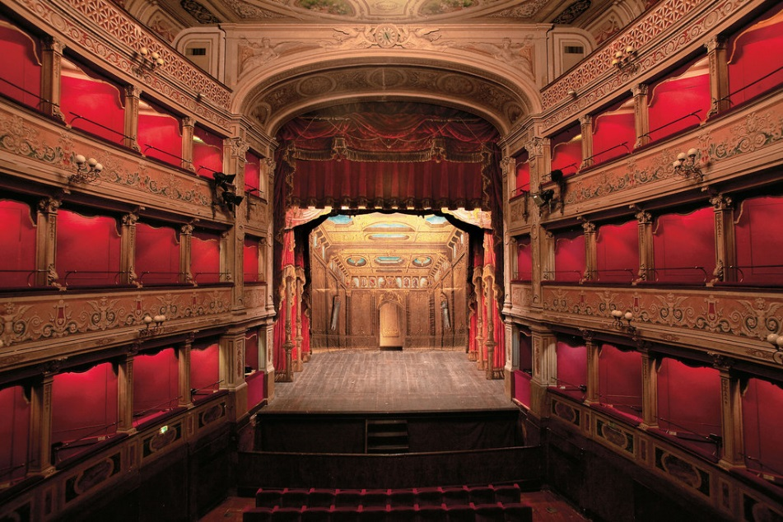
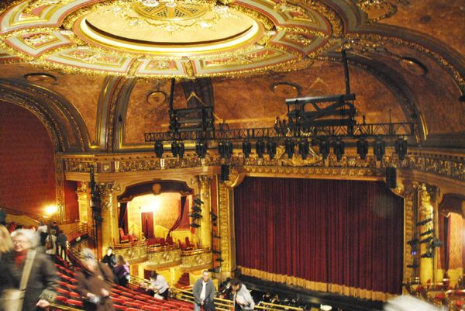
We knew how to hold attention in theaters.
Drama, Vaudeville, cinema, early concert halls and early opera houses were all direct sound dominated.
Teatro Caio Melisso, Spoleto ~350 seats Elgin Wintergarden, Toronto ~1200 seats
These theaters sport plenty of stage fabric and house absorption

Slide 12
We knew how to do it in Concert Halls
The Leipzig Alte Gewandhaus
Mendelssohn, Haydn and Mozart played in and wrote music for this hall.
With a reverberation time 1.2 seconds, direct sound was dominant in most seats.

Slide 13
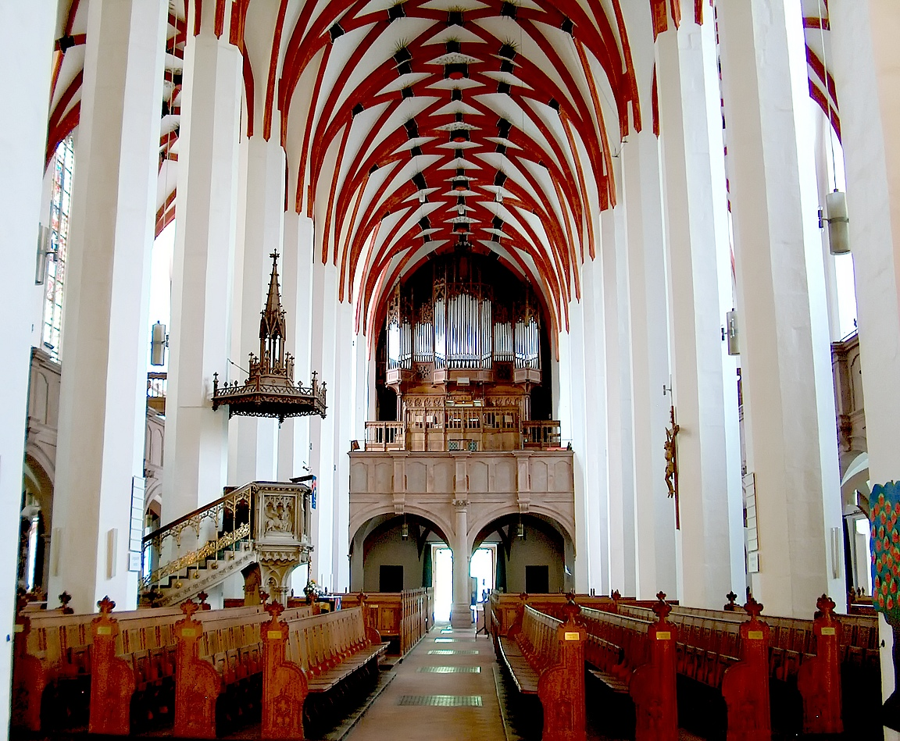
Bach’s Thomaskirche in Leipzig was festooned with banners and tapestries.
The reverberation time was ~1.6 seconds. (M. Long)
With such a low value in a huge space speech and music will be clear and engaging over a large percentage of the congregation.
Bottom line: You don’t need a long reverberation time to make beautiful music!
You need proximate direct sound – which allows the brain to hear the hall with envelopment.

Slide 14
The examples above are acoustically dry. Is it possible to have excellent proximity and reverberation too?
Yes! Consider Wagner’s Festspielhaus in Bayreuth
Proximity is lost when early reflections are too strong.
In Bayreuth the side wall niches block all first-order lateral reflections.
A high ceiling, fabric stage, and orchestra cover provide a clear, dramatically gripping sound in all seats.
This is an indoors Epidaurus for grand opera. The late RT is 1.7 seconds.

Slide 15
If clarity and proximity are already excellent, electronics can add just the right amount of early and late reverberation.
The “System formerly known as LARES” (www.ecousticsystems.com) avoids the poor timbre of the room by using as few microphones as close to the performers as possible .
Frequently only two microphones are needed.
Reverberation and reflections are generated electronically with feedback suppression.
The sound is distributed around the hall clean and uncolored.
We continue to improve our algorithms. Even with feedback common in our installations the newest algorithms are uncolored to me. They are also self-equalizing.
Our systems are inaudible unless you suddenly turn them off.

Slide 16
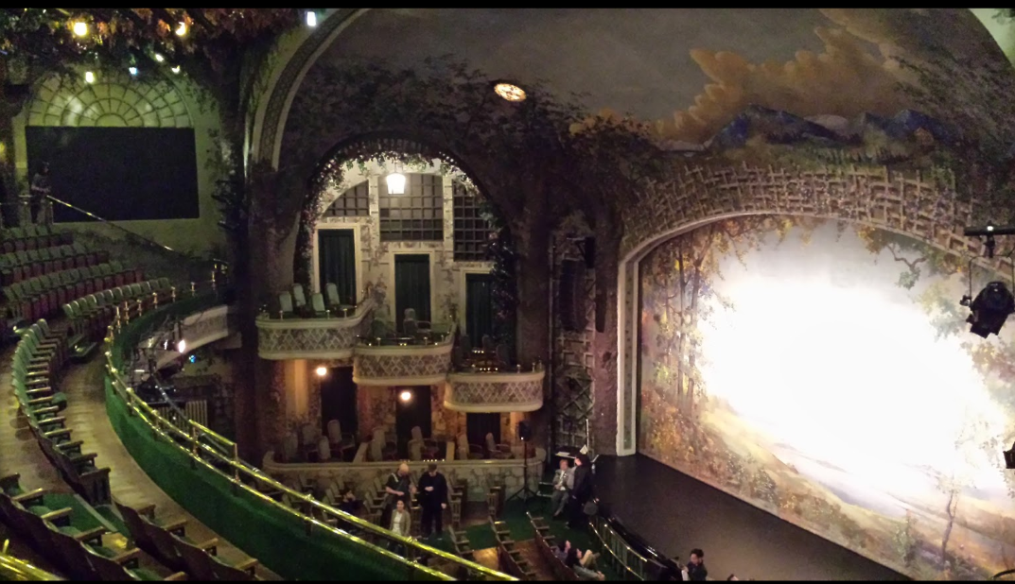
Our First System
We developed our system in 1991 at the urging of Neil Muncy for the Toronto Wintergarden, a beautiful Vaudeville Theater with excellent proximity. It needed late reverberation.
The microphones could only be attached to the balcony front – a bit too far from the stage.
Our system needed to be highly resistant to coloration from feedback.
It worked! The Toronto opera performed there for several seasons.
ISO 3382 measurements predicted the sound should be worse. We continue to find them useless.

Slide 17
Our second installation was at 51 Walden, a small hall in Concord Mass.
Proximity was poor. The musicians could not hear each other. We were asked to add reflections over the orchestra.
Bad idea! Electronic reflections made the orchestral communication worse. We added absorption and little late reverberation all around the orchestra stage. This worked very well.
This system is still used for every concert.

Slide 18
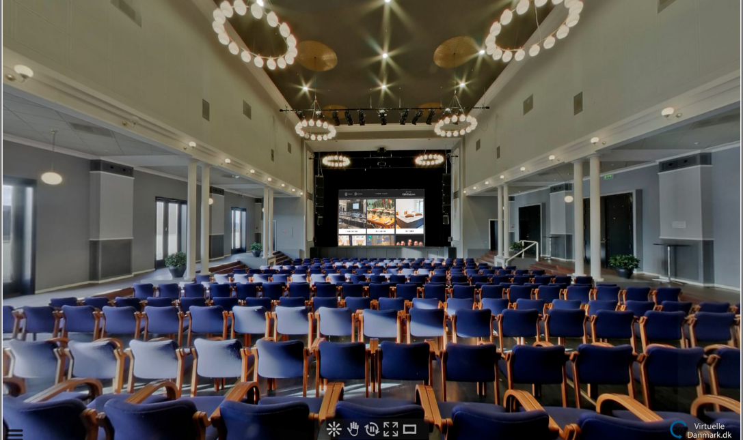
Some of our early installations in Europe were Dogs.
We were asked to adjust systems that had been designed and installed by others. The results were poor.
Torvehallerne, Vejle Denmark. A long narrow shoebox venue in a Best Western Hotel. Proximity was poor almost everywhere. LARES raised the RT, but did nothing for clarity.

Slide 19
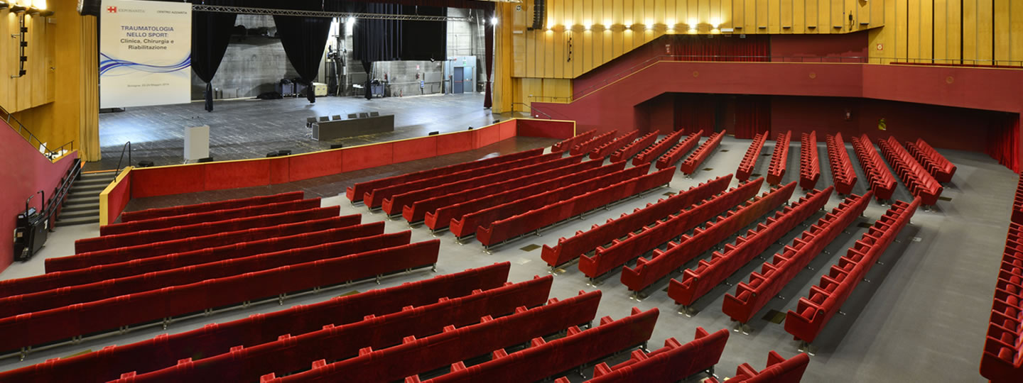
Palazzo della Cultura e Dei Congressi, Bologna
An enormous conference venue also used for concerts. It had a deep stage house with a large extended forestage. The rear of the audience could be closed off for smaller events. But with the rear closed off the RT was over 2.3 seconds. most musical performances were on the forestage, but the microphones were hung in the stage house.
My report to the acousticians did not succeed at being nice.

Slide 20
Aalborghallen, Aalborg, Denmark
A large shoebox with a relatively low ceiling and low natural RT. The stage area was boxy and reflective. Proximity was OK close to the stage, but lost by about the 8th row.
Our system increased the RT – but did nothing for the muddiness.

Slide 21
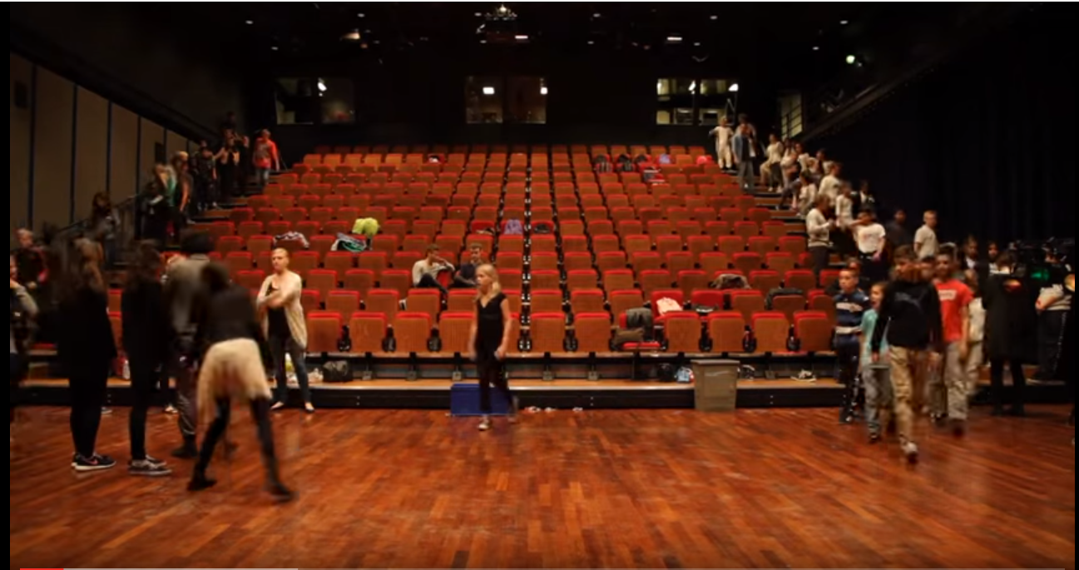
Arkin Museum of Modern Art Copenhagen
We were asked to participate in a enhancement shoot-out between our system, a TC Electronics system, and a third system.
The stage area is large, flat, with parallel walls, ceiling and no absorption.
The sound was gastly before even reaching the third row in the audience. It was not improved by electronics.
The job went to TC. I was glad of it!
I visited a similar halls in Finland with Eckhard Kahle. The sound was typically OK in the first two rows, otherwise quite muddy. Wooden, boxy stages are everywhere!

Slide 22
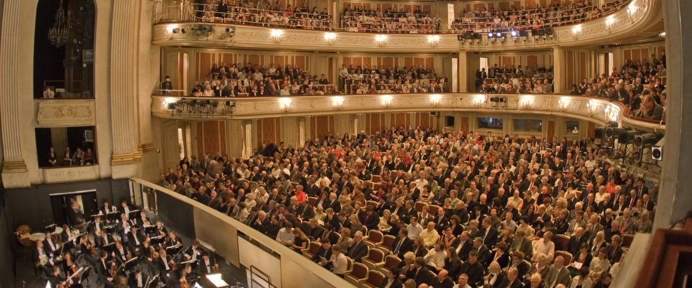
Berlin Deutches Staatsoper unter den Linden, An early success
Albrecht Krieger and I installed our system for Barenboim before the first performance of Rheingold in Germany since WWII.
Krieger and I adjusted the system while I sang from the stage. Barenboim hated my adjustments. He could not hear the singers clearly over the orchestra.
I reduced the enhancement level by 6dB above 500Hz. He loved the setting. The system ran under the radar for every performance until the recent renovation.

Slide 23
Schillertheater Berlin – An unfortunate mistake
Barenboim transferred our system to the Schillertheater during the renovation of the Unter den Linden house.
By accident I read in Der Spiegel that the side wall absorption of the Schillertheater had been removed to prepare for the Staatsoper. I visited the acousticians, but it was too late to put it back.
Proximity was lost by the third row of the balcony. Our system did nothing to help. Barenboim soured on the whole idea of acoustic enhancement.
The renovated Staatsoper will have none.

Slide 24
It may be possible to augment proximity with electronic enhancement
In a large venue the direct sound becomes too weak to overcome reverberation.
Reinforcing the direct with loudspeakers becomes necessary and feasible.
Examples: Grant Park Chicago, Hummingbird Toronto, The Armory system Steve installed in New York, and others.
Preserving Localization may be possible with multiple CBT arrays.

Slide 25
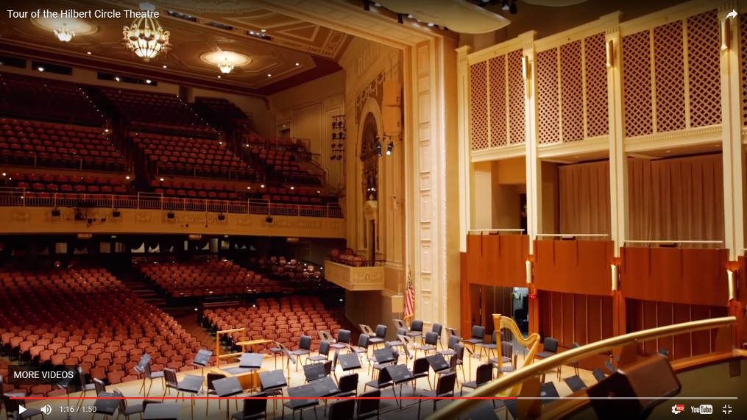
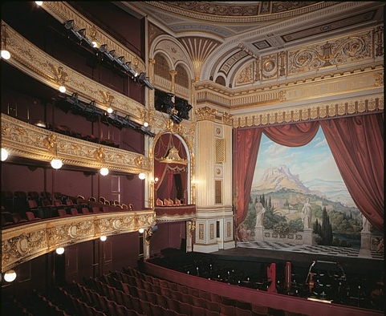
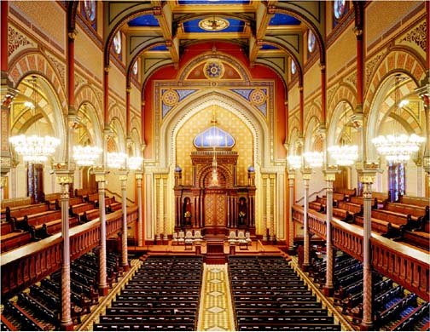
A few excellent examples
Adelade Festival Center Hilbert Circle Theater Indianapolis Old Royal Theater Copenhagen
All these halls provide an engaging, proximate sound to almost all the seats, in combination with warm, enveloping reverberation.
The enhancement is not audible until you turn it off.
Central Synagogue New York

Slide 26
Conclusions
Fix proximity before considering enhancement! If this is not in the budget, don’t accept the job.
Beware of coloration from an unpleasant hall sound. Amplifing the existing hall sound is not a good idea.
Be sure the system is not audible as such. Don’t play games.
Once the system is natural and beautiful, lock it down. Don’t let users adjust it for each performance – (beyond two or three presets.)
Don’t advertise your work. Silence is golden.

