Slide 1
The importance of attention, localization, and source separation to speech cognition and recall
Dr. David Griesinger
dgriesinger@Verizon.net
www.davidgriesinger.com

Slide 2
Acoustics of speech comprehension and recall
Speech comprehension has been intensely studied Effects of noise masking and reverberation masking on speech comprehension have been intensely studied.
Standards methods such as STI have been established that predict moderately well these masking effects on intelligibility.
This talk focuses on a third, and largely forgotten, acoustic factor in speech and music comprehension:
EARLY REFLECTIONS
Excessive early reflections inhibit both word recognition and recall
Even when intelligibility is high.
They add loudness, but add a muddiness to the sound that inhibits comprehension and reduces attention

Slide 3
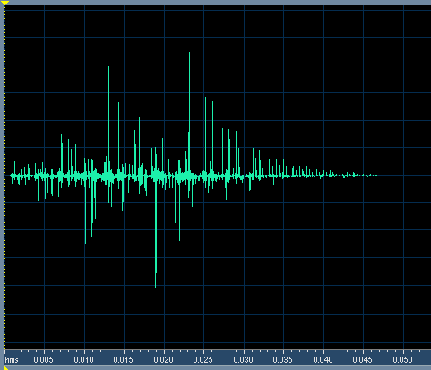
Example of early reflections on Speech
This impulse response has C50 and C80 = infinity. STI = 0.96, and RASTI = 0.93.
The second half of this sentence is convolved with this IR. The second half sounds muddy and distant because the IR randomizes the phase of harmonics above 1000Hz!!!
(Click for internet sound )

Slide 4
Intelligibility is not the same as Recall!
Many studies have investigated the effects of noise masking on the ability to recall speech.
Example: (Tepring Piquado)
Masking of individual words by speech babble at a level of -2dB results in 88.8% accuracy of single word detection.
but near complete loss of recall of a specific word and the preceding word in a sentence.
All this research shows that Recall requires a higher standard of acoustics than is measured by intelligibility.

Slide 5
Attention is Key!
Attention devotes the whole of working memory to a single task of comprehension and recall.
Without attention recall becomes difficult even in good conditions.
Attention is influenced by many factors
Considerable evidence indicates that SOUND is one of them!

Slide 6
When sound is perceived as close to a listener it demands attention. Muddy sound can be easily ignored.
Carl Wieman and Katherine Perkins assigned college students randomly to seats in a large classroom for “Physics in Everyday Life.”
They were divided into four groups based on distance to the teacher.
Class participation, quiz results and grades were tracked.
Students in the front half of the room did better in all aspects – more participation, more questions, and better grades by a full grade level.
At the semester break the seat positions were switched, but the previously front students retained their advantage.

Slide 7
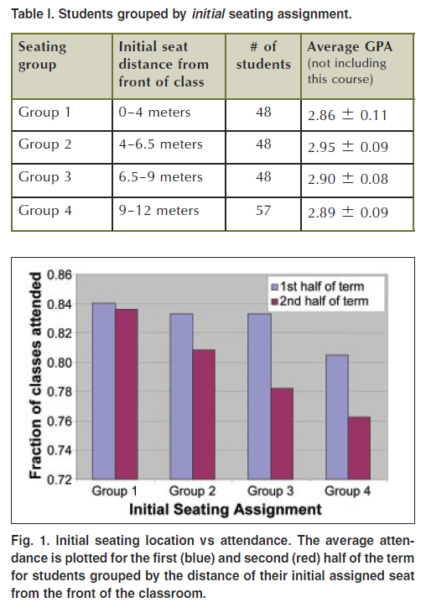
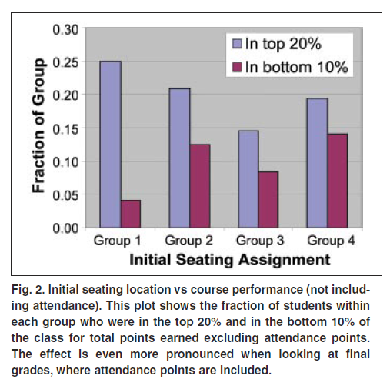
Weiman’s results are alarming!
What can explain these results? Is it visual closeness or acoustic closeness?

Slide 8
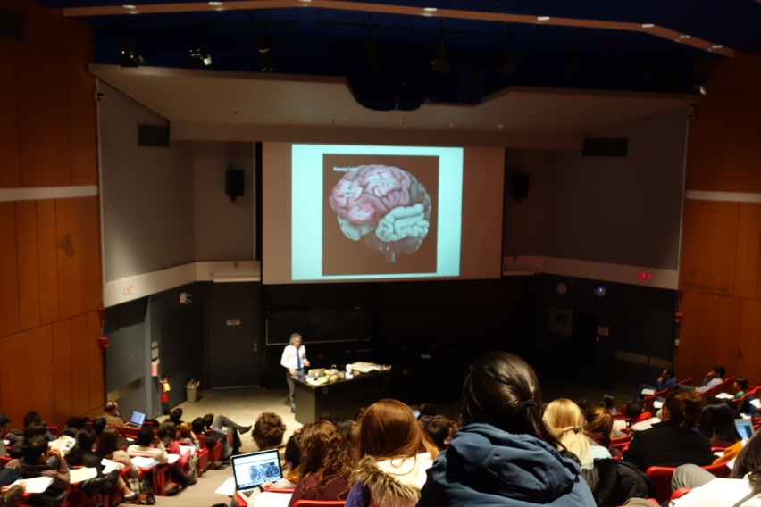
Binaural recordings in Harvard Science Center C showed extreme variation in acoustic conditions.
When the loudspeaker is used the quality of sound – but not intelligibility – varies greatly from front to back.
Sound from front row with no microphone.
Sound from rear of hall with no microphone.
The sound was clear but not loud.
With the microphone in the rear the sound was muddy and too loud. Students were looking at their cell phones and talking.

Slide 9
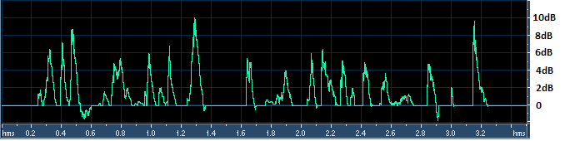
Measuring Clarity ratios with live speech
Clarity with no microphone in the front of the hall.
In the rear of the hall with no microphone.
Louder playback:
In the front of the hall with the microphone.
In the rear with the microphone.
Loudspeaker Amplification often reduces clarity.

Slide 10
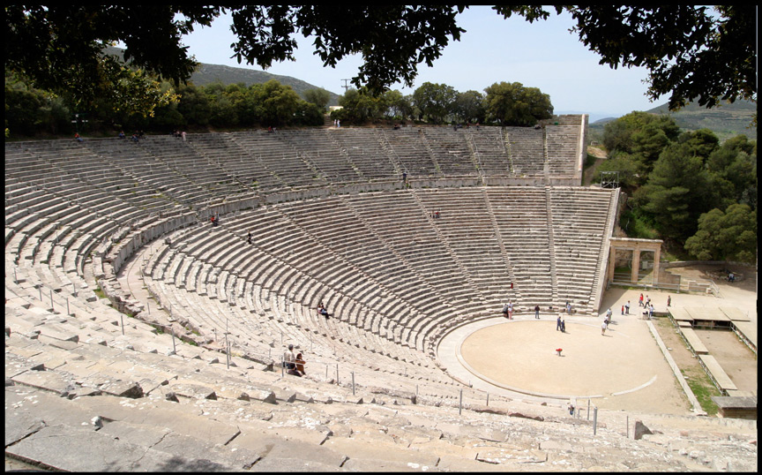
Could Wieman’s results be due to loudness or the visual proximity to the teacher?
There is substantial circumstantial evidence that the difference is NOT due to loudness or visual closeness.
People have known this for a very long time.
In Epidaurus the direct sound dominates in all 15,000 seats, and the sonic and visual sources coincide.
With the advantage of low background noise and undamaged hearing every word is dramatic and forceful.

Slide 11
How can we duplicate the attention-grabbing power of Epidaurus inside a room?
Rooms keep out the rain, and sometimes the background noise.
Sound in rooms is always affected by reflections.
Reflections add loudness to sound – but contribute to a perception of sonic distance.
Reflections also reduce the ability to localize a sound source.
Correspondence between auditory and visual localization enhances attention.
How can we prove this?

Slide 12
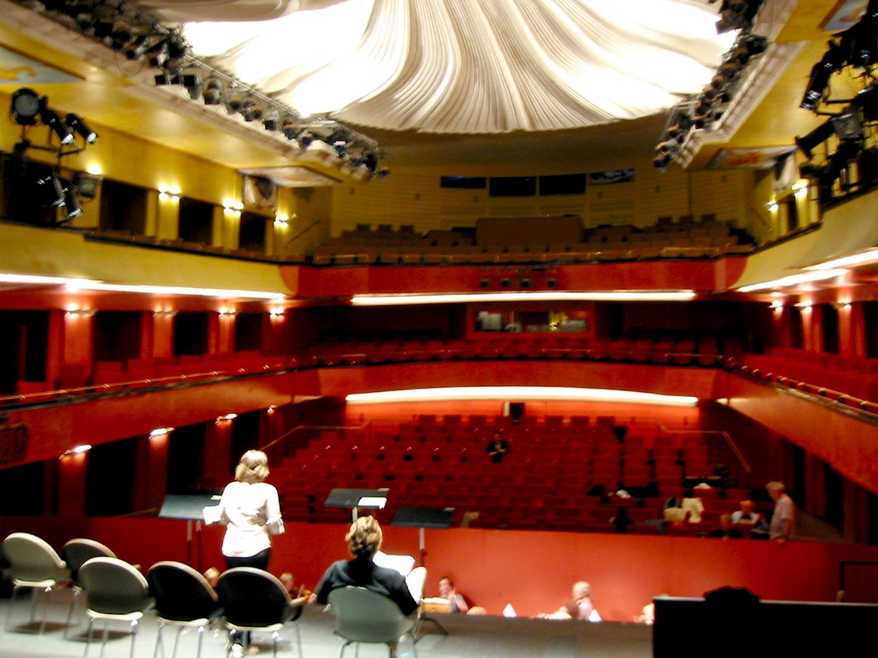
How do we know that sonic closeness focuses attention? Ask drama directors!
We were asked to improve loudness and intelligibility of the actors in this venue.
64 Genelec 1024s surrounded the audience, driven by two line array microphones and a LARES early delay system. A gate was used to remove reverberation from the inputs.
Five drama directors listened to a live performance of Chekhov with the system on/off every 10 minutes.
The result was unanimous – “it works, we don’t like it!” “The system increases the distance between the actors and the audience. We would rather the audience did not hear the words than that this connection is compromised. If they can’t quite hear the words they will pay ever closer attention. This is what we want.”

Slide 13
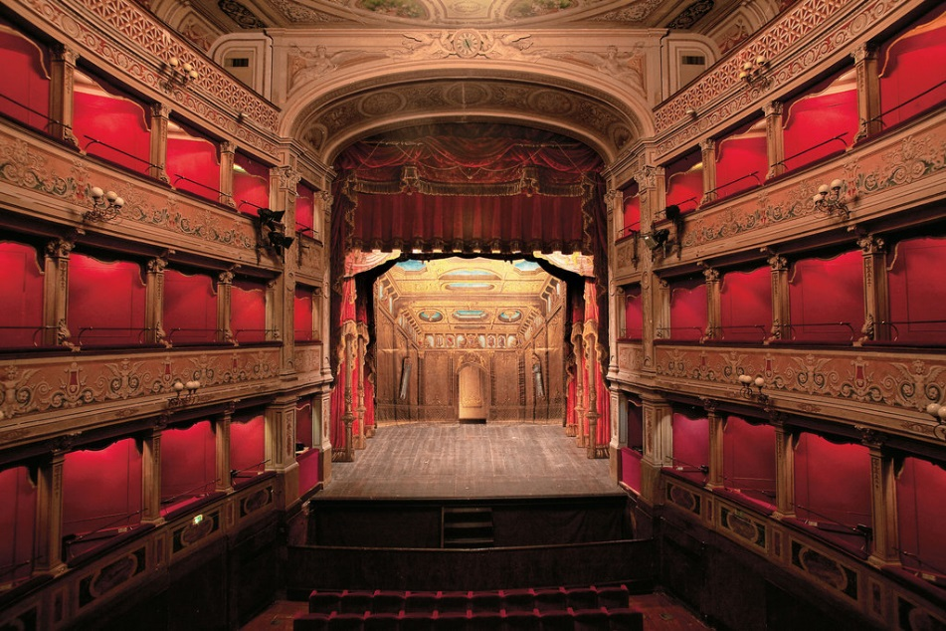
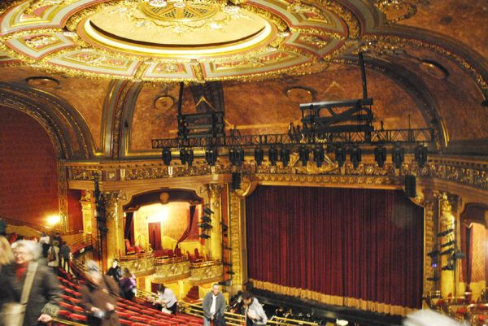
We know how to hold attention in theaters.
Drama, Vaudeville, cinema, early concert halls and early opera houses were all direct sound dominated.
Teatro Caio Melisso, Spoleto ~350 seats Elgin Wintergarden, Toronto ~1200 seats
These theaters sport plenty of stage fabric and fabric absorption in the house. Caio Melisso is regarded as one of the finest venues for chamber music in the world, in spite of having no early lateral reflections. The Wintergarden has similar properties, and excellent speech clarity.

Slide 14
Wagner’s Festspielhaus in Bayreuth
Note the side wall niches that block all first-order lateral reflections.
These features, a high ceiling, fabric stage, and orchestra cover provide a clear, dramatically gripping sound.
This is an indoors Epidaurus for grand opera.

Slide 15
We knew how to do it in Concert Halls
The Leipzig Alte Gewandhaus
Mendelssohn, Haydn and Mozart played in and wrote music for this hall.
With a reverberation time 1.2 seconds, direct sound was dominant in most seats.

Slide 16
Haydnsalle in Eisenstadt
The picture shows the current condition of the space, not the condition at the time of Haydn.
Most music (and other) rooms at the time had fabric and tapestries on the walls. These rooms were not heated!
But notice the absorptive curtain at the back of the stage has been retained. This curtain is very important to clarity.

Slide 17
Bach’s Thomaskirche in Leipzig was festooned with banners and tapestries during his time there.
The reverberation time was ~1.6 seconds. (M. Long)
With such a low value in a huge space speech and music would be clear and engaging over a large percentage of the congregation.
The author has binaural recordings of the organ in the Cathedral of Seville – also a huge space.
The clarity of sound even 80 feet from the organ is startling.

Slide 18
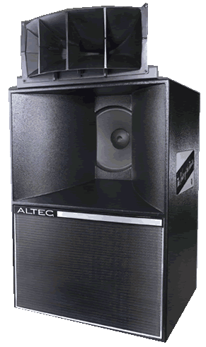
We know how to do it for Cinema
Start with an absorptive Vaudeville palace and add these:
Voice of the theater speakers have been standard equipment since the beginning of talkies.
These speakers feature high directivity – minimally exciting reflections in the hall.
They have excellent phase linearity in the frequency range of the vocal formants – creating an intensely focused, attention grabbing sound for dialogue.
Dialogue always comes from the center of the screen.

Slide 19
How can we predict when a sound will be perceived as present, or close?
Humans can distinguish when a sound is close or far in under a tenth of a second.
The ability is preserved even when loudness and spectrum are constant.
But no current hearing model can explain the distance perception effect.
That is not all. No current hearing model can duplicate our abilities to understand speech in noisy environments – a vital ability for survival.
Something vital is missing from standard practice!

Slide 20
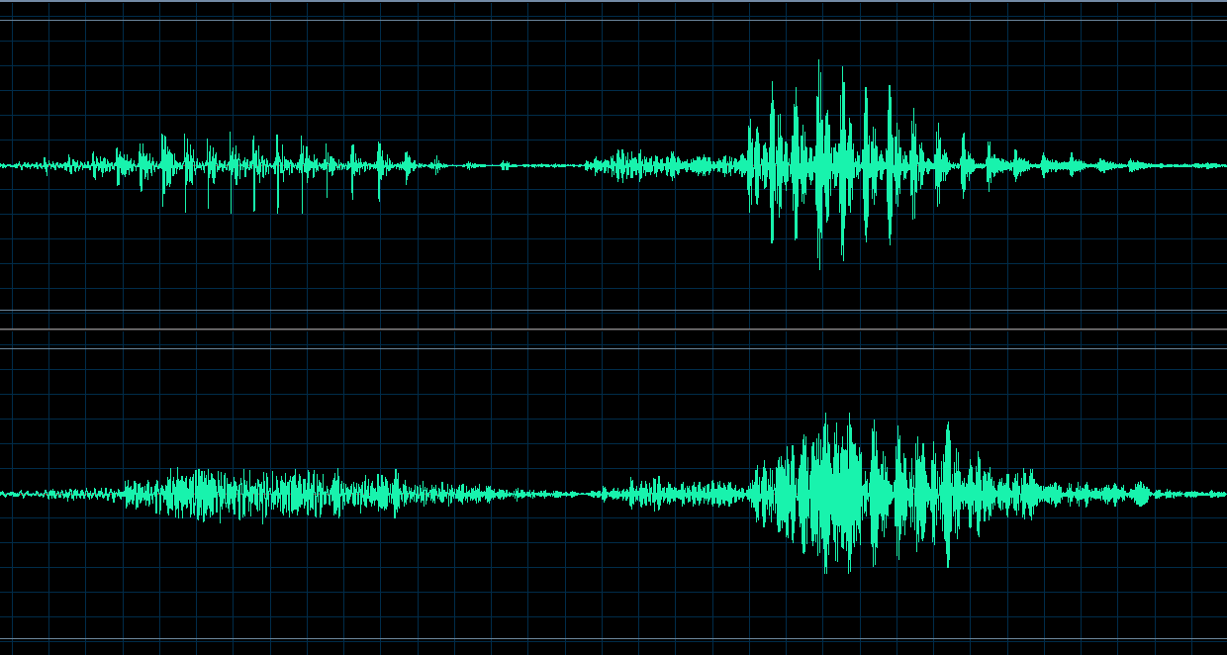
We hear a sound as close because the inner ear detect SPIKES in the speech waveform.
Broadband pressure waveforms of “One”
and “Two”.
These sound close!
These features cut through noise and reverberation, but they are destroyed by excess reflections.
These spikes are invisible to current hearing models, and to all the ISO3382 measures of acoustic quality.
The same waveforms with excessive early reflections sound distant.

Slide 21
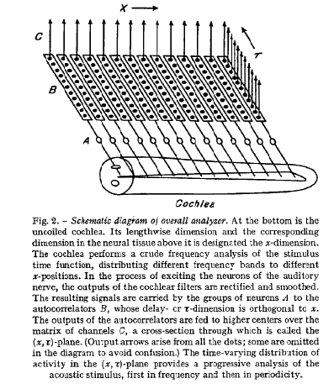
The mechanism for perceiving closeness was proposed by J. C. R. Licklider 1951
Licklider proposed that our acuity of pitch perception could only be explained by an autocorrelator located as close as possible to the hair cells.
We now pretty sure this circuit exists – and it is directly below the hair cells.
Before signals are sent to the auditory nerve they have already been separated from each other by pitch.

Slide 22
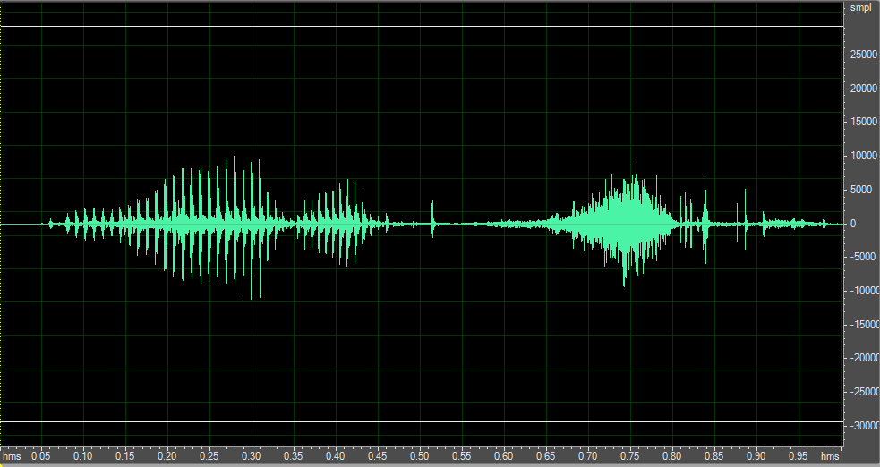
The upper frequencies in voiced speech cut through noise and reverberation
The syllable “one” voiced and then whispered, high-pass filtered at 1000Hz, with equal RMS level.

Slide 23
Voice and whisper in noise
Sometimes – maybe most of the time – you hear what you expect to hear, whether you actually hear it or not!
I will play sounds – see if you can guess what they are…

Slide 24
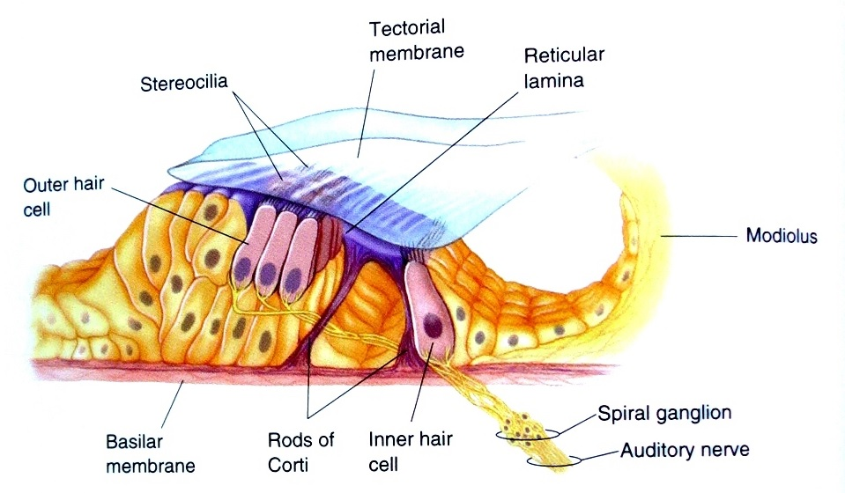
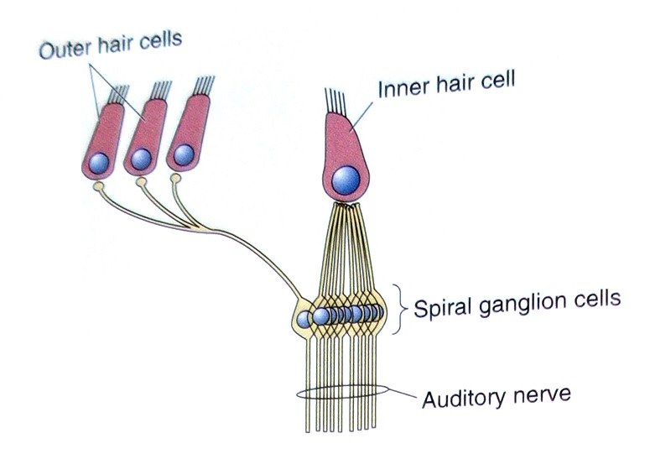
The Organ of Corti
Contains ~3000 inner hair cells, ~15,000 outer hair cells, and ~60,000 spiral ganglia. The inner hair cells detect basilar motion, the outer hair cells control the membrane sensitivity, and the spiral ganglia auto-correlate.
How do the ganglia work? Why are they vitally important?

Slide 25
The spiral ganglia in the organ of Corti enable source separation by pitch
Which is essential to surviving cocktail parties and enjoying polyphony.
Our C Model can separate two simultaneous talkers from each other if their vocal pitches are different by as little as half a semitone!
Without the peaks created by the phases of harmonic tones we cannot separate or localize these signals.
After separation by pitch
C and C# mixed

Slide 26
Comb filters as autocorrelators
An ensemble of comb filters can be constructed by connecting spiral ganglia cells to subsequent hair cells.
An ensemble of such filters would detect the presence of spikes in the basilar motion, and separate individual sources by their pitch.
A practical autocorrelator of the type Licklider proposed needs to be about 80ms long to achieve human pitch acuity.
A minimum of five equally spaced taps is required.
With this knowledge we have developed a measure that predicts when a sound source becomes distant and not localizable.

Slide 27
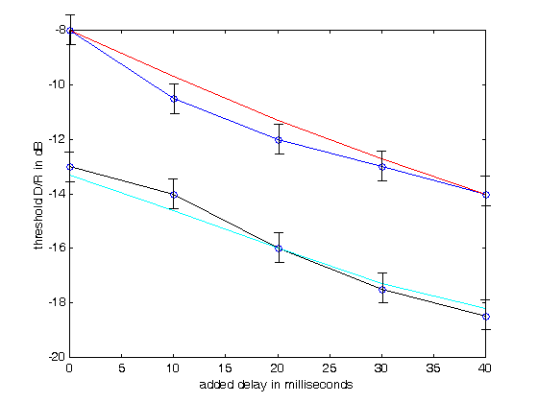
Our first measure, LOC, uses the ability to sharply localize sound as a proxy for near/far.
We determined the threshold of localization of male speech in reverberation as a function of D/R and pre-delay. RT values of 1 second and two seconds were tested.
For a 2s RT the threshold of localization can be as low as -17dB!
We developed the function LOC to predict this data. The red and cyan lines show the accuracy of the fit.
The LOC measure has been tested in real rooms and halls with useful results.
Black: 2 second RT, Blue, 1 second RT
Red and Cyan – values predicted by LOC

Slide 28
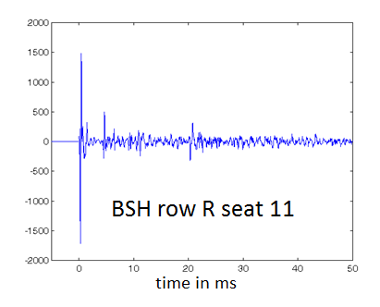
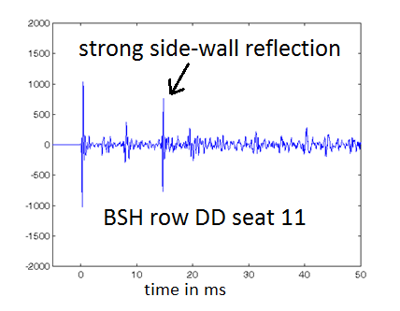
Example: Two seats in Boston Symphony Hall
C80 = 0.85dB IACC80 = .68 LOC = 9.1dB
C80=-0.21 IACC80 = 0.2 LOC = -1.2dB
C80 shows little difference. Current theories assume low values of IACC sound better than high values, so DD11 should sound better. LOC predicts that DD will sound poor and R 11 will be much better. It is!

Slide 29
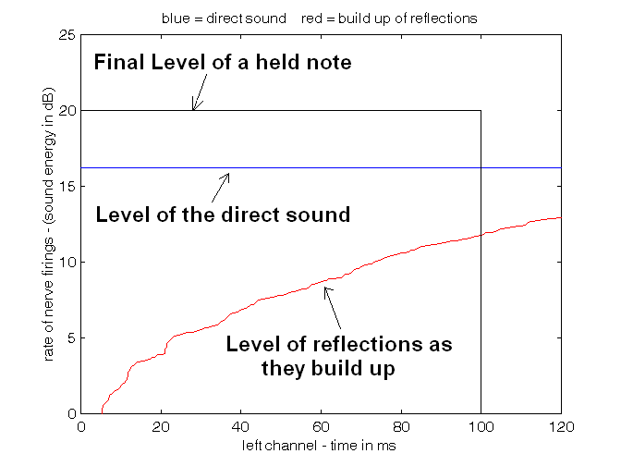
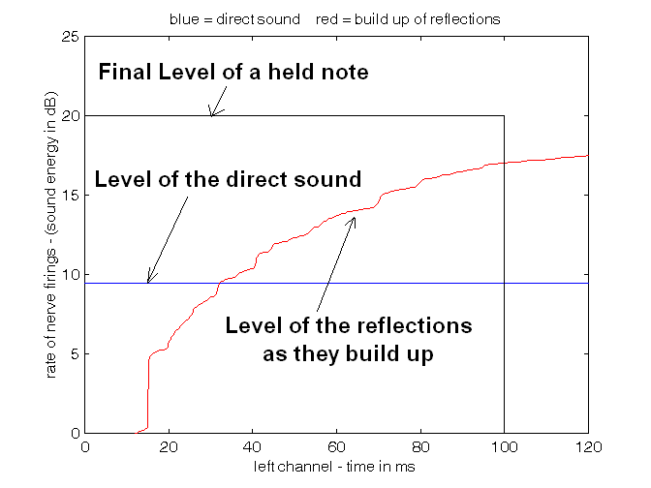
Here is how LOC sees the IRs:
row R seat 11. LOC = 9.1dB
row DD, seat 11. LOC = -1.1dB
LOC is the ratio in dB of the area under the blue line inside the black box, divided by the area under the red line inside the box. LOC > 3db indicates good clarity.

Slide 30
But what about classrooms?
The smaller the space the sooner multiple reflections come. The attention-grabbing properties of speech can be lost past the first few rows of students.
When sound reinforcement is used:
the direct sound from the teacher interferes with the sound from the loudspeaker.
If multiple speakers are used they interfere with each other
And the auditory localization of the sound – if this is possible at all – does not correspond to the visual position of the teacher.
All of these effects result in a loss of acoustic closeness, and contribute to a loss of attention.
Attention is focused by the perception of a direct sonic connection between speaker and listener.
This requires the perception of sonic closeness!

Slide 31
Intelligibility in small classrooms
We made an image-source model of a classroom.
We added the directivity of the source using data from Peter Mapp.
From the impulse responses STI and LOC can be calculated,
and the result can be auralized.

Slide 32
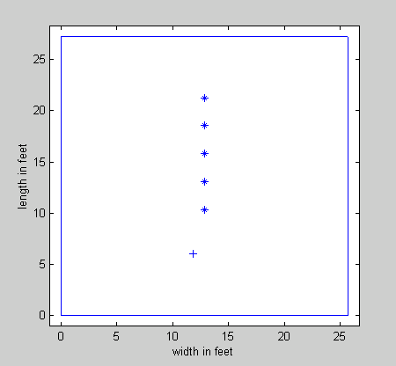
A 27’x25’x10’ room with surface absorption of 0.15 and RT 0.34s
A room was modeled with a single sound source and five receiver positions.
The intelligibility measured by STI is very good in all positions.
LOC greater than +3dB predicts good presence and localization. LOC less than zero is poor.
Receiver pos.
STI LOC
.75 -2.3dB
.73 -3.4dB
.74 -2.7dB
.74 0.3dB
.75 4.0dB
21.3’
18.5’
15.8’
13.8’
10.4’
9.5’
Teacher
6’
A small room with low RT has excellent STI – but presence and localization are only possible near the source.

Slide 33
What can be done?
In concert halls absorbing the back wall reflection or the ceiling reflection can make an enormous difference.
These reflections are the strongest and come the soonest.
But in this classroom LOC went up only 1dB.
The best solution is to increase the average absorption to 0.3
Impractical perhaps – but effective.

Slide 34
A 27’x25’x10’ room with surface absorption of 0.3 and RT 0.26s
Receiver pos.
The intelligibility measured by STI is constant and very good.
LOC is excellent to fair in all positions.
STI LOC
.84 2.4dB
.85 1.4dB
.85 2.4dB
.85 5.1dB
.85 8.5dB
21.3’
18.5’
15.8’
13.8’
10.4’
9.5’
Teacher
6’
A small room needs a lot of absorption if presence is to be high over all seats.

Slide 35
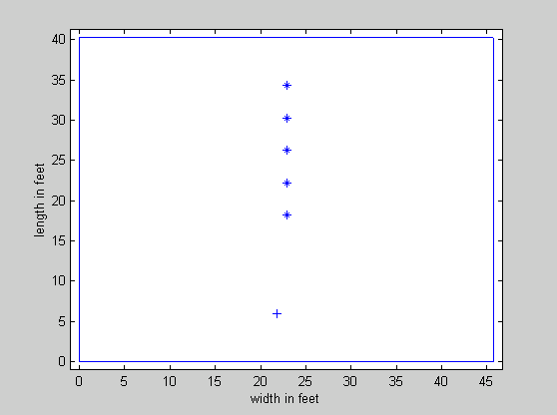
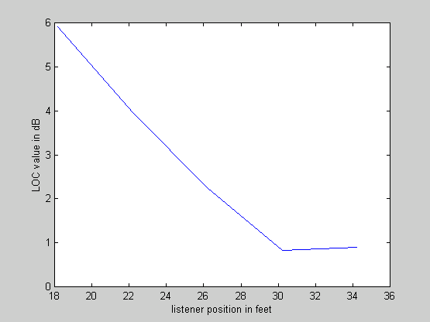
What about this lecture room?
If I model this room with a surface absorption of 0.28 and a ceiling absorption of 0.7, LOC is good nearly everywhere.
LOC = 2.4dB
1.4dB
2.4dB
5.1dB
8.5dB

Slide 36
Conclusions
The human ability to instantly perceive that a sound source is “near” has been ignored by current acoustic science.
The neural mechanism and the physics by which it works depend on phase relationships of harmonics above 1000Hz. It evolved not just for distance, but for the ability to separate harmonic signals into independent neural streams.
There is substantial evidence that the perception of “near” has consequences for the ease of comprehension, the ease of recall, and the focusing of attention.
The perception of “near”, and the ability sharply localize sound sources, and separate sound streams from competing streams and noise requires careful control of early reflections.
Too many reflections coming too soon destroys the sense of presence, the ability to localize, and the ability to separate sources.
The ability to localize, and separate sources is predicted reasonably well from an impulse response by the acoustic measure LOC.
LOC was calibrated with male speech. We need experiments to calibrate LOC for a variety of sound sources and rooms, and to study the effects of LOC on speech comprehension and recall.

